Slide 1
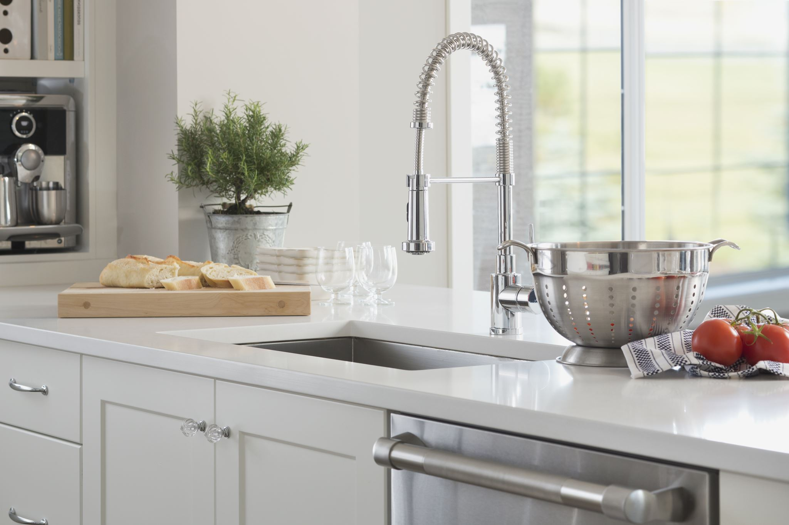
Your Kitchen, Your Food, Your Health

Slide 2
Objectives
Review statistics of people effected by foodborne illness annually
Provide knowledge of the most common pathogens and their “claims to fame”
Identify common places of contamination in your kitchen that could make you sick
Provide tips, “tried and true,” to get you through

Slide 3
Did you know …
48 million illnesses (1 in 6 Americans)
128,000 Americans will be hospitalized
Over 3,000 deaths (8 Americans each day)
https://www.cdc.gov/foodborneburden/2011-foodborne-estimates.html
Notes:
The CDC estimates that each year roughly 1 in 6 Americans (or 48 million people) get sick, 128,000 are hospitalized, and 3,000 die of foodborne diseases.

Slide 4
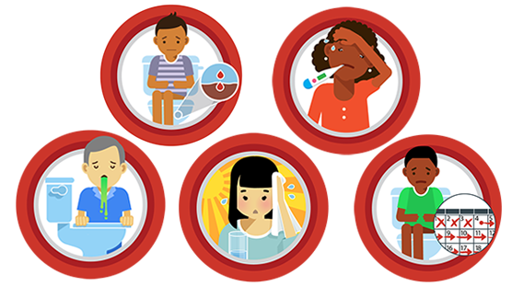
Symptoms of Foodborne Illness
Upset stomach
Stomach cramps
Nausea
Vomiting
Diarrhea
Fever
More severe:
Bloody stools
High fever
Frequent vomiting
Dehydration
https://www.cdc.gov/foodsafety/symptoms.html
Notes:
Food poisoning symptoms may range from mild to severe and may differ depending on the germ swallowed. The most common symptoms of food poisoning are:
Upset stomach
Stomach cramps
Nausea
Vomiting
Diarrhea
Fever
After you consume a contaminated food or drink, it may take hours or days before you develop symptoms. If you experience symptoms of food poisoning, such as diarrhea or vomiting, drink plenty of fluids to prevent dehydration.
When to See a Doctor for Food Poisoning
See your doctor or healthcare provider if you have symptoms that are severe, including:
Bloody stools
High fever (temperature over 102°F, measured orally)
Frequent vomiting that prevents keeping liquids down (which can lead to dehydration)
Signs of dehydration, including little or no urination, a very dry mouth and throat, or feeling dizzy when standing up
Diarrhea that lasts more than three days

Slide 5
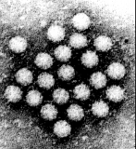
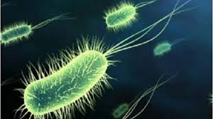
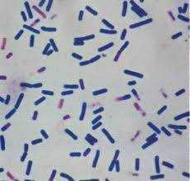
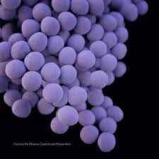
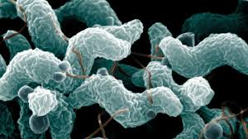
Top 5 FBI Causing Pathogens
Norovirus
Salmonella
Clostridium perfringens
Campylobacter
Staphylococcus aureus
https://www.cdc.gov/foodborneburden/2011-foodborne-estimates.html
Notes:
(FBI = Foodborne Illness)
There are 31 pathogens known to cause foodborne illness. Many of these pathogens are tracked by public health systems that track diseases and outbreaks. Eight of these known pathogens account for most illnesses, hospitalizations, and deaths.
Salmonella-non Typhoidal and Norovirus account for most of the illnesses resulting in hospitalizations. Salmonella and Toxoplasma gondii are the top two causing death in the U.S.
The top five germs that cause illnesses from food eaten in the United States are:
Norovirus
Salmonella
Clostridium perfringens
Campylobacter
Staphylococcus aureus (Staph)

Slide 6
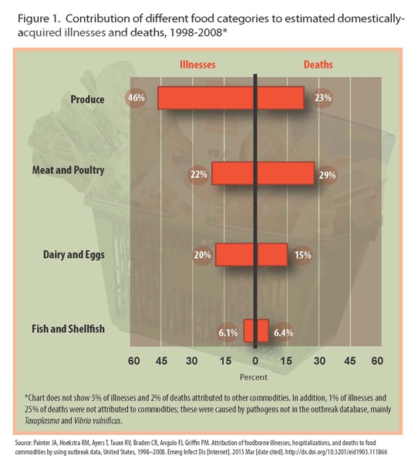
Notes:
You can see on this chart that produce contributes to the most illnesses at 46%, and about a quarter (23%) of all deaths. Meat and poultry cause 22% of illness, while causing 29% of deaths. Dairy and eggs cause 20% of illnesses and 15% of deaths, while fish and shellfish cause 6.1 % of illnesses and 6.4% of deaths.

Slide 7
Foodborne Outbreaks
21% from home
48% from food prepared outside the home
https://www.cdc.gov/mmwr/preview/mmwrhtml/ss6202a1.htm
Notes:
Twenty-one percent of U.S. outbreaks of foodborne illness with a known single setting resulted from food consumed in a private home, compared with 48% that stemmed from food eaten in a restaurant or deli, according to CDC statistics for 2009-10. Now, let’s look at where in the home causes of foodborne illnesses can hide.

Slide 8
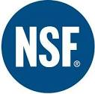
Germiest Places in the Kitchen
2013 NFS International Household Germ Study
https://www.nsf.org/knowledge-library/clean-germiest-kitchen-items
Notes:
As part of its 2013 NSF International Germ Study, NSF's microbiology team analyzed several kitchen appliances and tools for the presence of foodborne pathogens. This study reveals what common kitchen appliances and tools used to store and prepare food can harbor organisms, which cause foodborne illness if not cleaned properly.

Slide 9
Notes:
Of surfaces tested, 36% of those items tested positive for E. Coli, 36% tested positive for Salmonella, 14% tested positive for Listeria, and 43% of tested surfaces tested positive for yeasts and molds.

Slide 10
Refrigerator Vegetable Compartment
One of the germiest places in tested homes
Avoid cross-contamination:
Store produce separately
Separate ready to eat foods from unwashed or raw foods
How to properly clean:
Remove drawer
Use clean sponge or soft cloth and wash the bin with mild detergent and warm water
Rinse with tap water and allow to air dry or use a clean cloth
Notes:
NSF scientists found refrigerator vegetable compartments to be one of the germiest places in test homes. Germs found included Salmonella and Listeria, as well as yeast and mold. To effectively clean the vegetable compartment, first remove the drawer from the refrigerator if possible. Use a clean sponge or soft cloth and wash the bin with a mild detergent mixed with warm water. Rinse with tap water and wipe dry with a clean towel. To help control odors, use warm water mixed with a baking soda solution (about 1-2 tablespoons of baking soda to 1 quart of water). Rinse, wipe dry and clean monthly. Always store produce separately. To avoid cross-contamination, separate ready-to-eat and unwashed produce. Separate all produce from other foods — such as raw meat, poultry and seafood. In the refrigerator, produce should always be stored on a separate shelf above meat, poultry and seafood to avoid raw juices dripping onto the produce. Keep them separate in your grocery cart too, and during food preparation while using kitchen tools and appliances.

Slide 11
Refrigerator Meat Compartment
Top hiding spot for pathogens
How to properly clean:
Remove drawer
Use clean sponge or soft cloth and wash the bin with mild detergent and warm water
Rinse with tap water and allow to air dry or use a clean cloth
https://www.nsf.org/knowledge-library/clean-germiest-kitchen-items
Notes:
Perhaps not surprisingly, refrigerator meat compartments were also found to be one of the top hiding places for germs. In addition to yeast and mold, both Salmonella and E. coli were found. To effectively clean, remove the compartment/drawer from the refrigerator if possible. Use a clean sponge or soft cloth and wash the bin with a mild detergent mixed with warm water. Rinse with tap water and wipe dry with a clean towel. To help control odors, use warm water mixed with a baking soda solution (about 1-2 tablespoons of baking soda to 1 quart of water). Rinse, wipe dry and clean monthly — and whenever you see any spilled meat juices.
In the refrigerator, store meat and seafood on a separate shelf below produce to avoid raw juices dripping onto the produce.

Slide 12
Blender Gasket
Often overlooked, but still full of germs
How to clean:
Unplug and remove the jar from its base
Completely disassemble, removing blade and gasket
Place in dishwasher after each use
If hand washing
Wash gasket, blade and jar separately and thoroughly in hot, soapy water and rinse
Allow to completely air dry prior to re-assembling
Notes:
Although many of the households tested didn’t consider blenders to be a germy item, they were the third germiest item in this study. Salmonella, E. coli., yeast and mold were all found on blender gaskets. To clean, unplug the blender and remove the blender jar from the base. Completely disassemble the jar and remove the blade and gasket at the bottom. If dishwasher safe, place all pieces in the dishwasher after each use. If hand washing, wash the gasket, blade assembly, jar and lid thoroughly in hot, soapy water — rinse and dry before re-assembling. Perform this cleaning procedure after each use.

Slide 13
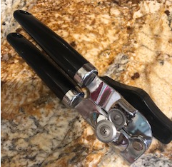
Can Opener
Used often in most kitchens
How to clean:
Run through dishwasher after use (if dishwasher safe)
If hand washing:
Wash with hot, soapy water
Rise with clean tap water
Allow to air dry
Notes:
While many individuals recognized that can openers could harbor germs, the NSF germ study found that these items were not being cleaned effectively, as traces of Salmonella, E. coli., yeast and mold were all detected. To effectively clean, place the can opener in the dishwasher after each use (if dishwasher safe). If hand washing, wash the can opener in hot soapy, water — rinsing thoroughly with clean tap water before air drying after each use. If hand washing, pay special attention to the area around the cutting blades to be sure all food residue is removed.

Slide 14
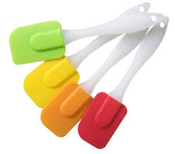
Rubber Spatula
One of the top 10 dirty spots
How to clean:
If two pieces, separate the handle from spatula portion
Place in dishwasher if possible
If washing by hand:
Wash with hot, soapy water
Rinse thoroughly with clean water
Allow to air dry
Notes:
Like can openers, most individuals identified rubber spatulas as one of the top 10 places for germs to potentially hide. NSF’s scientists discovered that these items were not being properly cleaned, as E. coli., yeast and mold were all found. To clean, for two-piece spatulas, it’s important to separate the handle from the spatula portion. If dishwasher safe, place both sections in the dishwasher after each use. If hand washing, wash in hot, soapy water, rinsing thoroughly with clean water. For one-piece spatulas, if dishwasher safe, place in the dishwasher after each use. Otherwise, hand wash thoroughly in hot, soapy water — paying special attention to the area where the handle joins the spatula. Rinse thoroughly and dry.

Slide 15
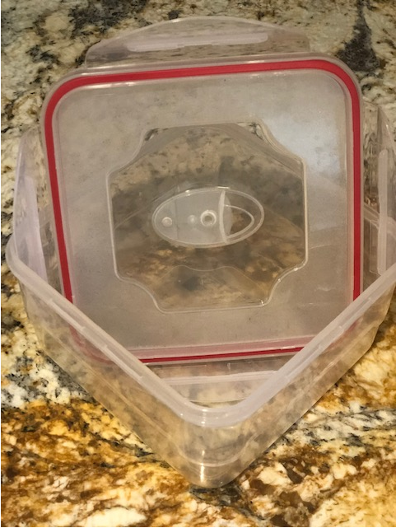
Food Storage Container with Rubber Seal
Eighth germiest place in the kitchen
How to clean:
Remove lid and place both lid and container in dishwasher
If hand washing:
Wash both container and lid with hot, soapy water
Rinse with clean tap water
Allow to air try
Notes:
Tests revealed storage containers were the eighth germiest place in the kitchen. Salmonella, yeast and mold were all detected. If dishwasher safe, place both the container and the lid in the dishwasher and wash after each use. If hand washing, wash both the container and lid in hot soapy water, paying special attention to the area around the seal as well as any grooves where the cover attaches to the container. Rinse thoroughly and allow to air dry.

Slide 16
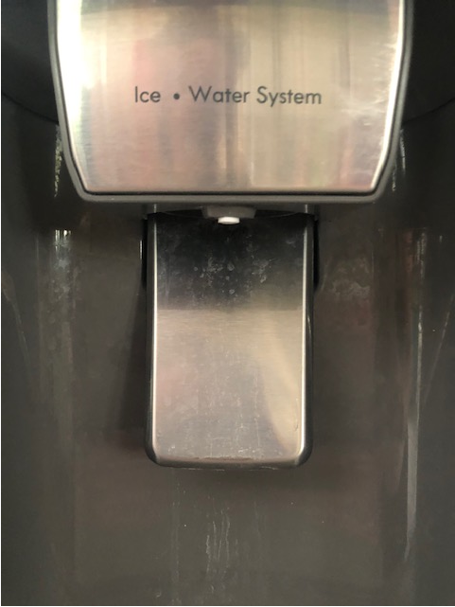
Refrigerator Water and Ice Dispenser
Concern with yeast and molds
Concerning for individuals with allergies
How to clean:
Follow manufacture directions when possible
A vinegar and water solution is often recommended
Notes:
While the refrigerator water and ice dispenser didn’t make the top 10 list of germiest places, the dispenser proved to be a concern for both yeast and mold, which can be a significant problem for individuals with allergies. Check your refrigerator manual for cleaning instructions. Many companies recommend using a solution of vinegar and water to clean the dispenser and ice maker. First, turn off the water supply to the refrigerator and then loosen the screw connecting the water supply line to the refrigerator. Once disconnected, use a small funnel to pour 3 to 4 cups of distilled white vinegar into the tube. Wait five to 10 minutes and then reconnect the water line. Turn the dispenser on to allow the vinegar solution to flow through the dispenser’s system and spill out through the waterspout.
To clean the waterspout, use a bottle or baby bottle nipple brush dipped in distilled white vinegar. Brush the inner side of the spout, then open the waterspout and allow it to run clear of any dirt and excess vinegar solution. Close the lever when there are no traces of vinegar. Clean the waterspout weekly and the refrigerator water dispenser system once or twice a year.

Slide 17
Knife Block
Pathogens like dark places
To clean:
Remove any knives in block
Turn the block over and shake out any debris
Take a can of compressed air and blow into the slots
Wash with hot, soapy water while using a small brush to clean inside the knife slots
Rinse with clean water
Sanitize with bleach solution
Allow to air dry
Notes:
Dark, moist environments can be a breeding ground for germs, and knife blocks proved to be no exception. Both yeast and mold were found in the knife blocks present in this year’s test homes. To clean, first remove any knives stored in the block. Turn the knife block upside down and shake lightly — or use a can of compressed air to remove crumbs and other loose debris. Hand wash the knife block in hot, soapy water, using a small brush (like a baby bottle nipple brush) to scrub out the knife slots. Rinse thoroughly with clean water. To sanitize, prepare a bleach solution of five tablespoons (1/3 cup) bleach per gallon of water or four teaspoons bleach per quart of water.
Either immerse the complete block in the water/bleach mixture or fill the knife slots. Allow the bleach solution to sit in contact with the slots for one minute. Rinse the block and knife slots thoroughly with clean tap water and place the block upside down on a clean surface to air dry. To avoid mold and bacterial buildup, wash knives thoroughly after each use and let them dry completely before placing them in the knife block. Wash and sanitize the knife block monthly if used frequently.

Slide 18
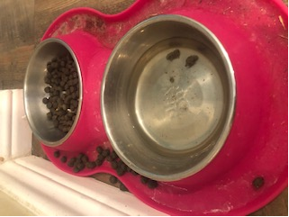
Other Areas of Concern
Sponges and dishrags
Kitchen sink and counter tops
Coffee Maker
Kitchen stoves
Animal food dishes
https://d2evkimvhatqav.cloudfront.net/documents/where_germs_are_hiding_infographic_sm.pdf?mtime=20200713162752&focal=none
Notes:
In another study, the NSF found that more than 75% of sponges and dishrags harbored coliform bacteria — which includes Salmonella and E. coli. Most sponges also had yeast and mold, and Staphylococcus aureus, or staph, was present on sponges in 18% of households.
“Sponges pick up bacteria during the cleaning process and are typically not properly — or regularly — sanitized before their next use,” said Dr. Rob Donofrio, former Director of Microbiology at NSF.
“Sponges are also wet and damp, providing perfect conditions for bacteria to grow. Change out sponges often or microwave for about two minutes to kill bacteria, and launder dishrags in hot water.”
Give them a quick swipe with a sponge or rinse with water and they’re clean, right? Unfortunately, the sink and countertops in your kitchen are likely host to an array of bacteria. Countertops can pick up germs from produce and grocery bags.
The NCF found that about a third of the countertops swabbed had coliform bacteria. Using a dirty sponge to wipe them down also spreads bacteria around. Kitchen sinks offer a fertile breeding ground for bacteria, too, since they can feed off leftover food particles. The NCF recommends cleaning the sink once or twice a week with a disinfectant.
COFFEE MAKER — Being dark and damp, this is a prime location for bacteria and mold to hide. Fill the machine with up to four cups of vinegar in the tank and let it stand for 30 minutes. Run a cycle with the vinegar, followed by two or three cycles with water until the vinegar smell diminishes.
KITCHEN STOVE — Often overlooked, they are often in contact with contaminated hands and food. Once a week, remove all the buttons and soak them in hot, soapy water — rinse them well and let dry.
BATHTUB AND SHOWER — Twenty-six percent of baths and showers harbor a bacteria called staphylococci — compared to the 6% found in garbage cans. Clean with hot water to remove anything from the drain, and make sure to disinfect regularly.
ANIMAL FOOD DISH — Animals often carry germs without our knowledge, especially through their saliva. Food dishes should be washed daily — either in the dishwasher or by hand with hot, soapy water.

Slide 19
Summary
Germs/pathogens can be anywhere
Foodborne illnesses can be prevented
Proper cleanliness and sanitation are crucial to helping prevent foodborne illness
Notes:
NSF’s 2013 germ study found germs on many everyday kitchen appliances and tools that come in direct contact with food — especially raw produce, meat, poultry, seafood and ready-to-eat items. While many germ study individuals correctly identified items that they thought would harbor the most germs, the study revealed that they are not always cleaning them sufficiently to prevent illness.
These findings are most concerning for households with at-risk populations, such as children, pregnant women, the elderly, or those with a compromised immune system (from illness). The lesson we can all learn as consumers is to follow manufacturer’s directions when it comes to cleaning and sanitizing kitchen tools and appliances.

