Slide 1
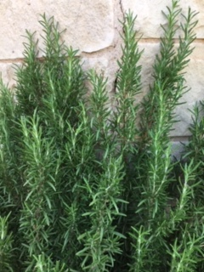
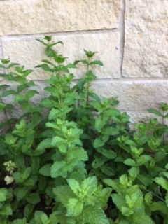
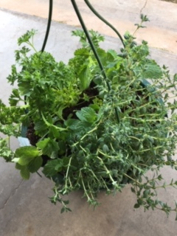
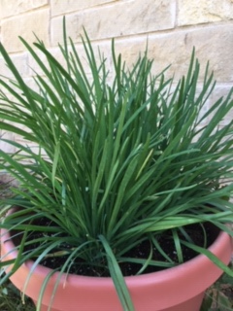
Indoor winter
gardening

Slide 2
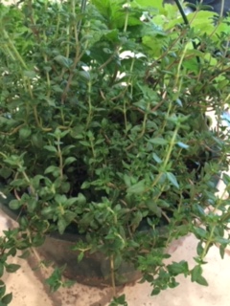
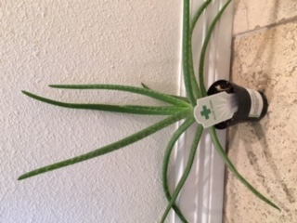
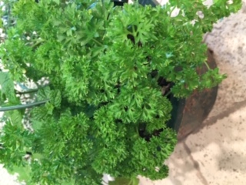
There are many benefits to having
plants in your home.
Notes:
The plants give off oxygen. Some of the plants are calming. Many can be used in teas. Many of these plants can be used in cooking.

Slide 3
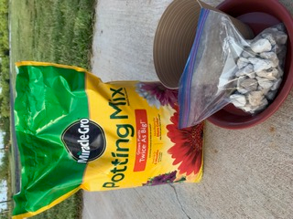
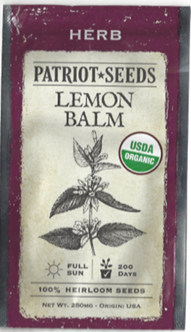
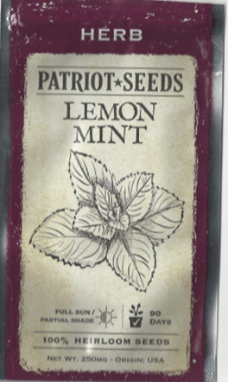
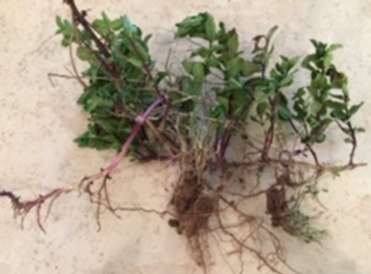
Supplies:
Soil, Rocks and
Containers
Seeds
Plants
Notes:
Make sure your container has holes in the bottom. Add some gravel to help with drainage. Then add some good potting soil. Add the plant and more soil as needed. Water as needed, but do not overwater.
I like to use established plants in the house. Growing your plants from seeds takes longer to grow, but it can be done.

Slide 4
I prefer to buy Organic Heirloom
seeds. When I am looking for seeds, I read the information on the stand and the seed packets.
Notes:
I try to buy organic Heirloom seeds every chance I get. I read the seed packets to see what type of seeds are in the packets.

Slide 5
Plants or Seeds?
Plants
Faster – Ready to use
Seeds
It takes longer to grow
Notes:
If you want to start using your plants right away, start with plants. If you don’t mind waiting for the seeds to spout and grow, use seeds.

Slide 6
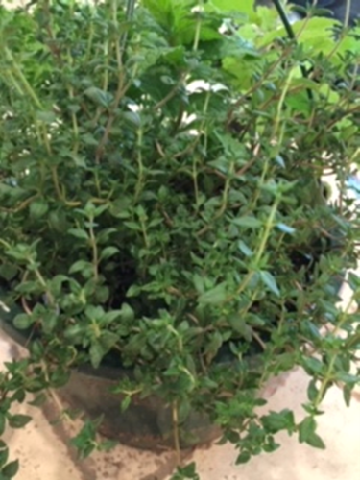
Cuttings
Rosemary
German Thyme
Peppermint
Notes:
Propagate –to reproduce
Peppermint can be propagated from cuttings and from roots. Other plants can be propagated from cuttings.

Slide 7
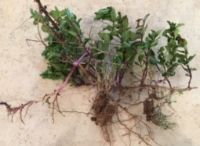
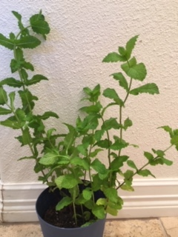
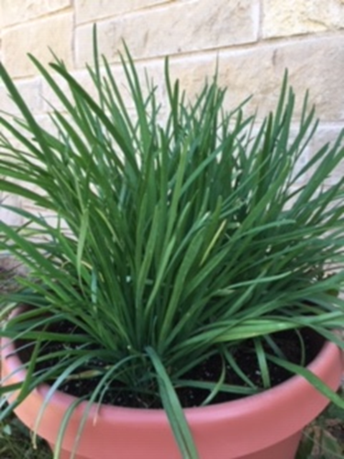
Roots
Peppermint
German Thyme
Chives
Notes:
Plants can be propagated from roots.

Slide 8
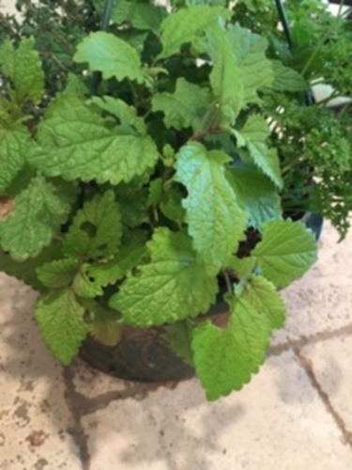
Care of plants
Peppermint
Notes:
Some insect enjoyed nibbling on the Lemon Balm. I placed the container of plants outside when we were going to be gone for a week. I placed the pot in my flower bed where the sprinklers would water the plants.
A natural way to keep insects and animals from eating your plants is to put some dish soap in a spray bottle with water. Spray your plants. It helps repel the animals and insects. If the soapy water is washed off by rain or sprinklers, you need to spray the plants with soapy water again.

Slide 9
Safety of plants and others in your home.
Do you have any small children or pets in your house?
Make sure your plants are a safe distance from your
Small children and your pets.
Notes:
I cut the roots plus almost an inch of the green onions off the rest of the green onions. I planted those pieces in a pot. The green onions were growing back nicely. Then my dog decided to eat my green onions that were re-growing. I didn’t think my container of green onions would be eaten by my dog.

Slide 10
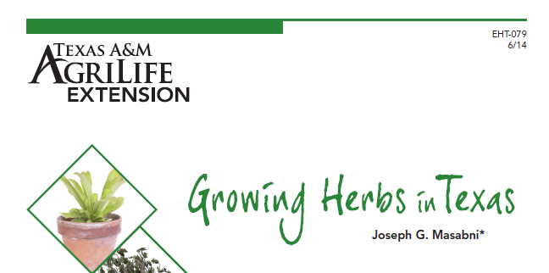

Slide 12
Notes:
Table 3 is part of Growing Herbs in Texas. This table is very informative.

Slide 13
References
Larry Stein and Joe Masabni, Texas A&M AgriLife Extension
Service, Publication # EHT-056 Fall Vegetable Gardening Guide
(Available on the TEEA website)
Joe Masabni, Texas A&M AgriLife Extension Service,
Publication # EHT-079 Growing Herbs in Texas (Available
on the TEEA website)

