Slide 1
Pressure Cooking TEEA Educational Program 2019-2020

Slide 2
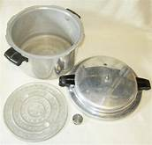
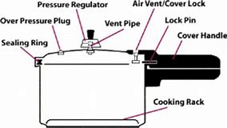
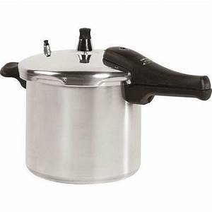
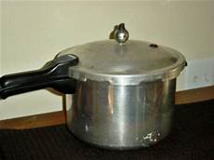
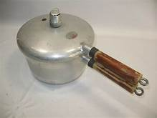
Remember When?
Notes:
Remember when…do any of you have memories of the pressure cookers we used on the stove? Cook a chicken in no time, make beans quickly? What memories do you have? Do you still have a pot at home?

Slide 3
Pressure Cooking
Objectives:
Understand the basic principles of cooking with pressure
Identify features of electric pressure cookers
Understand food safety principles for electric pressure cookers
Notes:
So today we are going to talk about the new craze in electric appliances…the electric pressure cooker. I hope by the end of the program, you will understand a little about how they work, know what kind of things they can do, and understand what you need to do to keep your food safe.

Slide 4
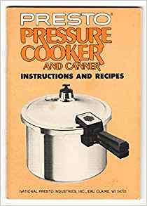
A Little History
In 1679 a French physicist invented an airtight cooking vessel that used internal pressure to allow water to boil at a higher temperature thus reducing cooking time.
1939 the pressure cooking became a hit. Presto unveiled a pot at the World’s Fair that women loved. It had a modern “saucepan-style pressure cooker” that “ featured an easy-to-close interlocking cover, eliminating the need for awkward lug nuts and clamps”
http://www.discoverpressurecooking.com/history.html
Notes:
Let’s look at some of the history around the pressure cooker. As early as 1679, a scientist discovered that if you put food in a small amount of water under pressure, the water would boil hotter. A regular pot boils at a temperature of _?___ (212 degrees F). SO if you make the water hotter, the food cooks quicker. It wasn’t until 1939, at the worlds fair, that women saw the “new modern” pressure pot and fell in love with it. It was sleek, easy to open and close, and did not use any lugs and nuts like the heavy old pressure canners did. The pot was made by Presto. In the United States, “Presto” soon became the name synonymous with pressure cooking.”
After the depression ended, the pressure cooker was the most purchased household appliance. There were 11 suppliers and stores could not keep- them in stock.
How many of you have a Presto Pressure cooker or Canner? Other brands?

Slide 5
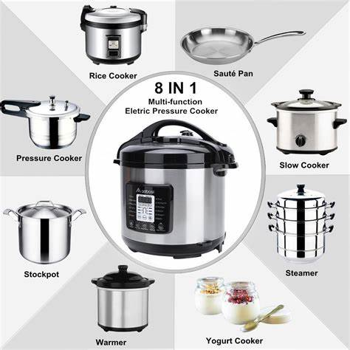
Fast Forward….
One Pot Wonder
One use electric appliances
Electric Pressure Cooker
Slow Cooker
Steamer
Rice cooker
Yogurt maker
Warming pot
Notes:
Things have certainly changed over the years. Now we can buy a number of small electric kitchen appliances designed to make life easier.
We can buy:
A crockpot to slow cook
A rice cooker to make fluffy rice
A yogurt maker for homemade yogurt
A warming pot
But the new electric pressure cookers are designed to replace all those appliances in one pot. They have gained favor, especially with younger cooks who were scared to use a stove top model of a pressure cooker or were not familiar with how to operate it.
With an electric pressure cooker, you push a button and can walk away. You don’t have to watch the pot or worry about adjusting the temperature of the burner.
(Did any of you ever tell stories or hear stories of pressure cookers blowing up or being hard to use? )

Slide 6
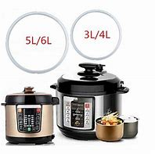
Advantages of an Electric Pressure Cooker
Foods retain most of their nutrients and are tastier.
Saves energy.
Saves time in preparing meals.
The kitchen is cooler.
Less cleaning is required.
Need few counter top appliances.
Cooks with little or no fat.
Can fit family size.

Slide 7
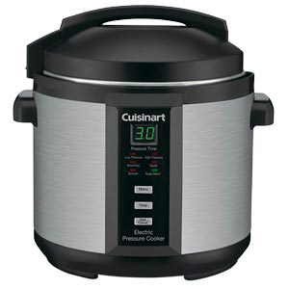
So What is Pressure Cooking?
A food-preparation method using trapped steam
Retains the flavors and nutrients of the food
Saves energy compared to other cooking methods
Notes:
It’s simple really. The Pressure raises the temperature higher than boiling, so food cooks quicker….
It seals the food inside a pot with liquid, using heat to create steam, which increases the pressure in the vessel.
The appliance then traps or releases steam to control the level of pressure.
With more pressure, the boiling point of the liquid rises, and the food cooks faster at a higher temperature.
Pressure cooking retains the flavors and nutrients of your food while also creating moist and delicious results and saving energy in the process.
For instance:
Most meat will cook in 30 minutes
Poultry in 15-20 minutes
Soups and stews in 30 minutes

Slide 8
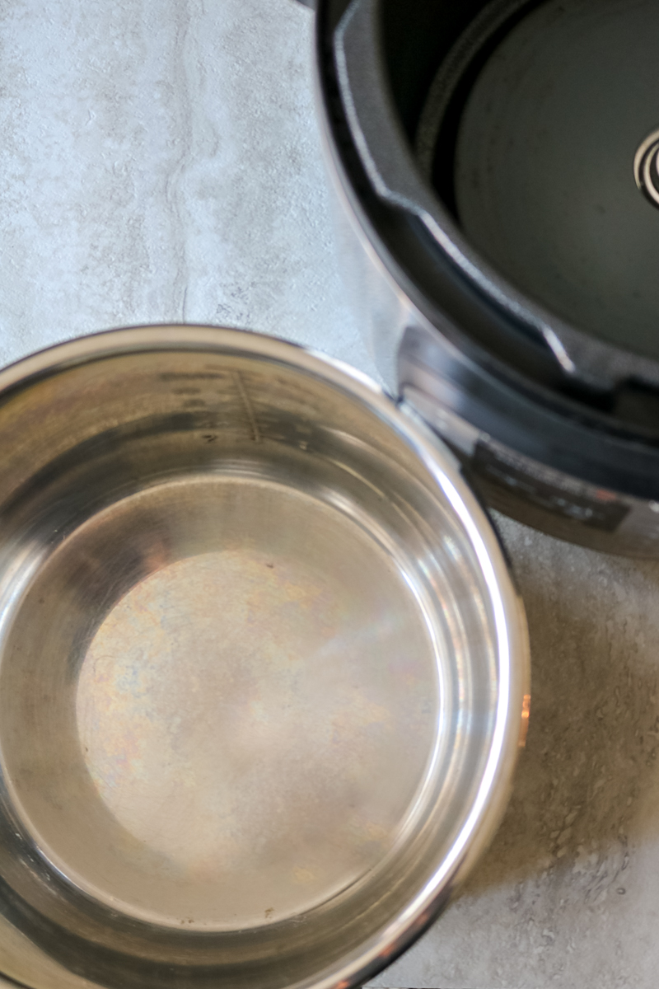
The parts of an electric pressure cooker
Inner Pot:
The inner pot fits inside the base unit
It is removable for washing
It is essential for cooking – Do Not operate your Electric Pressure Cooker without the inner pot

Slide 9
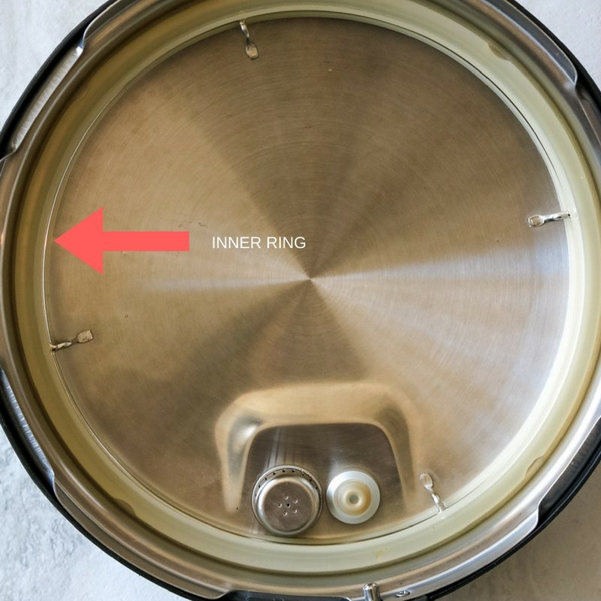
The parts of an electric pressure cooker
Silicon/Inner Ring:
This is on the lid of the Electric Pressure Cooker and helps to seal in the pressure
Notes:
Exactly like a gasket on a stove top model, the silicon ring helps seal in the pressure. And like a stove top model, it needs to be cleaned after each use and replaced if it gets weak or damaged.

Slide 10
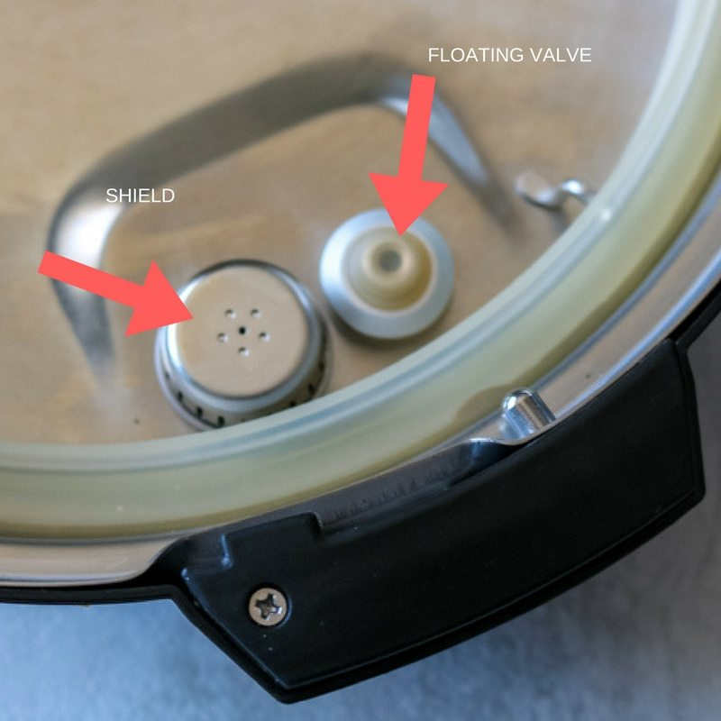
The parts of an electric pressure cooker
Floating Valve and Shield:
Shield prevents food from getting trapped in the release valve
Float valve pushes up and seals cooker when pressure is sufficient
Notes:
The shield prevents food from getting trapped in the pressure release valve and the float valve is designed to be pushed up once there is sufficient pressure inside the cooker.
Once pushed up, the silicone band seals the pressure cooker and the pin of the float valve serves as a lock, preventing the lid from being opened before the pressure has been released.

Slide 11
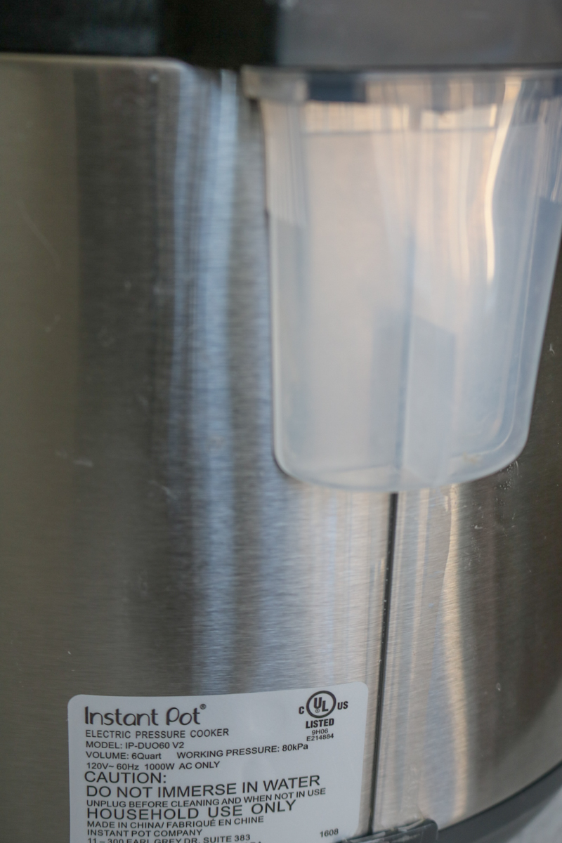
The parts of an electric pressure cooker
Condensation Cup:
Plastic cup collects any moisture/condensation that leaks out during the cooking process
Most common during the cooking of stews or stocks
Notes:
Steam or condensation may collect under the rim. The condensation cup catches the liquid that may collect.

Slide 12
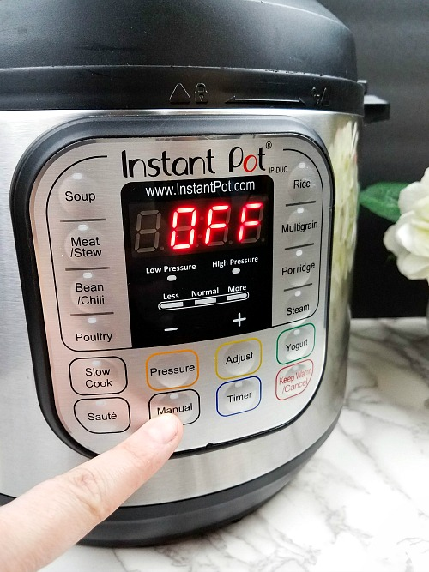
How do I use the settings?
Some pressure cookers have multiple program buttons
Each button refers to a different cooking method with preset cook time
Notes:
The front of your Electric Pressure Cooker can look pretty complicated, with all the different buttons denoting different programs. But once you understand what all the buttons mean, it’s very straight-forward.
Basically, each button refers to a different cooking method and has a preset cook time and pressure setting to make things more user-friendly.

Slide 13
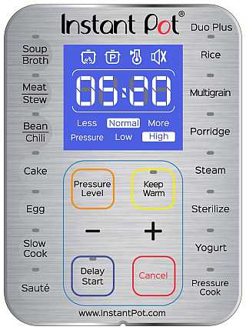
More about the settings
Know what you want to use your electric cooker for
Each brand has different setting.
Instant Pot is just a particular brand.
Shop for a brand that meets your needs.
Notes:
The Instant Pot has a lot of settings. Be sure you know what you want to cook with your pot. You can cook basically anything you want with just the pressure level buttons.
Under the pressure setting column, you’ll see “high,” “low,” and “normal.” A high-pressure setting indicates the Pressure Cooker is cooking at high pressure, and the lid is sealed to keep the pressure trapped. A low-pressure setting indicates lower pressure, but the appliance is still pressure-cooking. A normal setting shows that the appliance is functioning as a slow cooker and is not sealed or using pressure.
The Keep Warm setting will automatically turn on when cooking is done. Most cookers will need to be turned off or unplugged to end the Keep Warm setting.

Slide 14
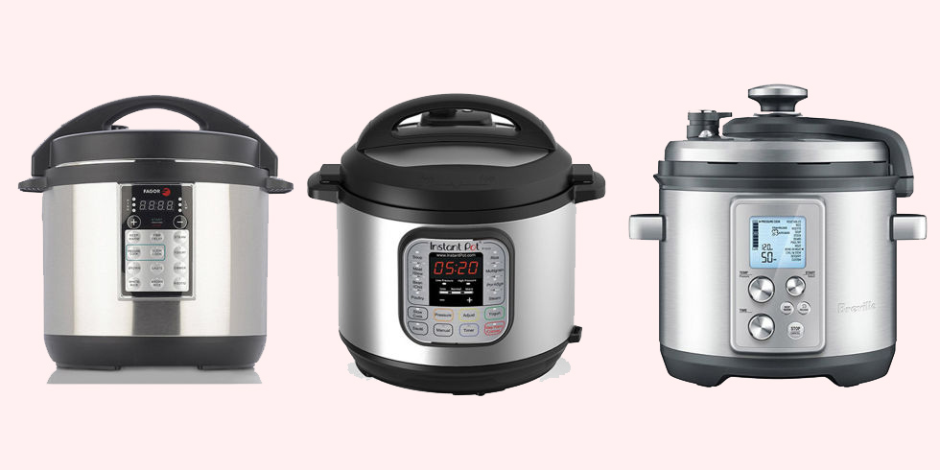
From Good Housekeeping
Notes:
Examples of different brands of electric pressure cookers.

Slide 15
Button | Pressure Setting | Cook Time
Slow Cook | Normal | 4 Hours
Pressure | Low or High | Manual
Soup | High | 30 minutes
Meat/Stew | High | 35 minutes
Bean/Chili | High | 30 minutes
Poultry | High | 15 minutes
Rice | Low | Auto
Multigrain | High | 40 minutes
*table based on Instant Pot brand Pressure Cooker
Notes:
Here is an example of a table that shows cooking times for various program buttons as featured on the Instant Pot brand pressure cooker. Each brand will have their own instructions and times included. Be sure to use the instruction sheets and manuals that come with your brand of cooker.

Slide 16
Altitude adjustments
Increase cooking time by 5% for every 1,000 ft above 2,000 ft
ALTITUDE | COOKING TIME
3,000 ft | +5%
4,000 ft | + 10%
5,000 ft | +15%
6,000 ft | +20%
7,000 ft | +25%
8,000 ft | +30%
Notes:
As with any type of cooking method, you need to make an adjustment for your altitude. Water boils at a lower temperature the higher you get above sea level, so adjustments must be made for your food to cook properly in your pressure cooker. Again, each brand will include their own directions for altitude adjustment.

Slide 17
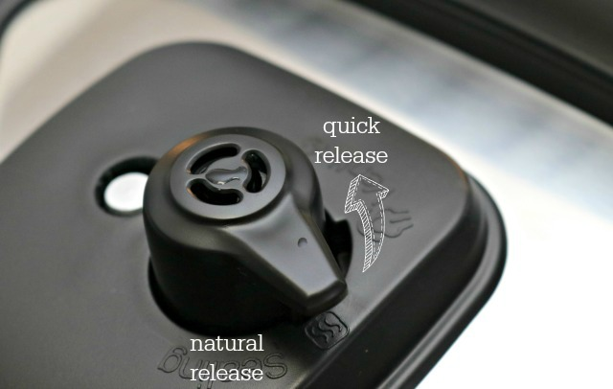
Natural release
Natural Release (NR) lets pressure dissipate on its own
10-30 minutes
More liquid=longer time to depressurize
Foods stay intact
Best for foamy foods or dishes with lots of liquid
Notes:
How to release pressure Remember that your pot builds up steam to cook with. Before you can open your pot safely, you must release the pressure.
Natural Release (NR) lets the pressure slowly dissipate on its own, depressurizing as heat gets released from the metal parts of the cover.
Depressurizing can take between 10 and 30 minutes, depending on how much liquid is in the cooking pot.
Recipes with more liquid will take longer to depressurize than dishes with less.
The (NR) method lets food stay intact during the depressurization process, as there is less movement within the appliance.
Foamy foods or dishes with lots of liquid are best left to the (NR) method.

Slide 18
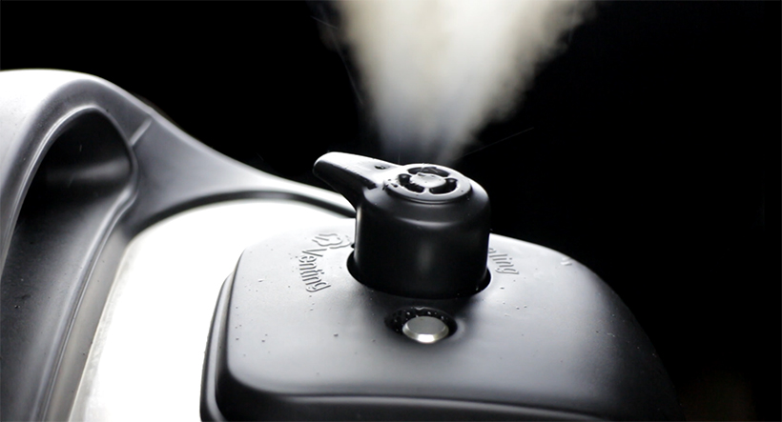
Quick release
Quick Release (QR) is manually venting the cooker
1-2 minutes
Best for foods that might overcook (seafood or vegetables)
Not recommended for high starch foods
Wait until all steam is released before taking off the lid of the pressure cooker
Notes:
To utilize the quick release method (QR), you can manually turn the steam release valve to the “venting” position. This cools the cooker down faster and only takes 1 or 2 minutes to completely depressurize.
The quick release method is ideal for foods like salmon and crab that you don’t want to overcook, or vegetables such as broccoli and bok choy that cook very quickly.
However, keep in mind that it is not recommended when cooking recipes high in starch content, as the quick release method can result in food bubbling out of the handle.
Please Note: It is crucial to wait until all the steam has been released from the Pressure Cooker before taking off the lid. NEVER try to force the lid open before depressurization is complete, as this can be very dangerous!

Slide 19
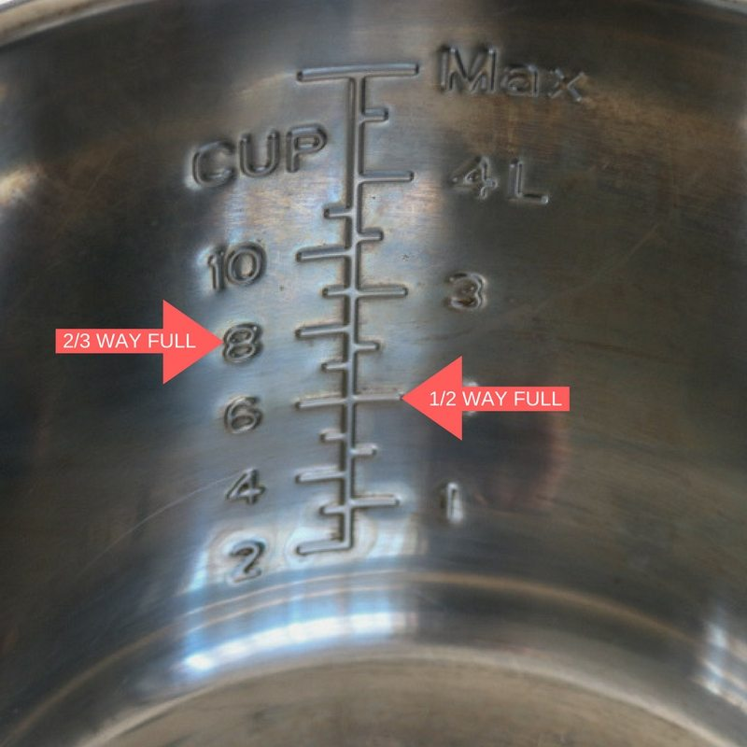
Cooking Guidelines:
Do Not Overfill:
Max Line printed on Inner Pot is not intended for Pressure Cooking
For Pressure Cooking: maximum 2/3 full
For Food that Expands During Cooking (such as grains, beans and dried vegetables): maximum ½ full

Slide 20
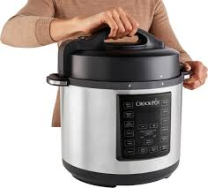
Safety Tips:
When in use:
Do not use an extension cord.
Do not leave the house.
To Safely Remove The Lid:
Do not remove lid until all the pressure has been released.
Always tilt lid away when opening
Wear waterproof, heat- resistant silicone gloves

Slide 21
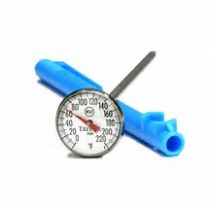
Think Food Safety
Use a thermometer to make sure your meat is cooked to the right temperature.
Avoid using the “preset” button. Remember food in the danger zone (as in a preset method) is not good to eat after 2 hours.

Slide 22
Let’s Consider…
Not all electric pressure cookers preform all the functions equally well.
Most don’t slow cook as well as your slow cooker.
You will have to tweak recipes to get them to work.
The time it takes for the Electric Pressure cooker to heat up and cool down are not counted in the “recipe time.”
Where are you going to store it?
How often will you use it?
Notes:
While electric pressure cookers do preform a multitude of functions, not all preform equally well. Some also take a considerable amount of time to heat up and cool down. That time needs to be considered as well as the cooking time.
Converting your recipes can take some experimentation. You may even have to adapt recipes meant for electric pressure cooking if it did not come from your appliance manual or web site.

Slide 23
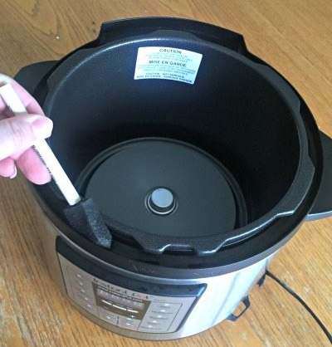
How to clean
Clean edges of pressure cooker, but be careful with moisture
Follow the directions that come with your pot.
Notes:
Electric pressure cookers have been found to develop an odor and harbor bacteria under the silicone ring and around the top of the cooker. If they are not cleaned well, they will not be safe to cook with.
Several things can be used to clean the area around the lip of the cooker; like a damp cloth, an old toothbrush, a new foam paintbrush, etc.

Slide 24
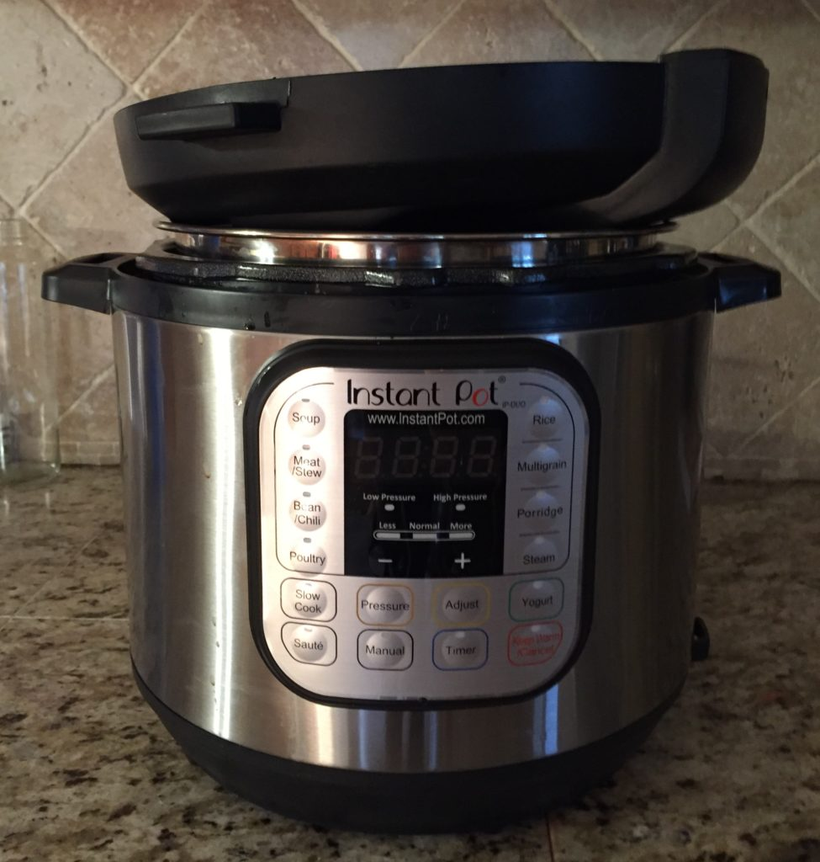
How to clean
Lid is Top-rack dishwasher safe
Remove sealing ring and anti- block shield
Clean the silicone ring and dry completely before putting it back in place
Prevent odors by placing lid upside down until completely dry
Check steam release valve and float valve, as well as the anti block shield.
Notes:
One way to prevent the lid from retaining odors is to place it upside down on the pot until it has completely dried or you are ready to use it.
Check steam release valve and float valve, make sure no food or debris is blocking the valves

Slide 25
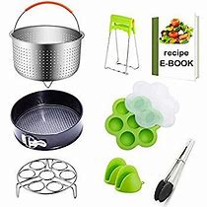
Accessories
Need vs Want
Notes:
And with anything, there are a lot of gadgets you can buy. Lots of colors, exciting looking things…but are you really going to make a cheese cake in your pot? Need an egg cooker for 12? Think about what you will really use. As with anything else, if you aren’t going to use it, it will become a storage item. Use your pot awhile before you decide to spend on a lot of parts, pieces and gadgets.

Slide 26
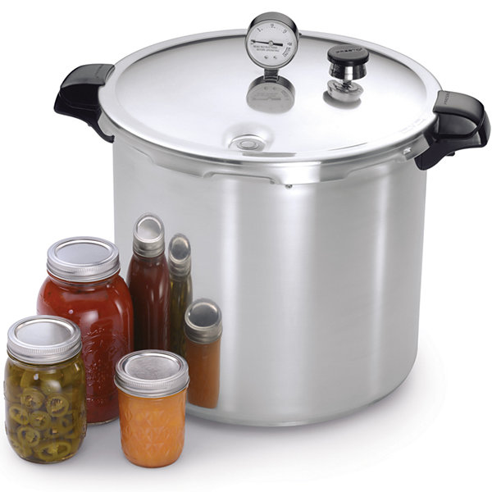
Canning in an Electric pressure cooker? NO!!!!
According to the National Center for Home Food Preservation (NCHFP):
“food may end up under processed. Under processed foods are unsafe and can result in foodborne illness, including botulism poisoning, if consumed.”
Use the electric pressure cooker for making dinner, but leave canning to the stove top pressure canner.
Notes:
And before anyone askes – you can not use an electric pressure cooker to water bath or pressure can.
In addition to holding too little water, pressure cookers have less metal, which means the time it takes to come to pressure is shorter than that of a pressure canner.
The time it takes them to cool down is also shorter. That might seem like a good thing, but it actually means the food in the jars is heated for less time – and that means bacteria won’t be fully killed during processing.
According to the NCHFP “the food may end up under processed. Under processed foods are unsafe and can result in foodborne illness, including botulism poisoning, if consumed.”
By the way, if you are looking for canning and food preservation information, National Center for Home Food Preservation is the best place to check online.

Slide 27
Questions?

Slide 28
Recipe source ideas
https://www.pressurecookingtoday.com, Pressure cooking today
https://www.yummly.com/recipes/pressure-cooker-chicken, Yummly
https://instantpot.com/, Instant Pot web site
https://www.gopresto.com/recipes/, Presto web site
https://www.foodnetwork.com/recipes/photos/pressure-cooker-recipes, Food Network web site
https://www.hippressurecooking.com/, HIP Cooking

Slide 29
Thanks to :
Kathy Smith, Family and Community Health Agent, Parker County Extension for use of her presentation “Cooking Under Pressure”
and
Becky Hutchings, University of Idaho Extension Educator – Minidoka County for her presentation “Cooking under Pressure”

Slide 30
References
http://www.discoverpressurecooking.com/history.html
https://www.goodhousekeeping.com/appliances/pressure-cooker-reviews/g204/electric-pressure-cooker-reviews/

