Slide 1
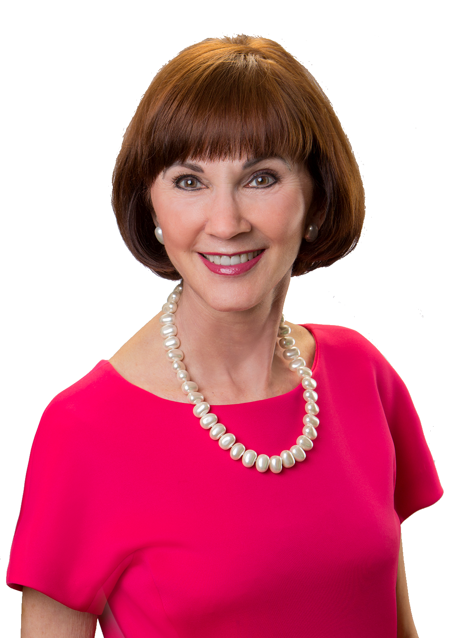
Plan to Control
Your Aging Years
June
September 2017
Debbie Pearson
RN, BSN, CCM, TxCG, ALCA, NSA
www.AgeYourWay.com
www.NursesCaseManagement.com
Notes:
NOTE TO PRESENTOR: This script was written by Debbie Pearson in her voice relaying her experiences. As you present the program, there may be points where you will want to change the wording slightly to reflect that it is Debbie’s experiences you are relaying, rather than your own.
Thank you for allowing me a place at your table. I’m honored to be here because you are the people who disseminate information to a rich variety of communities. You hold the magic key to make a difference to others in a way that can change lives for the better.
You wouldn’t go on a trip without a plan: tickets, agenda, a place to stay, gas in the car, reservations, maybe even some research. Yet for our most mysterious and complicated journey, the one that begins with age or injury, most of us are like hitchhikers on a deserted road. We jump into a stranger’s car and before we know it we’re swerving around a bend toward an eighteen- wheeler and we realize our driver is drunk and the seatbelt doesn’t work, and…
Don’t be that traveler.
Realize your own extraordinary aging journey can last years, even decades, with twists, turns and surprises around every corner. Your attendance today will help you survey the terrain, design your own roadmap and age your way. Customizable lessons apply whether you’re looking ahead to your own future or scrambling to assist an elderly relative or a family member in crisis.

Slide 2
Why Plan?
Notes:
If you haven’t planned, you’re in good company. Our society seldom applauds life’s final act; everyone knows what’s next, so let’s all cover our eyes. But denial not only diminishes the last third of our excellent adventure in this world, it puts somebody else in the driver’s seat, a sure way to hit that oncoming truck.
We can do better. Think about how enthusiastically you prepared for other milestones: higher education, career, parenting. We study, focus, and try to guide the course of our lives. I’ve learned you can draw upon the same skills for the aging years with rewarding results.
By following a guide, your personal plan will leave no question about your unique wishes for both living and dying. More than that, your plan includes legal and financial information, essential to executing your strategy. When shared, your written plan provides a gift to family, saving them from the agony of choosing for you while they fight with each other over who can better read your mind. Documentation is crucial, since with aging or injury, there is a chance you won’t be able to verbally communicate your wishes or be actively involved. If that time comes, what’s in writing must serve as your voice.
By sharing patient stories and hands-on experience, I’ll introduce you to the value of applying control to the aging process to avoid the heartbreak that comes from lack of planning. And, when people ask me who needs this information, I tell them it’s really for a select and high risk group: anyone who is at risk to age. That might be you or it might be someone you know.
Although the time we’ll spend today is limited, there is time allocated at the end to answer questions. You’ll also take a few gems of wisdom with you and will be able to:

Slide 3
Learning Objectives
How Planning Impacts Control
Three Stages to Plan
Four Parts of a Blueprint
Guide Others to be Active
Notes:
Recognize how planning impacts control over the aging years.
Identify the three stages available for planning.
Understand the four parts of a Blueprint to plan.
Guide others to become active in the aging process.

Slide 4
uiu
Control vs. Chaos
Notes:
First, I want you to look at this couple and think . . . if they were your family, would you opt for their aging years to have control or chaos? This couple has a story I know well because they are real patients I’ve had the honor to serve. Since 2000, I’ve helped as both a case manager and a court appointed guardian. But my work as a case manager has not been for a hospital or a medical practice. It’s been working directly for patients to serve as an extension of who they are and what they want to happen in their lives. As a result of this opportunity, I’ve gathered a ton of experience. But experience is a hard teacher because she gives the test first, the lesson afterwards. That’s why I’m here: to share those lessons that were learned the hard way.
Years ago, I assisted an engineer who, at forty-seven, received a devastating diagnosis: Huntington’s Disease. This is an inherited condition that causes progressive degeneration of nerve cells in the brain, affecting muscle coordination, mental ability and behavioral symptoms. To compound the tragedy, his two teenage daughters stood a fifty-fifty chance of inheriting the congenital disorder, making this a family crisis.
On meeting Bill, I recognized his intelligence, strength, and compassion for others, all of which stoked his decision to make a plan immediately. Like the best of plans, this was an act of love. Still, following his diagnosis, his marriage dissolved, as is often the case with catastrophic conditions. His daughters operated in a state of fear for both their father and their future.
Bill knew three things for certain: the disease would end his life, he wanted to spare his young daughters from burdensome responsibility, and he needed to make a plan to guide the stages of his illness. He got busy on our Age Your Way plan, documenting all his wishes and assigning medical and financial powers of attorney to his brother, a decision designed to relieve pressure on his girls and to assure his wishes were followed. Special documents protected Bill’s financial assets for his minor daughters, using government benefits where possible. Because Bill’s brother lived out of state, he engaged me to oversee medical care as the disease progressed.
I began to work with Bill when he was in a retirement community that provided limited assistance. He was still independent at first but when he lost the use of his arms, there was no option but to transfer to a skilled nursing facility.
Bill’s admission to the nursing home was heartbreaking. The daughter who showed up to help smelled and looked like a street urchin. It was obvious she hadn’t bathed, washed her hair, or changed her clothes for weeks. It was clear she was frozen with fear while absorbing the reality that she had tested positive for the Huntington’s gene.
If we didn’t have a clear plan in place to follow, I could have easily gotten derailed by the agony I felt looking at Bill’s daughter. But there was much to do to assure that Bill’s plan would be clearly followed at the facility. A detailed set of orders had to be put in place as a guide: all his preferences and wishes for medical care. I soldiered on, doing Bill’s work.
This is where he remained for three years and became both immobile and non-verbal. Nevertheless, we made decisions based on Bill’s own wishes, communicated when he had a voice. When painful decision points were encountered, his brother and daughters didn’t need to wrestle with choices. Although silent, his voice was heard, his wishes followed. No guilt, no arguments. Bill controlled the outcome and minimized surprises. Everyone knew and honored his wishes for a natural death, daughters by his side.
Unfortunately, Bill is in the minority. Less than one third of Americans have even executed documents to name their Power of Attorney or executed their Directive to Physician.

Slide 5
NOT
The Family
Notes:
For a different perspective, let me introduce you to another patient – Party Phyllis. She had an insatiable desire to live life to the fullest - despite being physically disabled and in constant pain. After more than six back surgeries, metal plates and cages held her spine together from neck to tailbone. Still she managed to remain active with her zest for life, sheer determination, and her two strong friends: Oxycodone, and Hydrocodone. Where others would have assumed a fetal position, Phyllis refused to take to her bed except to sleep at night.
All went well until that awful evening when her children dropped by unannounced at suppertime. They found Phyllis with a glass of Chardonnay in one hand and a scotch on the rocks in the other. Why not? It was happy hour. Her adult children were appalled, knowing drugs and alcohol don’t mix. Their opinion didn’t matter. Phyllis considered cocktail hour to be non- negotiable. The children were ready to exert their legal authority, claiming Phyllis was impaired. The truth: Phyllis was in that grey area — not fully-capable mentally and physically, but not incapacitated.
That night, in the middle, I became the referee as we sat at her kitchen table, seeking a compromise: A spot where Phyllis was free to continue living her way along with some peace of mind for her children. Not a single solution I offered was acceptable to either side. Safety and quality of life can often be in conflict. When the night got late, we finally settled on a trial that neither liked.
Against her will, Phyllis agreed to have a night sitter come to her home in time for cocktail hour each evening and remain with her until morning. The sitter’s job was to get Phyllis safely to bed and be up and down with her throughout the night as needed. Protect her from falls. Against their better judgment, the family agreed to give this a try. The mediated plan went on for years— and it worked. When the end came for Phyllis, it was unrelated to narcotics or alcohol. It was from an overwhelming infection in her spine. She’d been permitted to live her life her way until the end.
The moral of this story is that priorities and wishes belong to the patient, not the family. Support people are engaged to understand the patient’s wishes and execute their plan. This is not an opportunity to change lifelong habits and wishes, but to serve as an extension of that person.

Slide 6
3 Stages Available to Plan
STAGE 3:
Someone else takes control
STAGE 1:
In complete control
STAGE 2:
Assistance needed
Notes:
Bill and Phyllis are two examples of planning stages. Every one of you has three stages available to design your own unique plan. The question is, which stage will you choose . . . . . . . or which stage will you land in from not making a choice?
Stage 1 is where you are in complete control. You are mentally clear and functionally able to gather information and document wishes. Bill is a perfect example of a Stage One planner.
Stage 2 is where assistance is needed. These are the people who were reluctant to plan, in denial, or simply unaware that they had an option to plan. The person in Stage 2 may not be able to complete their plan alone but they can help you fill in the blanks for them and provide answers, making the final product an accurate reflection of who they are and what they want. Phyllis provided the direction for her plan but needed assistance and support to carry it out.
Stage 3 – is where someone else does the best they can to manage your crisis.
This was the situation with a man I’ll call Dan. One of those loners who disconnected from social support at some time during his life. Not social media but the person-to-person connection. Divorced. Estranged from his only daughter. Essentially a recluse. Dan was referred to my company, Nurses Case Management (NCM), to see if we could extract information and obtain his wishes. After others had tried and failed to crack the outer shell of Dan, we were the last option.
Our meeting with Dan, at the very minimum, would initiate his plan. What we got was two thin threads of a strategy – he wanted to maintain the estrangement with his only daughter and he wanted to continue his solitary life. We knew this wouldn’t be an option for long due to his failing health, however it was a start. Dan’s patience ran thin as he ushered us out with an agreement to meet again the following week. But this start never progressed because within days of our meeting Dan had a catastrophic stroke – leaving him unable to speak or swallow.
This may sound familiar to some of you. No legal documents executed. So little of a plan in place that what we had was useless. While hospitalized, his daughter made an enthusiastic attempt to insert herself as the responsible party. She always loved her father dearly and wanted to devote the rest of Dan’s life to caring for him and his money – after twenty years of detachment. Anything he needed: just give her the authority and the checkbook and she’d be ready.
Since Dan had nothing in writing, devoted daughter would need to become his court- appointed guardian. Her enthusiasm didn’t wane until she spoke to the court investigator. He explained that she’d need a background check and court oversight of every penny spent. What do you think happened? Poof! Gone!
As a result, my company became the court-appointed guardian. As Dan’s guardian, we had a legal solution but what about the ethics of decision-making for a stranger? Someone we barely knew. Not an enviable position for Dan or for us.
Our challenge was that we didn’t know Dan well enough to look through his eyes or know what he wanted. Who did? Our research began. There were only three people who knew Dan well: one friend, his housekeeper, and his ex-wife. That became our ethics committee, our advisors. They provided the context of who Dan was and what types of decisions he made in the past.
We eventually came up with a plan, one that established palliative care as the strategy. We transitioned Dan to hospice care with a focus on keeping him comfortable. Did we make decisions as Dan would have chosen? Maybe, maybe not. Because Dan surrendered all control due to lack of planning: no information, no documentation of wishes.
Sad, isn’t it? And frightening! Would you want your housekeeper and your ex-spouse comprising the majority verdict for you? I know I wouldn’t. Under the circumstances, it was the best we could do.
Although Dan’s decision-making situation is not the norm, it also isn’t rare. Stage Three planners abound – those who default to crisis management simply by not planning. Families are often scattered around the country and children are reunited with parents at a time where little to no information is available. Even families who are geographically close may not have explored beneath superficial conversation. This is both sad and completely avoidable.

Slide 7
The Story & The Structure Debbie@AgeYourWay.com
Notes:
Well . . . after forty years of watching the good, the bad, and the ugly, I felt compelled to take action. First, I poured out my heart to document the lessons learned. My patients and families had been so generous in their teachings, how could I let this treasure stay only in the tiny folds of my brain? So, I wrote my first book “Age Your Way” until the stories were out on paper. It felt great. This became my way of influencing others by painting the contrasting pictures – planning vs no plan. Anyone who reads the stories will touch the texture of lessons learned.
But, what about those who were then motivated to plan? It’s unconscionable to light a flame and then let it die. So, I wrote my second book “The Blueprint to Age Your Way.” It’s literally the step-by-step format to execute a plan. From page one until the last, you will follow the well-worn path paved by hundreds of patients. All their brilliance and all their bumbles that shaped the secret sauce to success. The magic of moving the future from passive to active involvement. Both books are available directly from me or on Amazon. Time doesn’t allow me to cover all parts of the Blueprint but I’ll give you a glimpse of the four major categories: legal, medical, financial, and personal. One of the greatest benefits of having a written blueprint is that information gathering goes from being “nosy” to filling in the blanks of the workbook.

Slide 8
Directives for Life
Power of Attorney
HIPAA Release
Directive to Physician
Guardian Designation
Complete all advance directives
Provide copies to your agent and physician
Originals in safekeeping and accessible to another
List location of other important documents
List agents so documents don’t go “stale”
Notes:
Legal is the foundation of a stable plan. Many people will proudly tell you about the documents they’ve executed: their will, who their executor is, where their family funeral plot is located. And you wait – and wait – and wait. What about advance directives that take care of the living years? Planning for aging is all about documents that will take effect while alive. Special attention should be paid to the following:
Having advance directives that are the latest version and legal in your state. Your best protection is when these are done by a reliable attorney.
Medical and financial power of attorney. Who has authority to act? This person can also be called your proxy or advocate.
HIPAA release to allow sharing of medical of information.
Directive to physician that documents end-of-life wishes for incurable or irreversible conditions.
Guardianship designation that names who you would trust and who you would exclude if you require a guardian.
Once documents are completed, putting them in a hidden drawer defeats the purpose of doing them. After all, they were executed for the time when help is needed from your trusted agent. Provide copies to your responsible party and your physician.
Keep the originals in a safe place where someone, other than you, knows the location and can access them.
List the location of other important legal documents such as birth certificate, trusts, income tax returns, etc.
And, pay special attention to assure legal paperwork is not at risk to go stale. Many legal documents that I review read like a “who’s who of diseased and disabled.” The named agent, of the same generation, is no longer available to make decisions or carry out the obligations assigned to them. It’s imperative to name alternates of a younger generation to allow documents a long life, lasting for decades.

Slide 9
Your Chance to Document Wishes for Care Well in Advance of the Crisis
List medical information to allow another to be an informed medical advocate
Make health insurance data available
Complete medical planning worksheet to guide care if you are unable to speak
Notes:
Medical is the second part of the plan. This is your chance to get your thoughts in writing well ahead of the crisis. Planning allows you to document wishes for care and disclose medical information to your trusted agent. This type of sharing does wonders to guide a family through the aging process. Some of the parts include:
Listing of medical information, doctors, medications, medical conditions. An informed agent or family member is your best advocate. It’s unreasonable to count on someone to guide your care if they are operating with a blindfold.
Medical insurance data must be available so your helper can access what you’ve put in place.
Complete your medical planning worksheet that records specific wishes for care if aging or injury renders you incapable of verbalizing your wishes.

Slide 10
Don’t wait to obtain financial information after someone is incapacitated!!!!
Bank accounts. Others to know what not to close.
Assets, income, obligations.
Investments, real estate, business holdings.
Life & other insurances – tap in to what’s available.
Notes:
Financial – can we really talk about this? Why not? If you think it’s hard to obtain this information when someone is alive and active, just try to get financial details after someone is incapacitated. A plan should gather and list these items:
Bank accounts, credit cards, safety deposit box, etc. When someone steps in to help, if they consolidate bank accounts and inadvertently close the account that receives social security, there is an automatic assumption of death. With this, social security payments stop along with an end to Medicare benefits. I worked with a patient who lived this nightmare, taking almost a year to re-establish benefits. During that year, she had to pay privately for all her medical care and prescriptions. Your agent requires information to avoid mistakes.
Assets, income, obligations. When help is needed, another person must have the tools to keep your life flowing: paying utilities, rent, insurance, and so much more.
Investments, real estate, business holdings. Where are additional resources to be accessed if needed for your continued support?
Life and other insurances. You’ve invested in these safeguards for a reason. Without transparency, they can go untapped.

Slide 11
Potpouri of
All the Rest
That Matters
Phone numbers, service providers, logins/passwords.
List fears, favorites, concessions you agree to
Funeral & burial wishes, demographic data.
Specific bequests of sentimental heirlooms.
Notes:
Personal is the final part. This is the potpourri of so much.
Phone numbers, service providers, logins / passwords. These are essential means to maintain function of your life and your obligations.
Listing of fears, favorites, concessions that are acceptable to you. In working through this section with a patient, she looked up partway through her fears and favorites listing and said, “my children have no idea who I am.” How true is that for most of us? Our children know we are . . . their parents. But what about when roles reverse? Let’s provide them with the needed information of how to care for and comfort us when our life changes and we take the position of the vulnerable and frightened child.
Funeral and burial wishes. While most of you have preferences in this area, few have disclosed the information. Even supplying demographic information to the funeral home can be an emotionally draining experience for your survivors. They will need your parent’s full names and place of birth, all your military information, who you want for pallbearers. The list goes on and on. Providing all that is needed in advance is a tremendous gift.
Specific bequests; the personal gifts that fall outside the will. This allows family heirlooms and sentimental objects to go to the person who would be the most touched by the article. It also saves lots of fights.
If you have a sense of being overwhelmed by the complexity of planning, then you are getting a glimpse of why this is such a tremendous gift to others as well as a blessing to yourself.
While I share my final story, be thinking of questions you’d like to ask.
For the last story, I want to share what a family planning session looks like. It starts with all the hard work you’ll do for either yourself or your loved one. After the work is completed, then the sharing of information takes place.
The first time my husband, Hank, and I did this, we gathered the family for a meeting: our three children, their spouses, and the eight grandchildren. Then we made a game-time call. Sixteen was too large a group to review our plan. The grandchildren were sent out to play and the six adults were ushered into my home office. Then we did the unthinkable. We shut the door! All the faces turned pale, their voices silenced . . . as they waited for the bomb to drop – speechless. A dreaded certainly that one of us had a terminal condition or we were divorcing, after all these years. My family is never speechless so Hank and I took advantage of the silence.
There was no bomb. Simply years of experience to know this was the gift they needed. We reviewed one chapter after another, revealing the details of our lives and the assignment of responsibility each child would eventually have. When we finished, we looked up to see six sets of eyes, all filled with tears. Tears of gratitude, tears of relief for what they would never have to unearth when we progress to the stage of needing help. They were also incredibly relieved that we weren’t dying or divorcing.
We had just given them the best gift we had ever given. It was so good that we re-gift it every year with annual reviews, updating any items that have changed.

Slide 12
Notes:
This is the picture from our last planning session. They are no longer frightened and no longer silent. Every bit as appreciative.
Planning. The gift you can give to yourselves – and to those you care about.
Now we have time to answer any questions you might have.

