Slide 1
iPad 101
Presented by:
AARP Mentor up 4-H Tech wizards

Slide 2
AARP Mentor Up 4-H Tech wizards -Purpose-
Bringing youth and adults together.
We live in a world full of technology that is always changing and growing. This has made it hard for older adults to keep up. Youth today have grown up with technology and are skilled at using it. We are giving these youth the opportunity to share what they know with older adults.
From left to right: Mrs. Anne, Jacob, Payton, Kasi, Jessica, Alexis, and Mr. Bill at the Wesleyan Assisted Living Home in Georgetown, TX

Slide 3
Objectives
Be able to successfully learn to navigate an iPad
Change settings
Download apps
Use the calendar & maps
Useful iPad tips
FaceTime
Payton demonstrating iPad skills

Slide 4
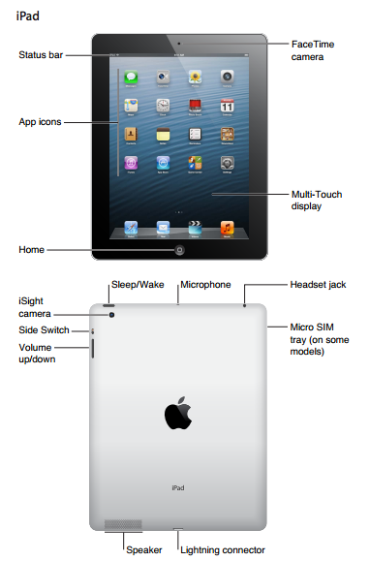
Getting to know your iPad
http://ipads.techforteachers.com/ipad-basics/get-to-know-your-ipad/screen-shot-2012-11-26-at-10-44-37-am/
Notes:
There are several key buttons to become familiar with on an iPad.
Sleep/Wake button (Also the Power button)
Home button
Volume switches (Up and Down)
Side switch (depending on your model of iPad this will be a mute switch or a screen resolution switch)
Other things to familiarize yourself with on an iPad are
Camera on the front and back
Charging dock (also called the lightning connector)
Headphone jack

Slide 5
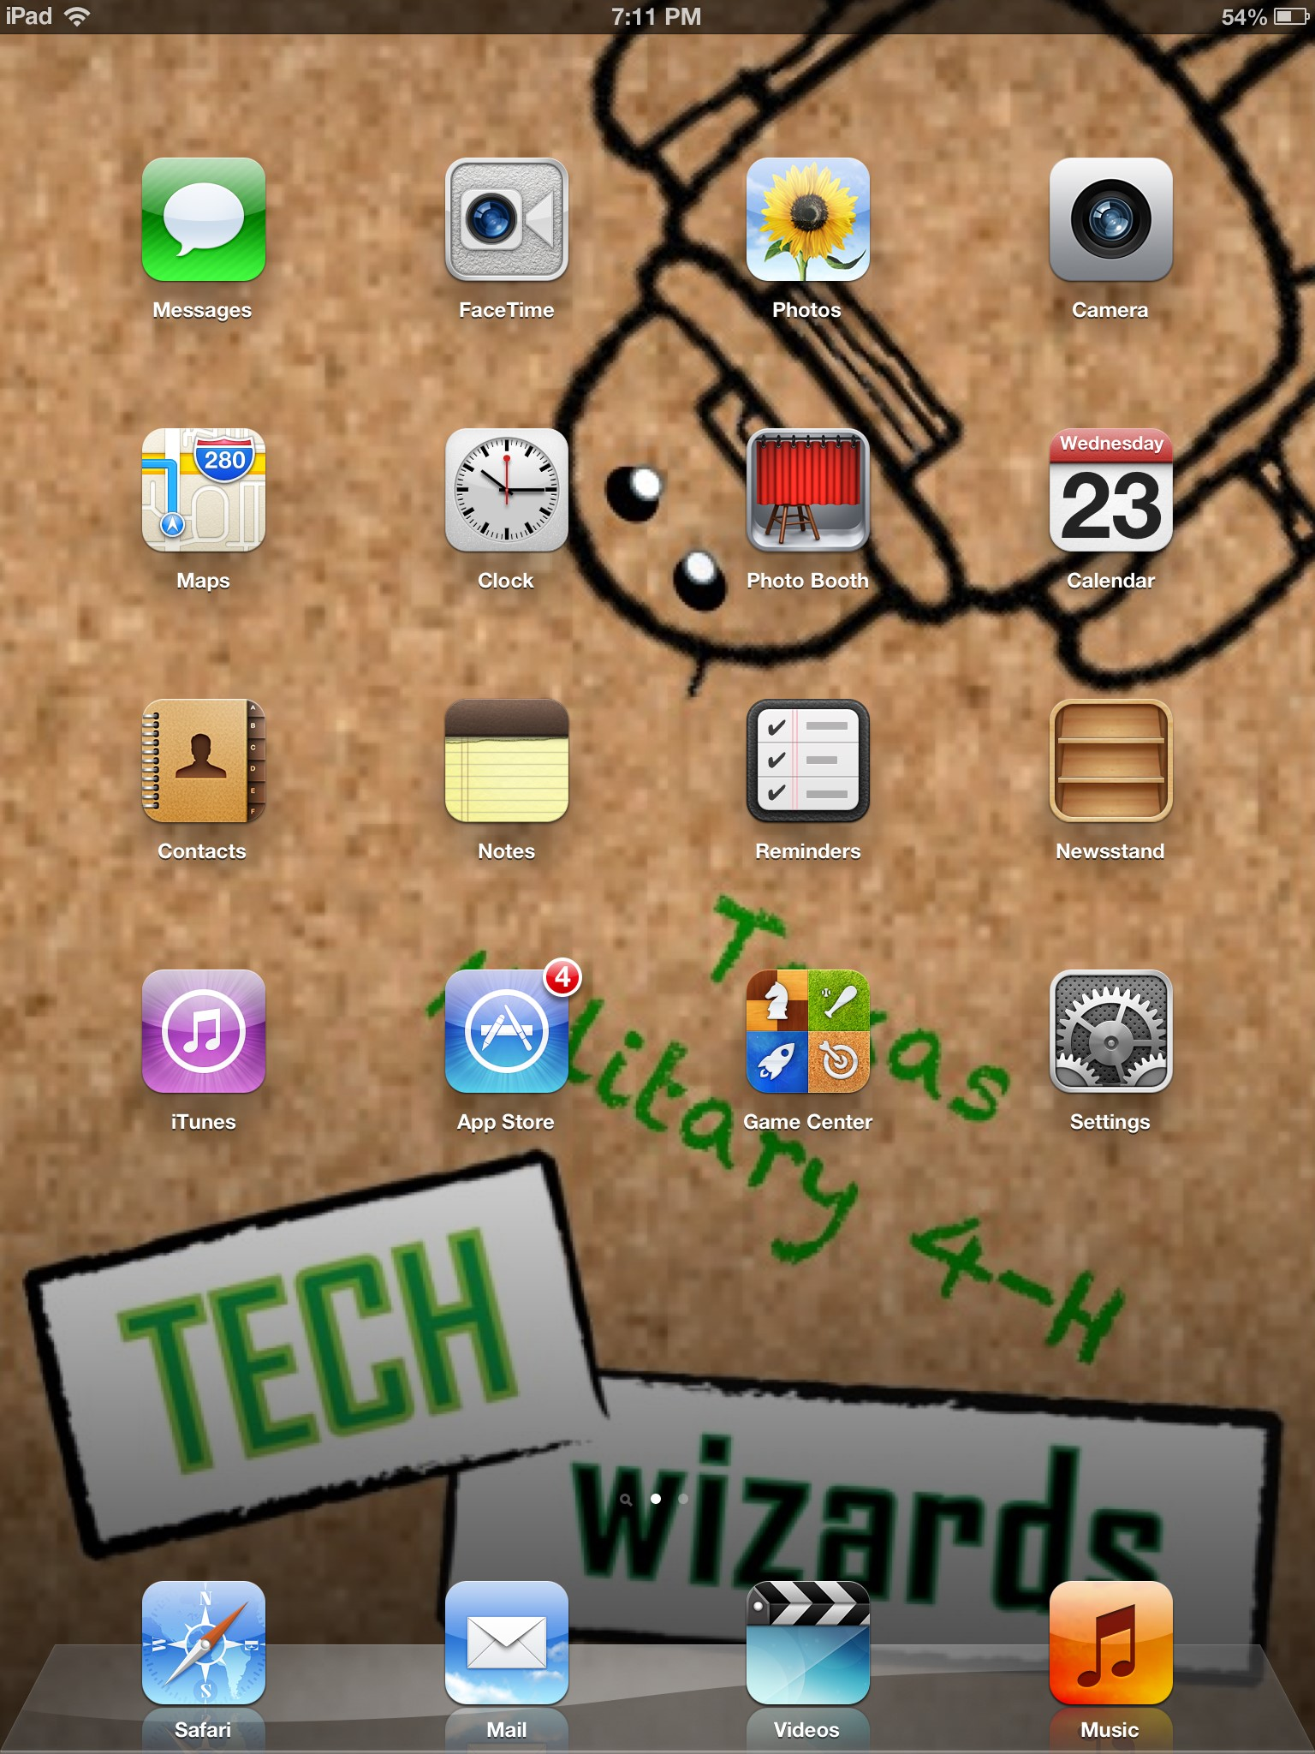
Preinstalled apps
Your iPad comes with certain apps that you do not have to install yourself.
An app is an application that serves a particular purpose, such as telling the weather.
Notes:
The preinstalled apps on our iPads are:
Messages – Uses your Apple account to send iMessages or syncs with your iPhone to send messages
Facetime – Allows you to make video calls to your friends and family
Photos – Stores all of the photos you take and allows you to share them in a number of ways
Camera – Take photos and videos to capture memories
Maps – Search for a location and get step by step directions through Apple Maps
Clock – Contains a world clock, alarm settings, stopwatch, and a timer
Photobooth – A fun tool to take crazy photos
Calendar – This calendar allows you to add events and set reminders or alarms so that you never forget a birthday or anniversary again
Contacts – Stores a list of all your friends and family. This can be connected to your iPhone to transfer all of the information between devices
Notes – A place to jot down information that you do not want to forget
Reminders – Allows you to set reminders for yourself and will play an alarm when they are due
Newsstand – Holds magazines and news articles that you download through the App store
iTunes – Helps you search and find music and videos to download to your device, it is linked to your Apple account
App Store – Allows you to search and purchase apps that interest you through your Apple account
Game Center – Stores your game statistics through your Apple ID
Safari – The Apple version of internet explorer that allows you to surf the web
Mail – Allows you to check your e-mail on your device (We will go over setting this up later in the presentation)
Videos – Stores any videos or movies that you download onto your device from iTunes
Music – Stores any music that you download onto your device from iTunes

Slide 6
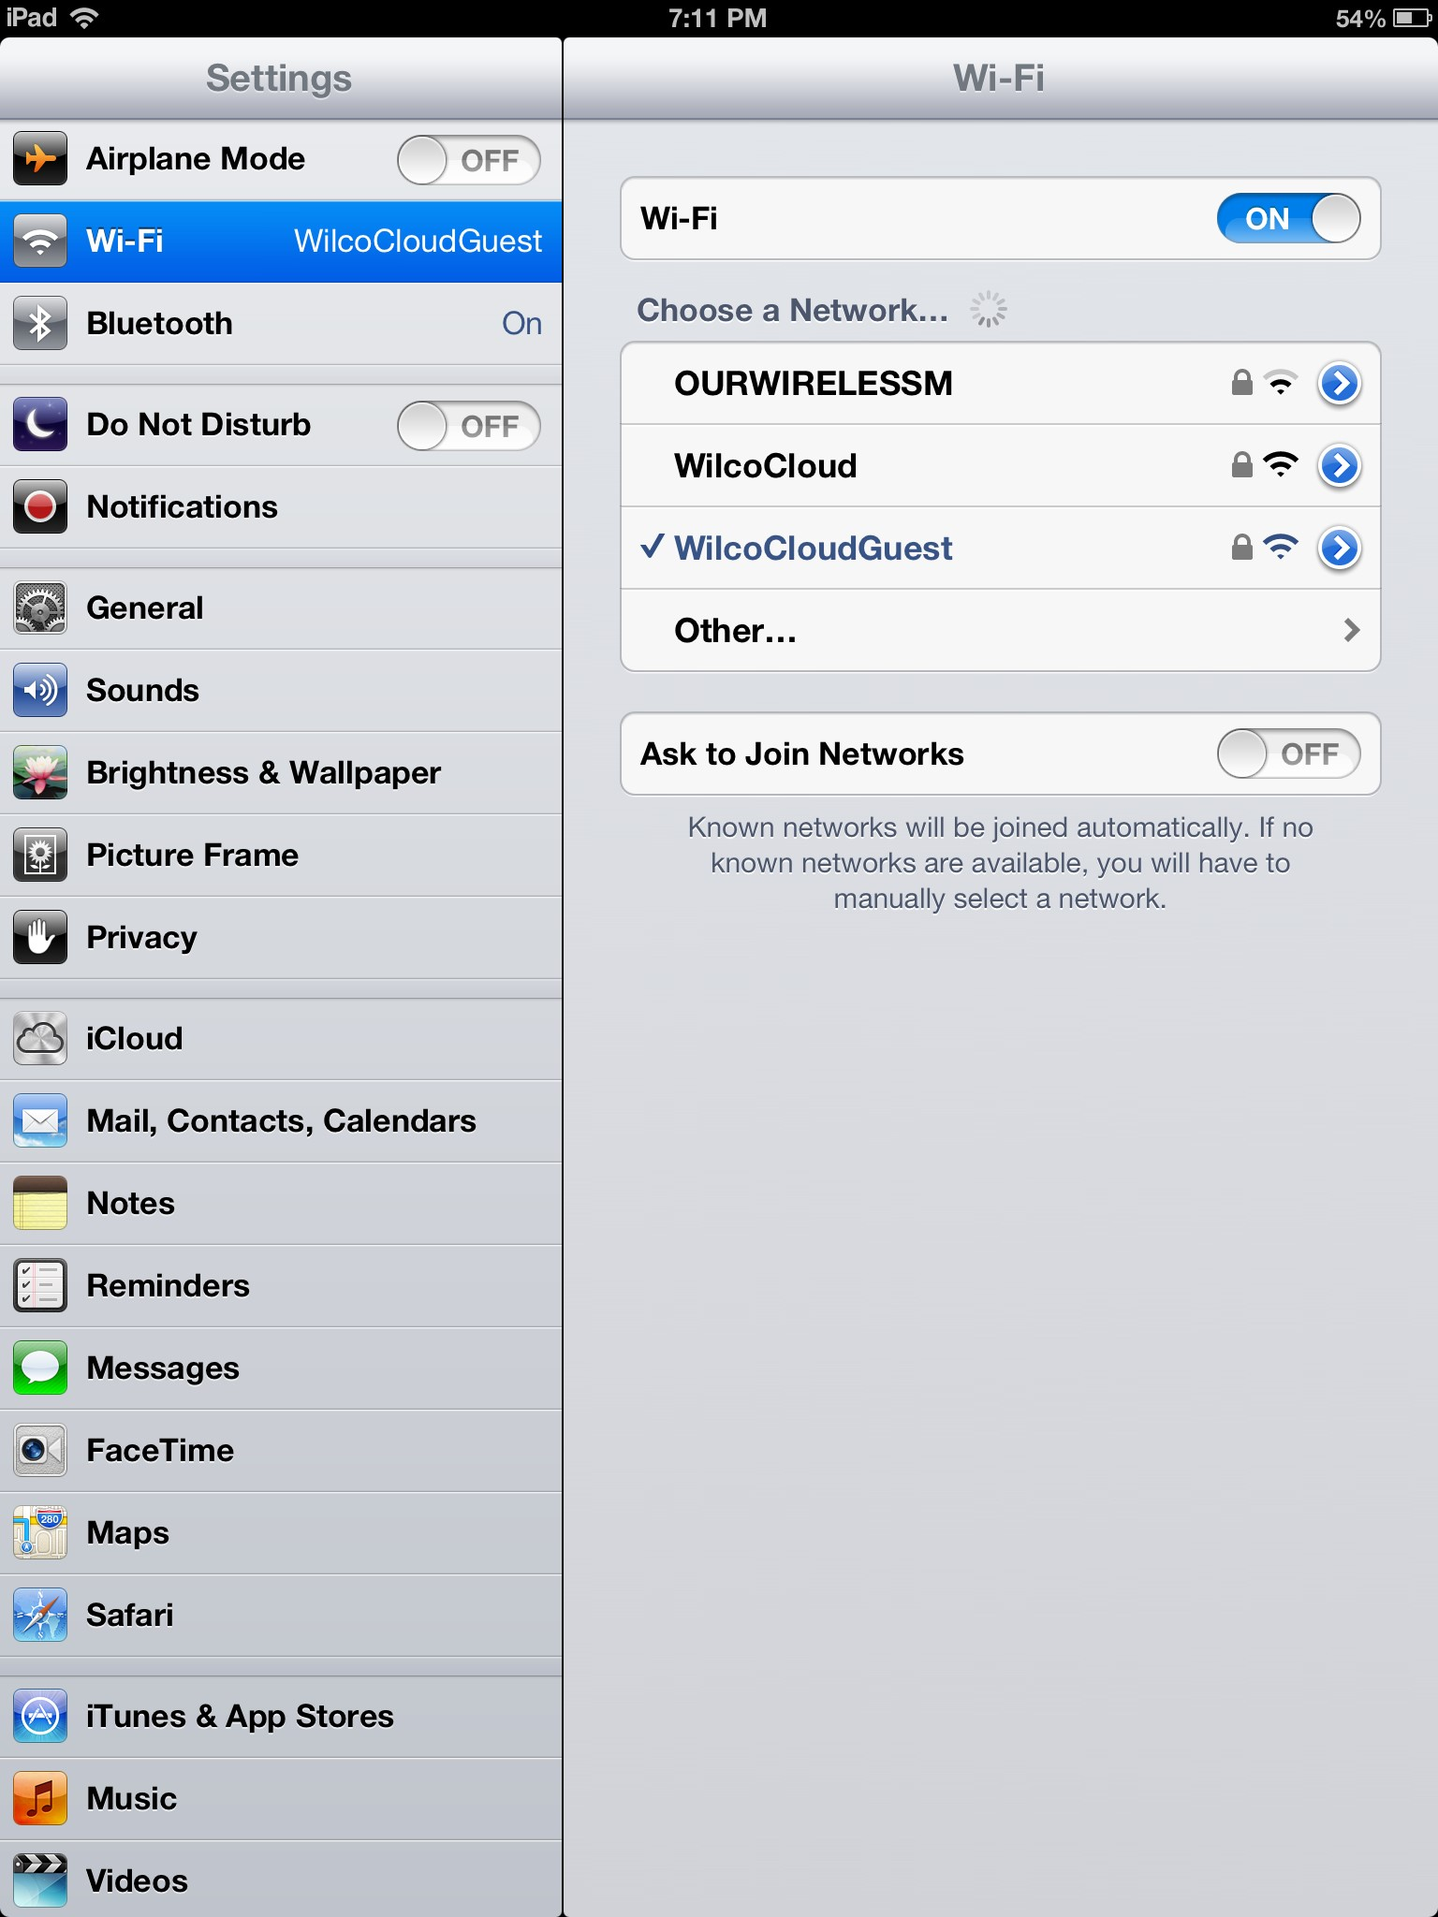
Settings: Overview
The settings icon on your iPad is your command center.
Here all of the important functions of your iPad can be changed.
To use most of your iPad apps, you will need to connect to an internet source via Wi-Fi.
Notes:
Open the settings icon from your home screen.
There should be two panes that you see when the screen opens.
The left side contains a list of functions and the right side is the open folder of the information for the function that is highlighted.
On our screen we have selected Wi-Fi on the left and on the right you can see our options.
To connect to a particular Wi-Fi source, you will click on the title, not the arrow button on the right.
You may be asked to enter a security passcode that protects the Wi-Fi network from unauthorized users.
When the iPad is connected to internet, you will see a fan-like icon appear next to the word iPad at the very top left hand corner of the screen.

Slide 7
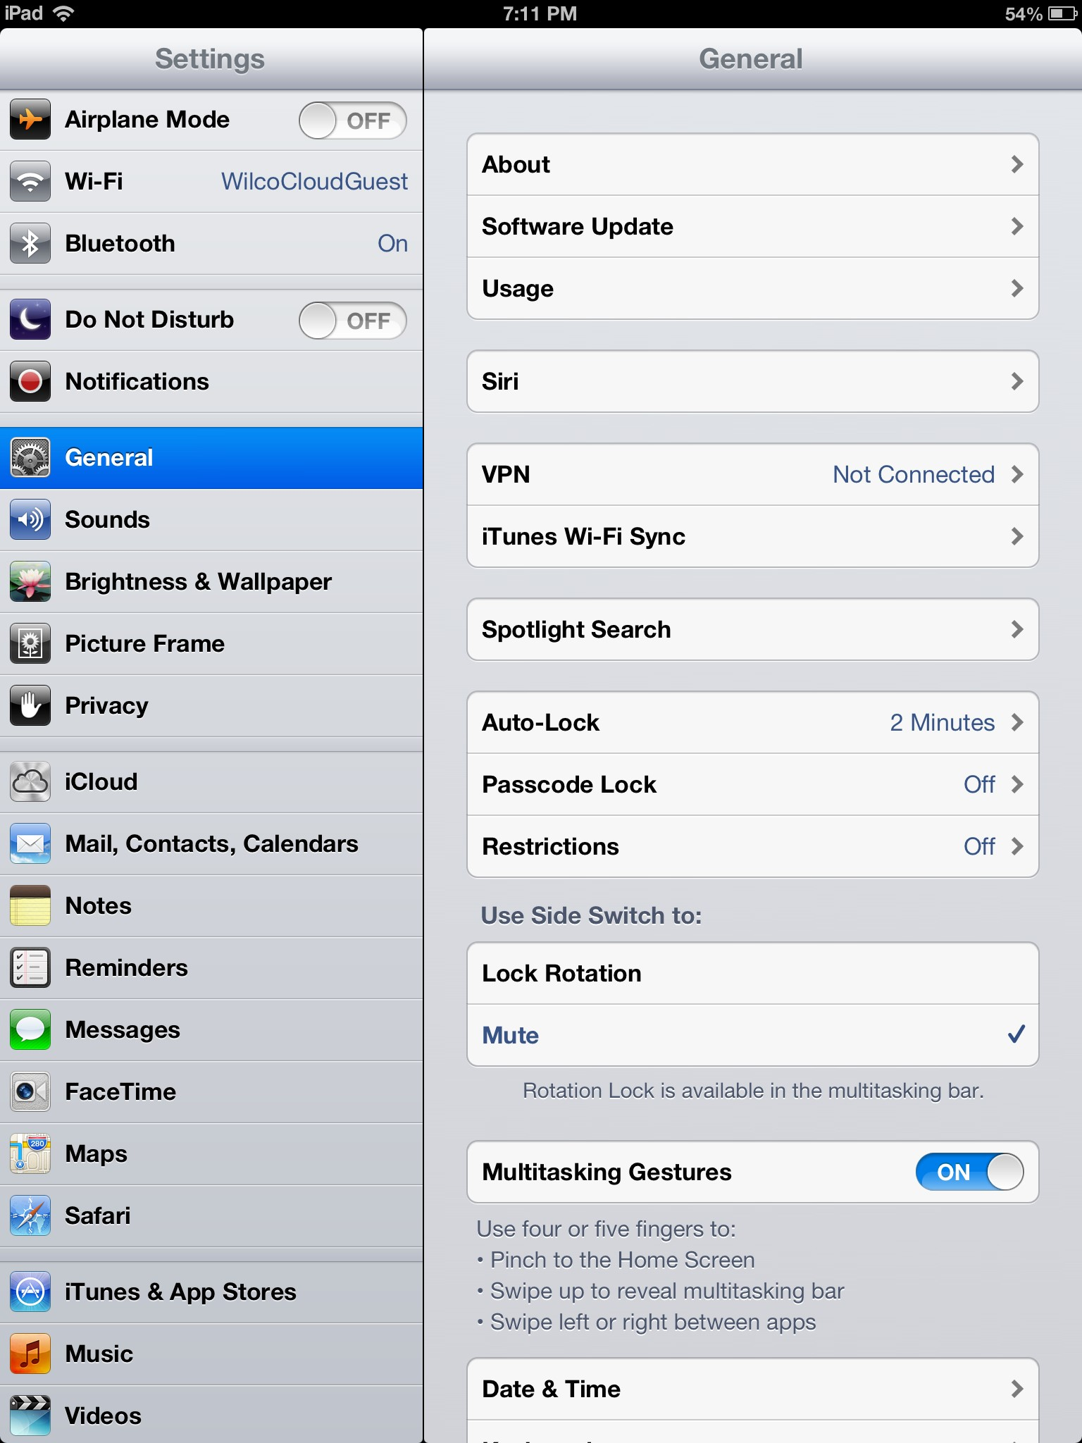
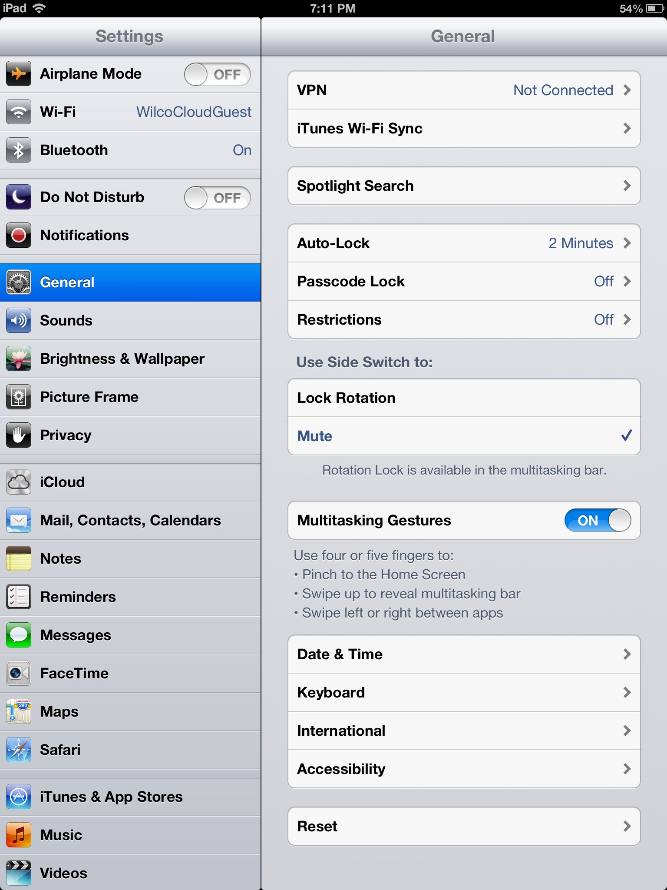
Settings: Accessibility
Use your index finger and drag from the bottom of the screen to the top to scroll down on the General Settings Menu
Notes:
Many of the iPad’s most basic functions are found in the “General” section on the left side of the screen.
For instance, if you scroll down through the general settings page, you will find an option called “Accessibility”

Slide 8
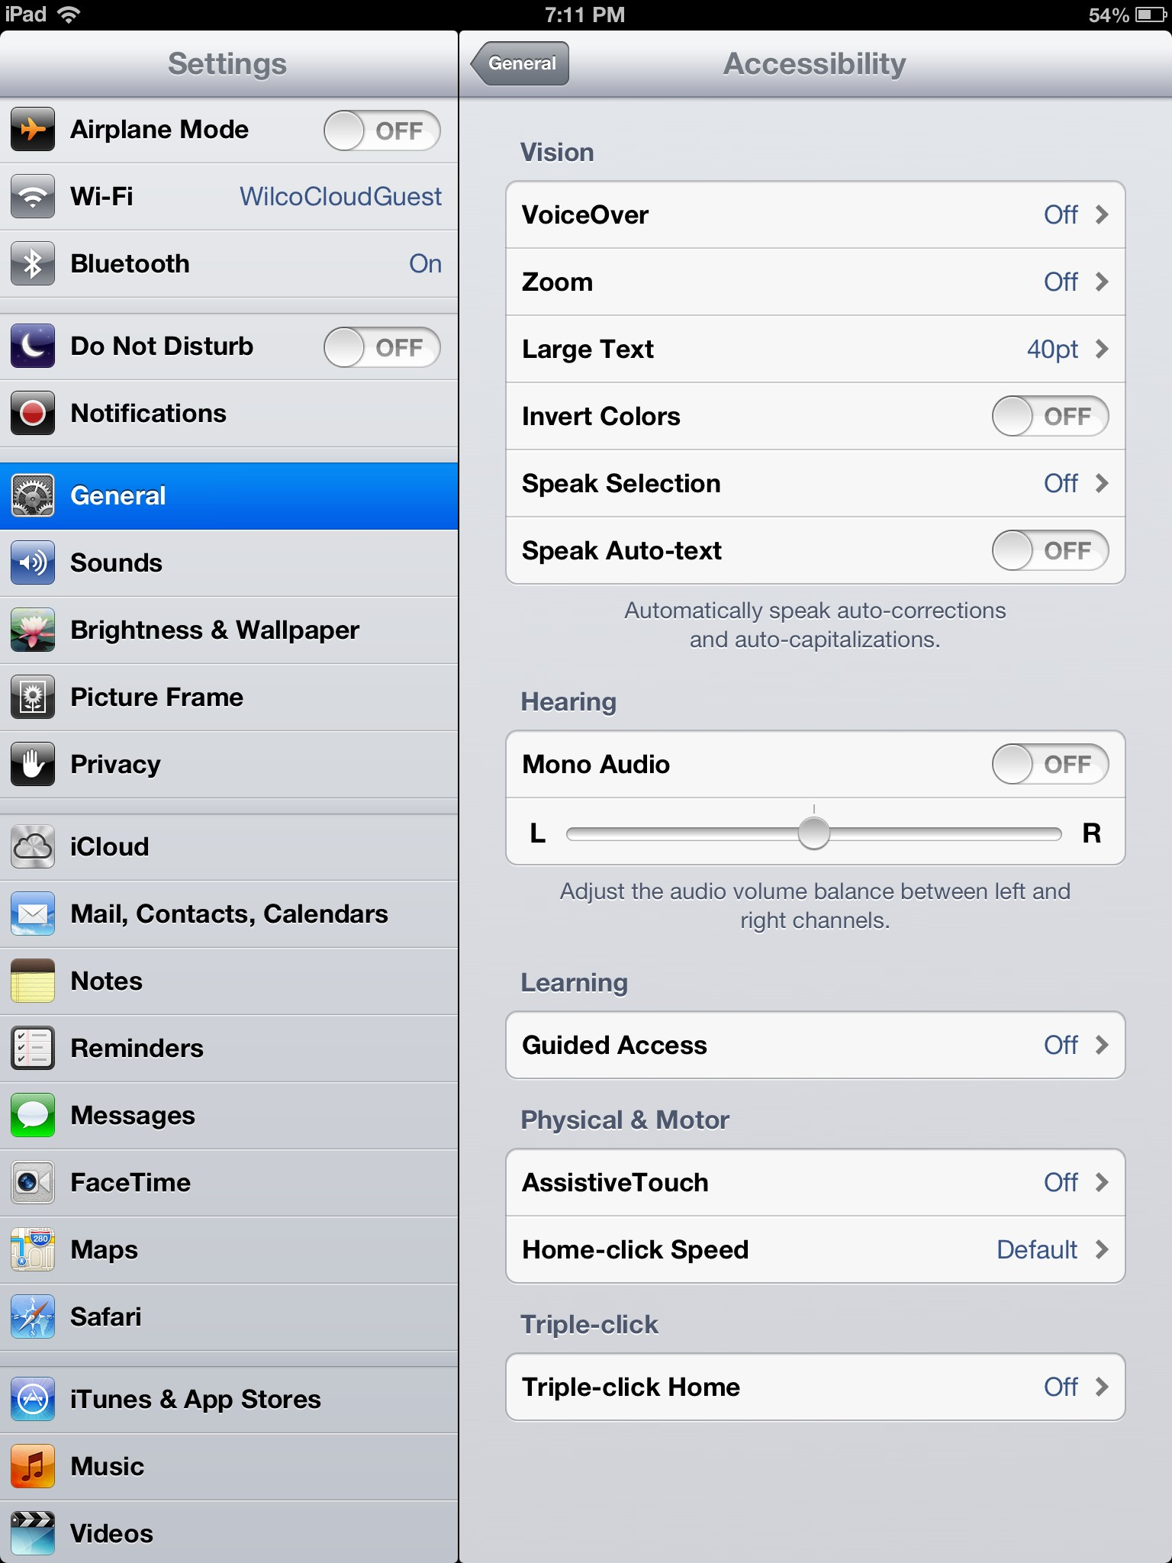
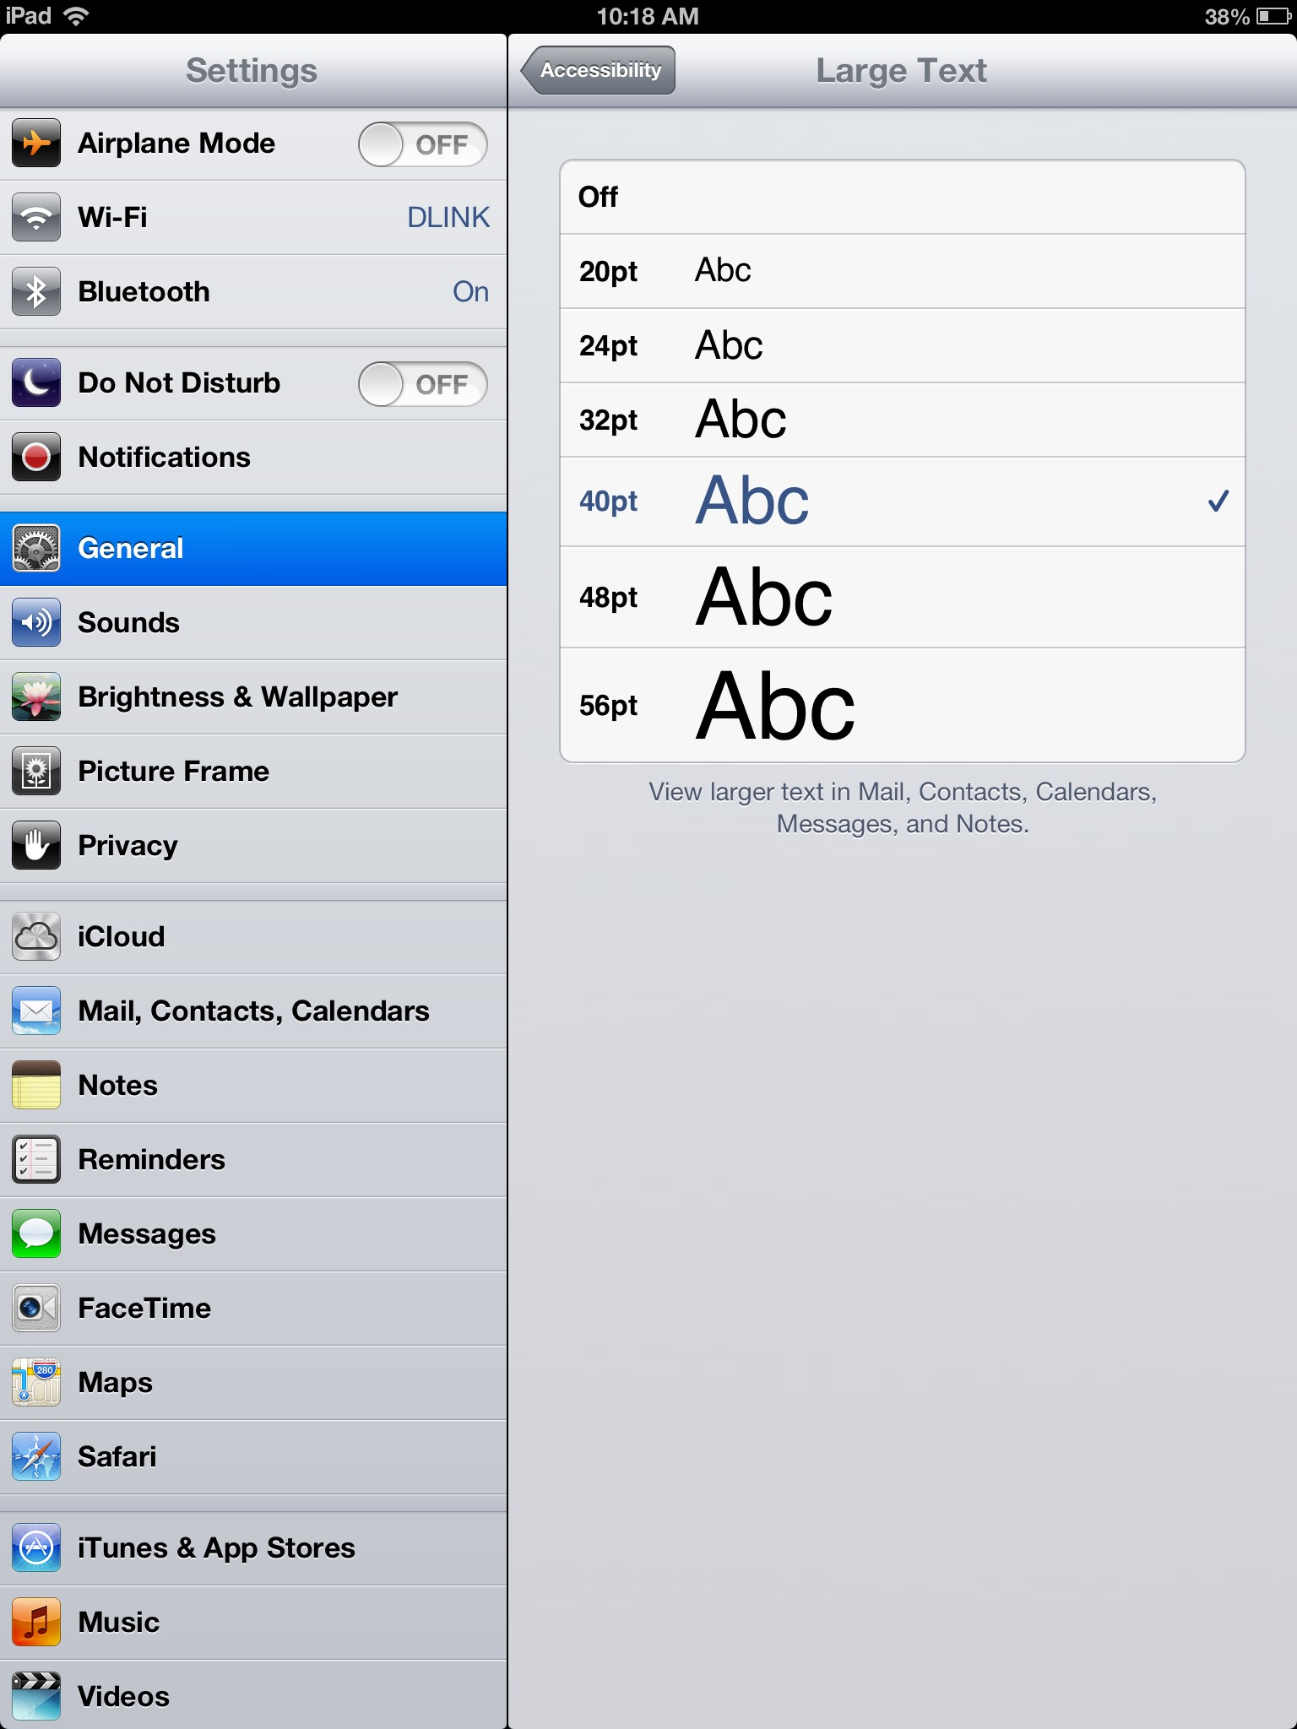
Settings: Accessibility
Notes:
Once you have opened the Accessibility function, you will be brought to this screen.
There are many options on this menu. One of the most useful is the ability to change your font size.
Select the “Large Text” option from the Accessibility screen and you will see the options on the right side of my screen.
To change your font size, simply tough the title of the size you would like to see.
Note that at the top of the right side of your screen you can see which menu you are looking at.

Slide 9
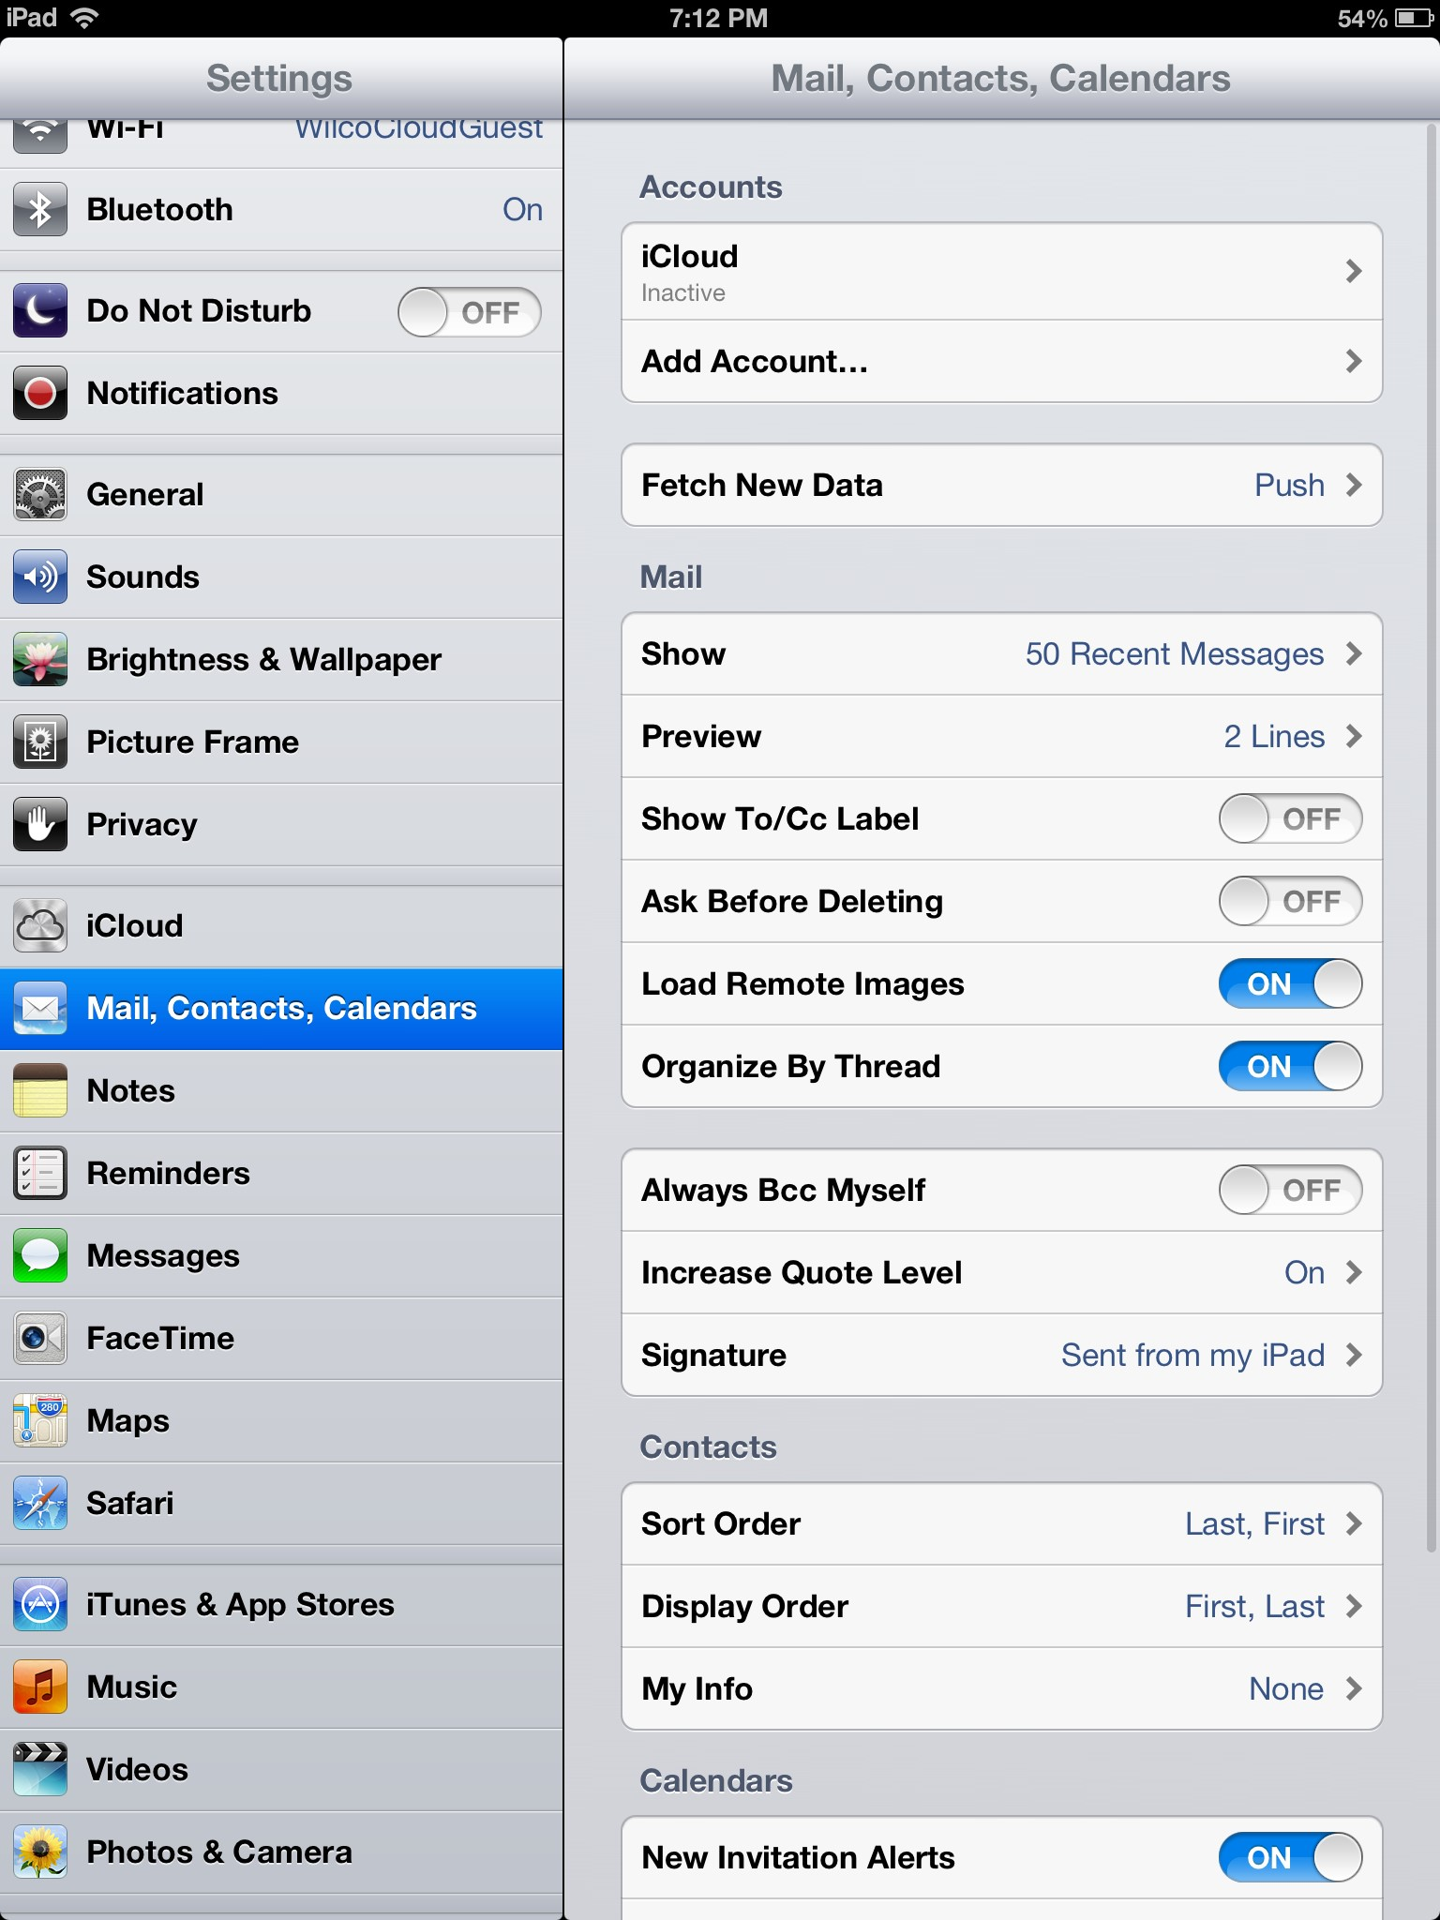
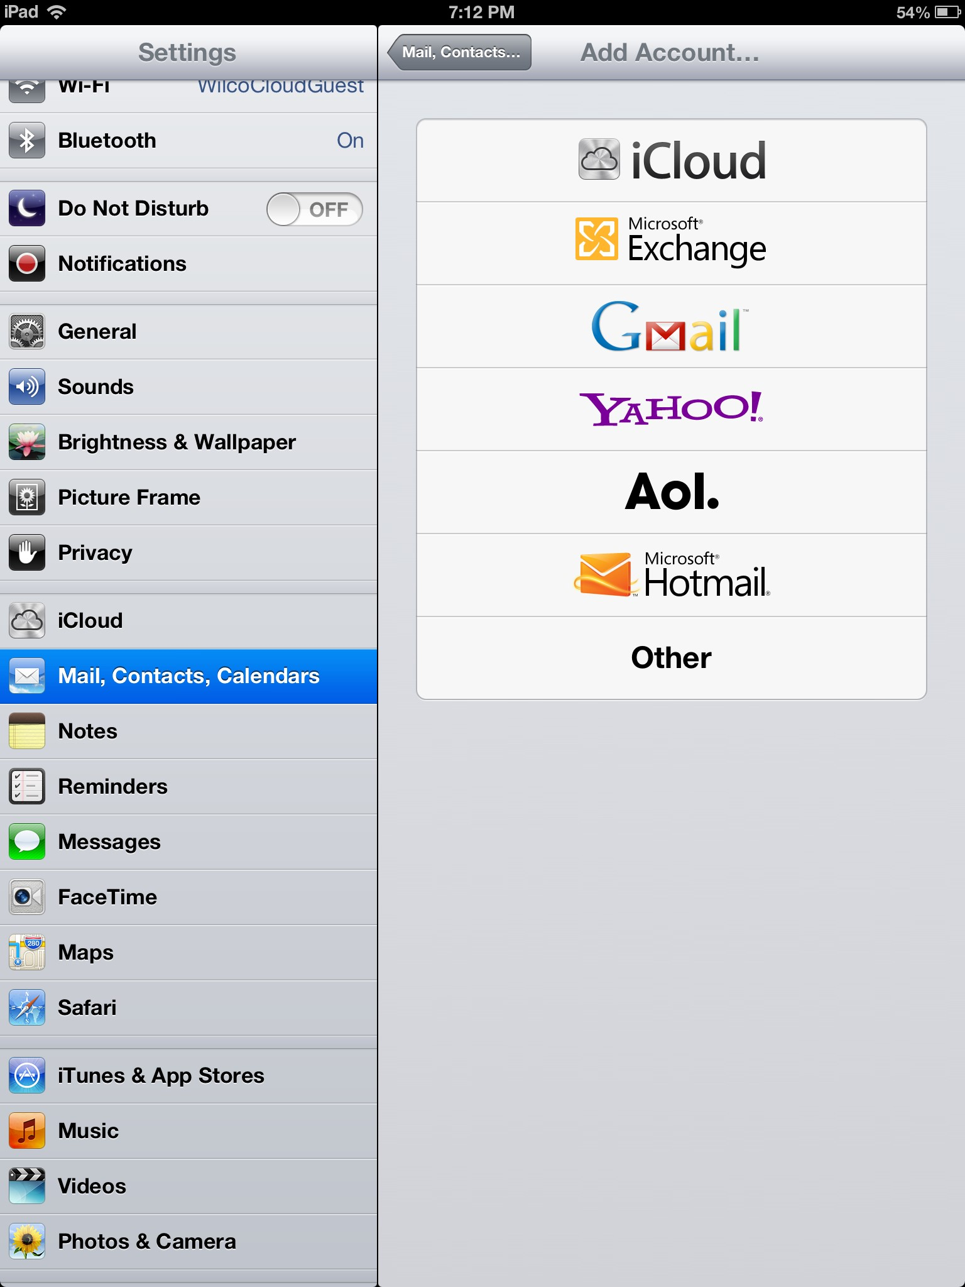
Settings: Adding an email account
Notes:
Another useful function found in Settings is managing your e-mail accounts.
To do this, select the “Mail, Contacts, Calendars” option on the left hand side of your screen.
You will see the “Add Account” option near the top of the Mail, Contacts, and Calendars menu.
After you have selected that option, you will see the screen on the right.
To add an account, you will select which e-mail server that you use, and enter your Name, E-mail address and password on the screen that pops up.
After it verifies the information, you will be able to receive, send, and view you e-mail on your iPad.

Slide 10
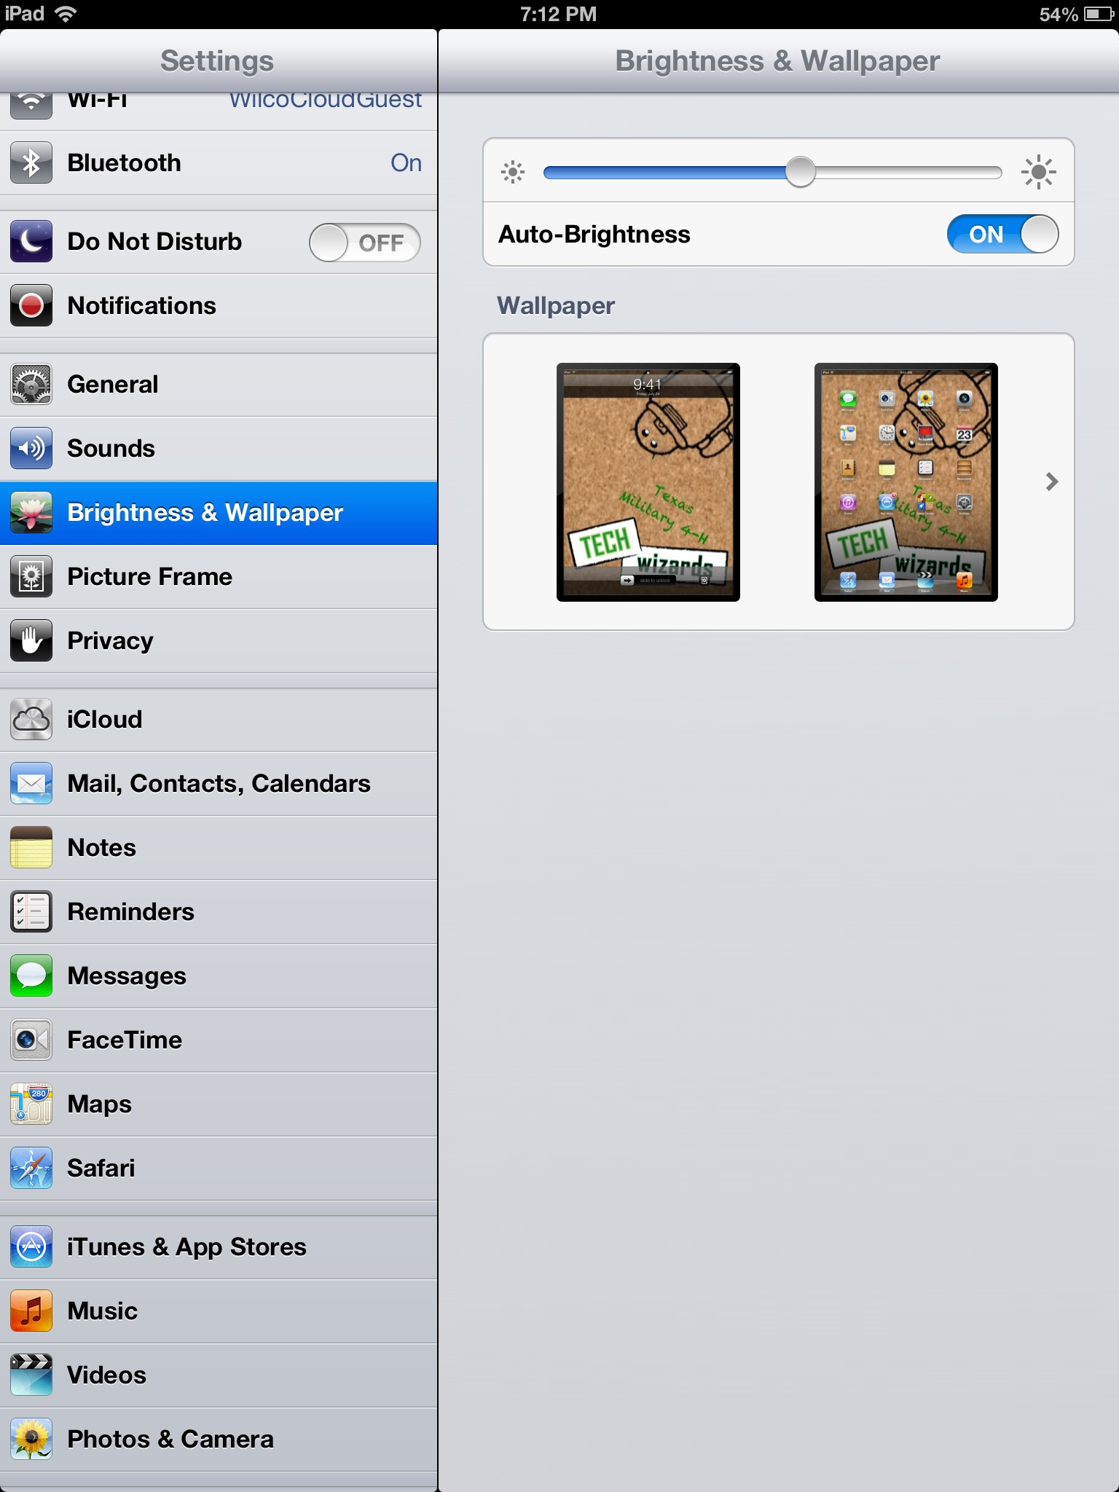
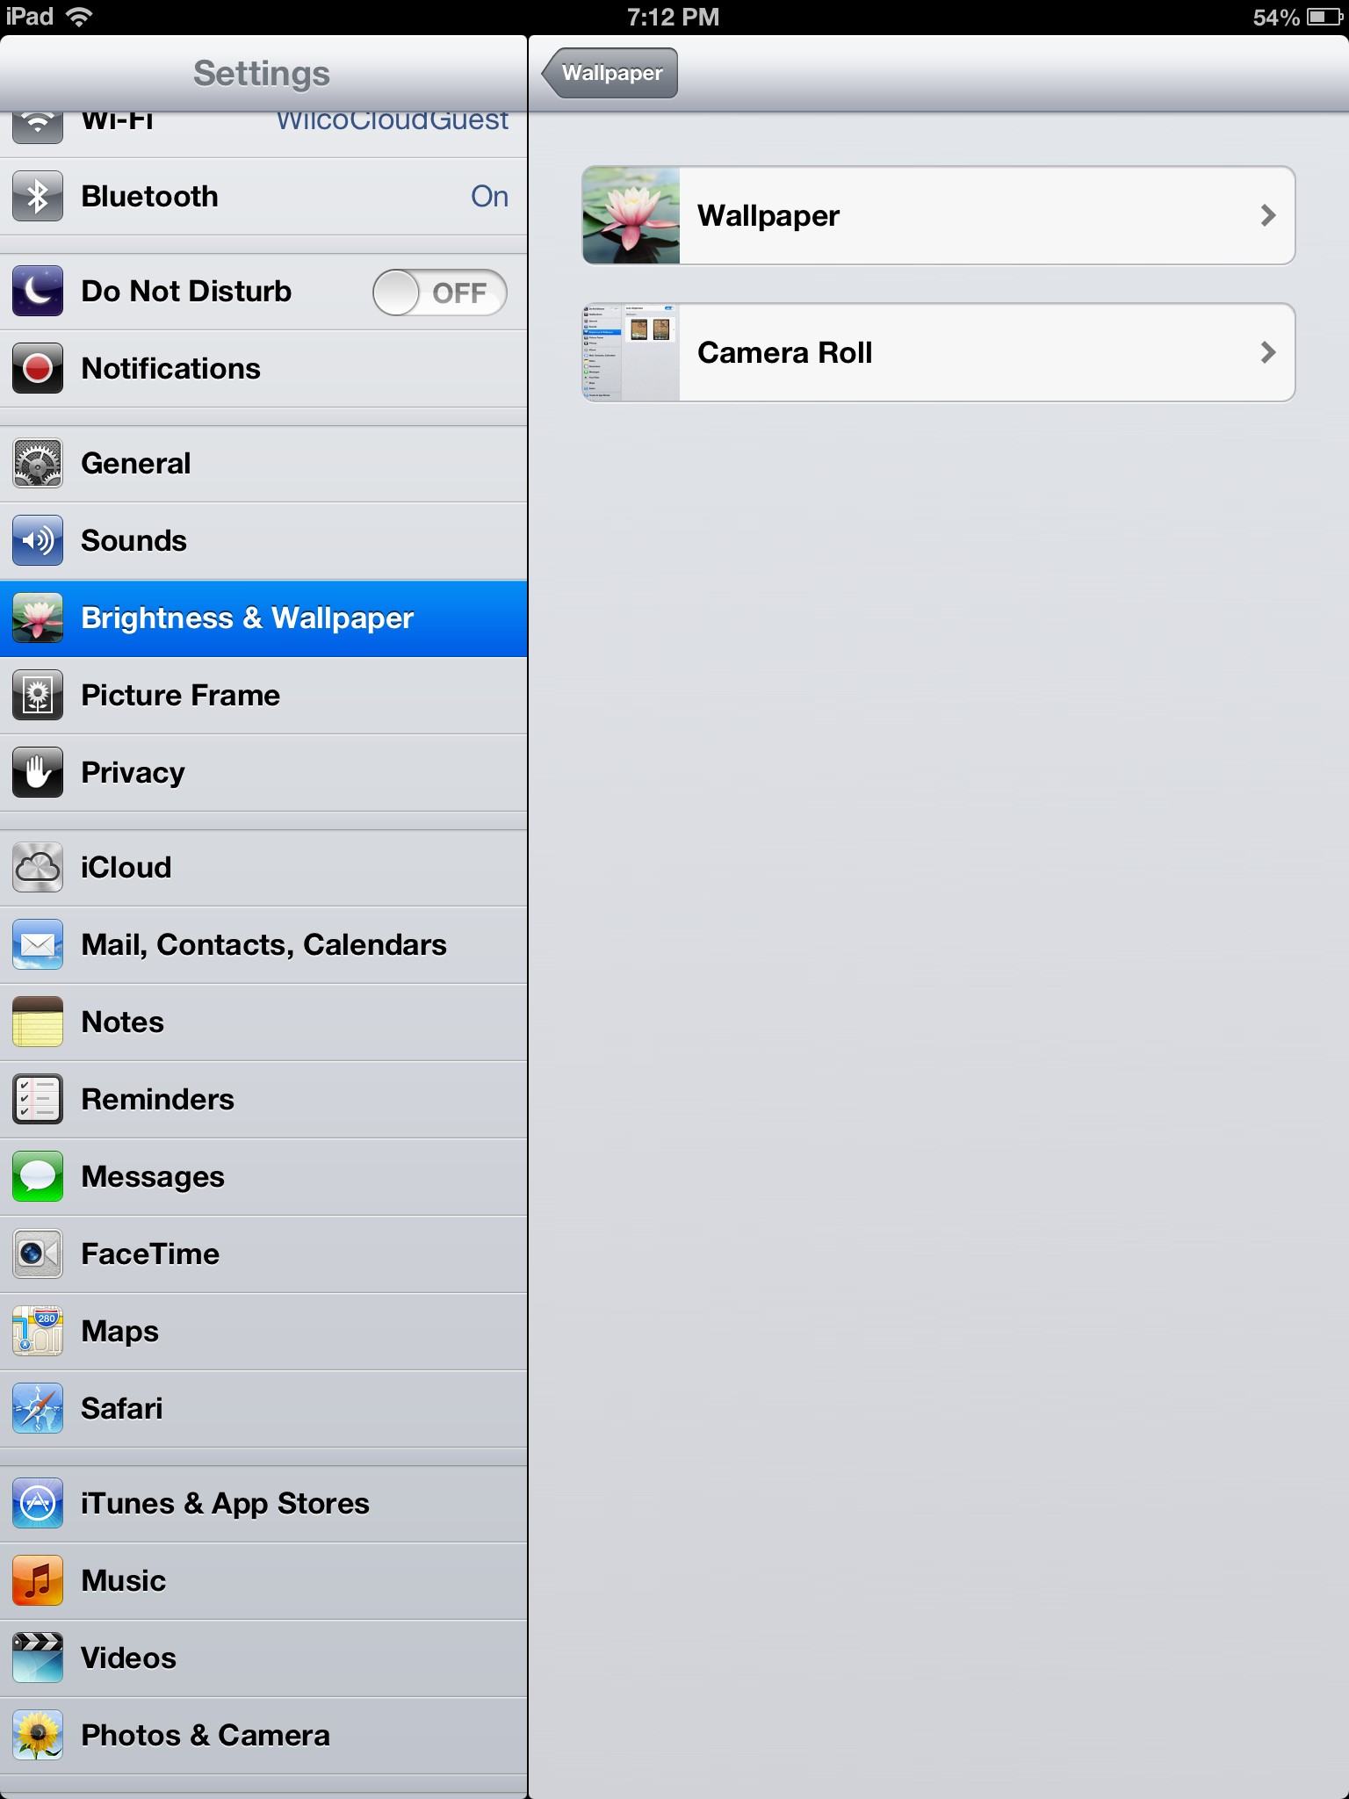
Settings: Personalizing your iPad
Notes:
You can change the background on your iPad from the Settings menu as well.
Simply select the “Brightness & Wallpaper” option from the left hand side of your screen.
Then select the Wallpaper icon.
You will be able to choose from preinstalled pictures in the Wallpaper folder or from your personal pictures in the Camera Roll folder.

Slide 11
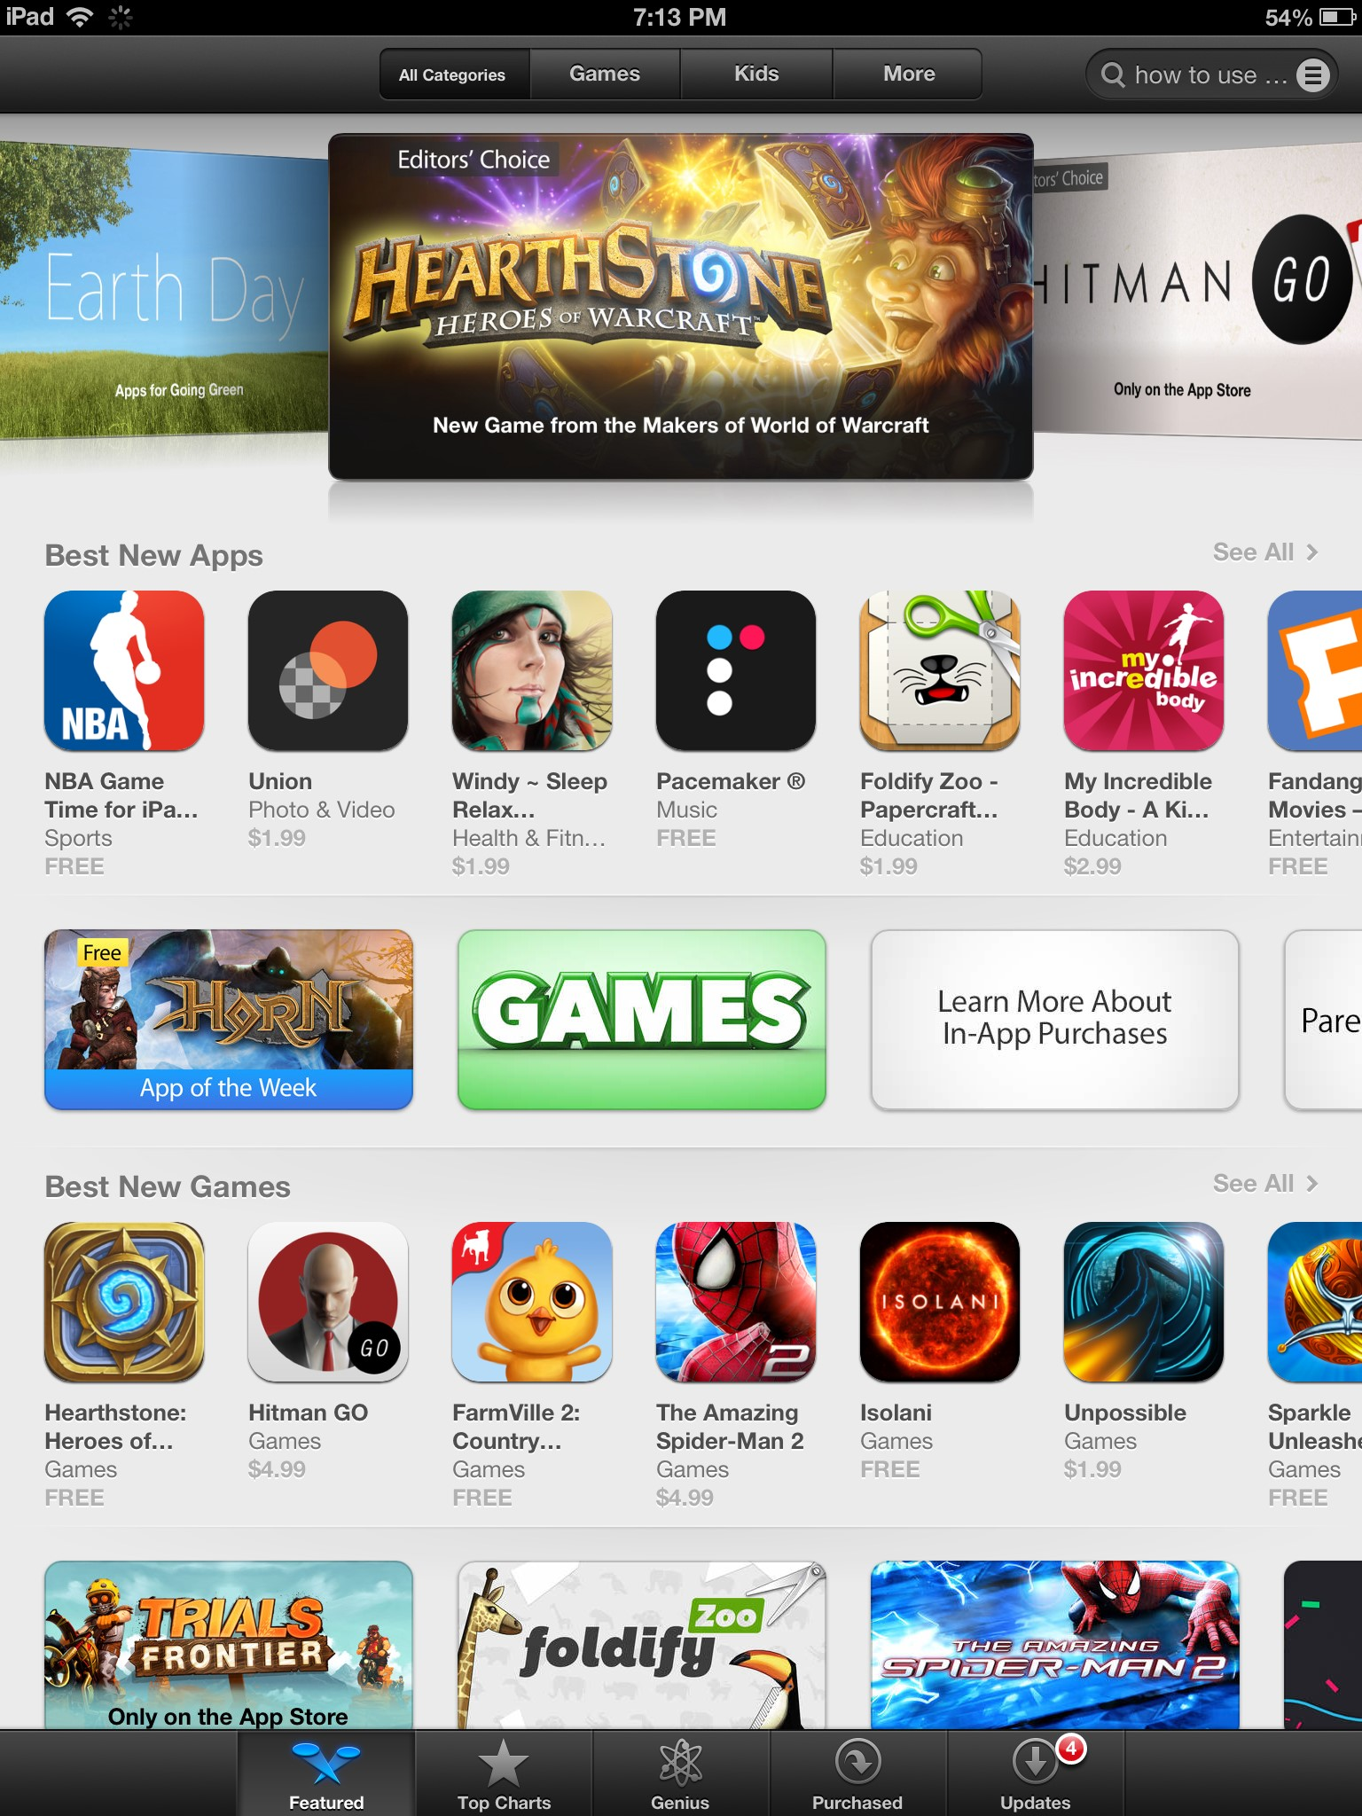
The app store
When you open the App Store, you will see this screen.
Here you can search and download apps that interest you. There’s an app for almost everything.
Notice that there are several options at the top and bottom of the screen.

Slide 12
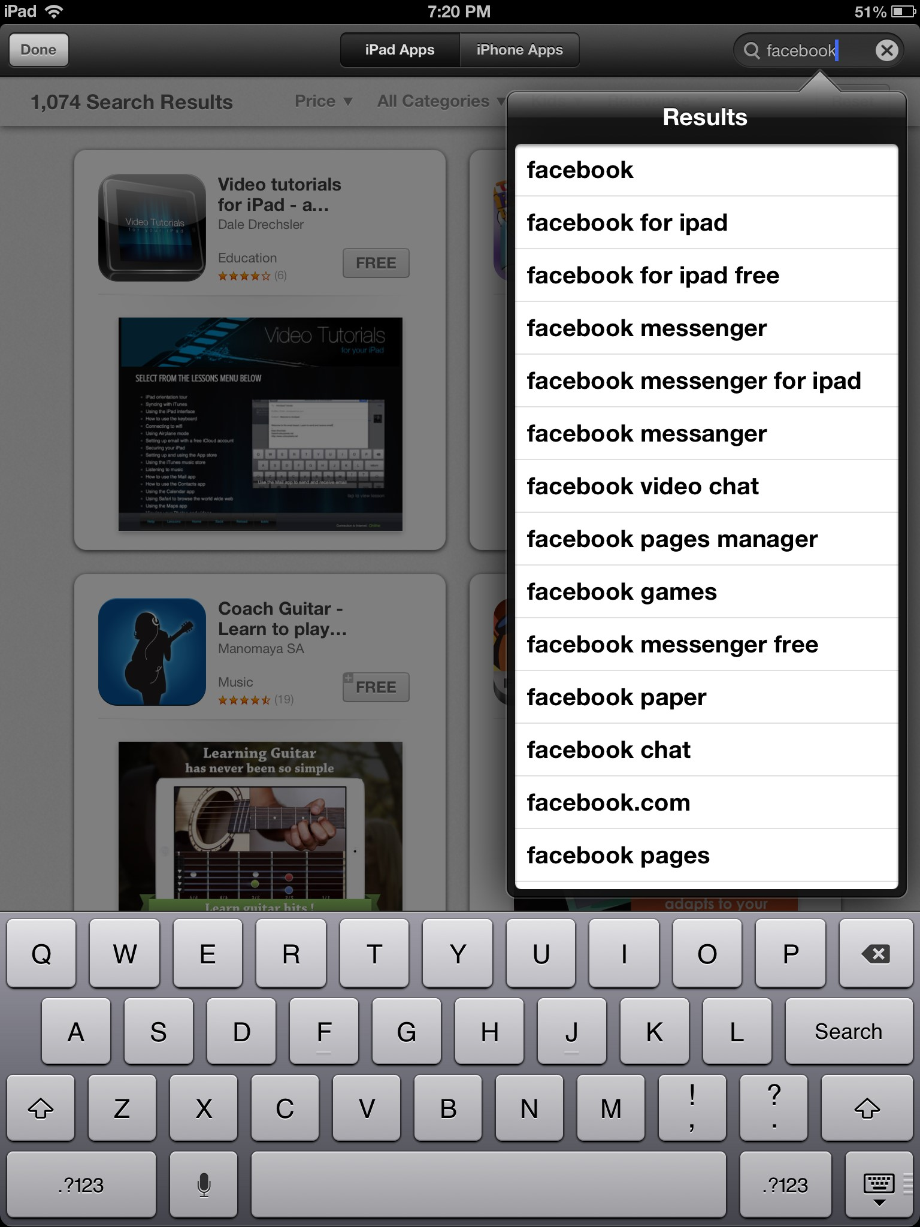
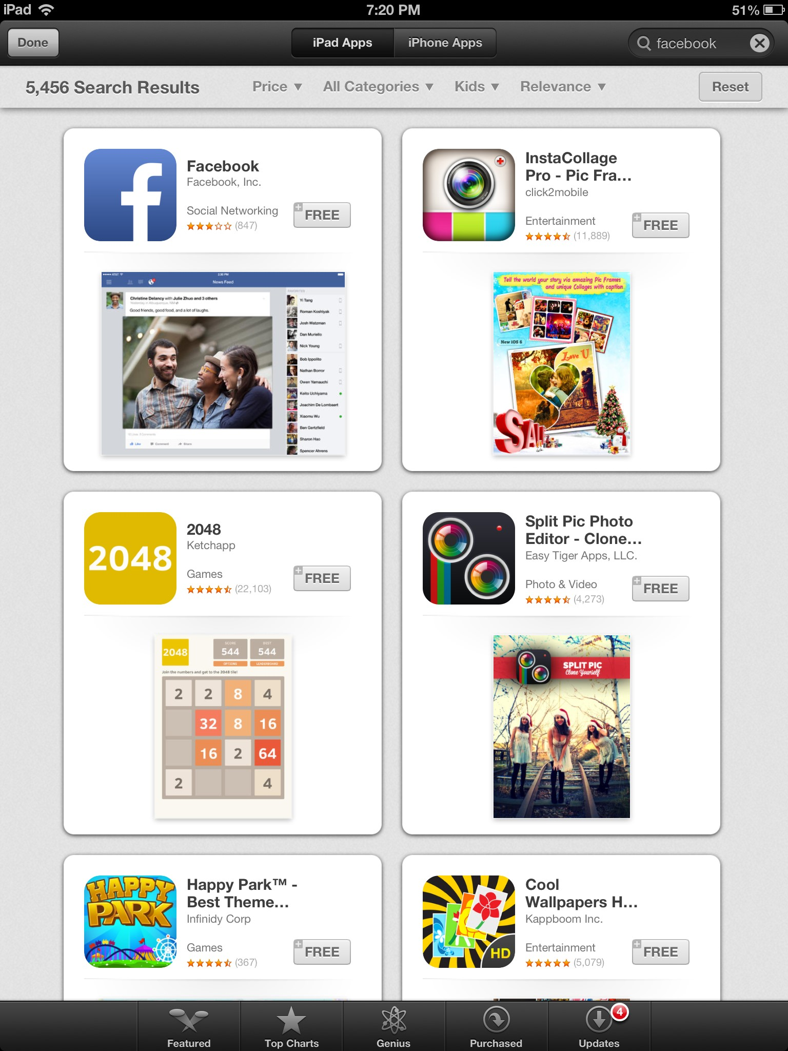
The app store: Searching
Notes:
To search for an app you would like to download, locate the search bar at the top right hand corner of the screen.
Type the word or app that you are interested in finding, such as Facebook.
The App Store will search for your request and come up with a screen that looks similar to the one on the right.
Some apps cost money, and others are free. Facebook is a free app.
All apps are downloaded through your Apple account.
You will need to know your Apple ID and password to download any apps, music, or videos.

Slide 13
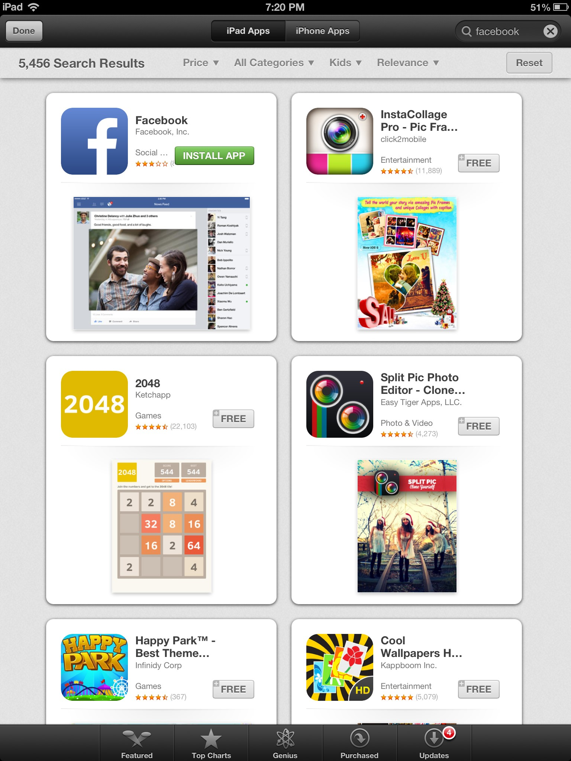
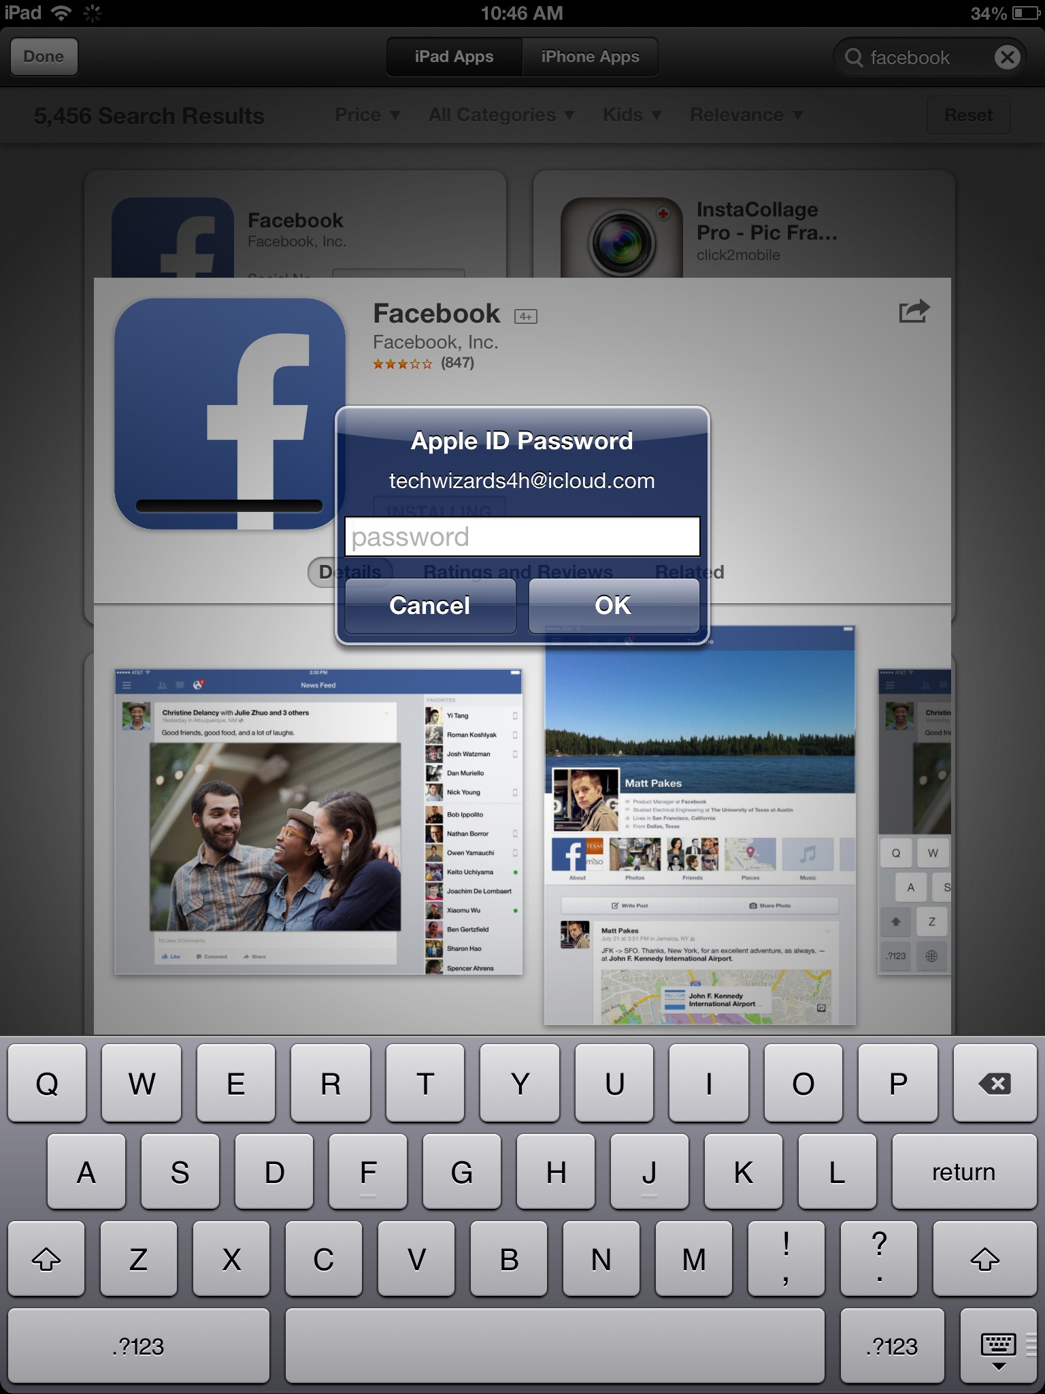
The app store: Downloading
Notes:
Once you have located the app that you want to download, you will click on the icon that lists the price, in this case, “Free”
The icon will then change to say “Install App”.
When you click on that, you will be asked to provide your Apple ID password.
Enter your password and click OK to download the app.
It will then appear on the home screen of your iPad.

Slide 14
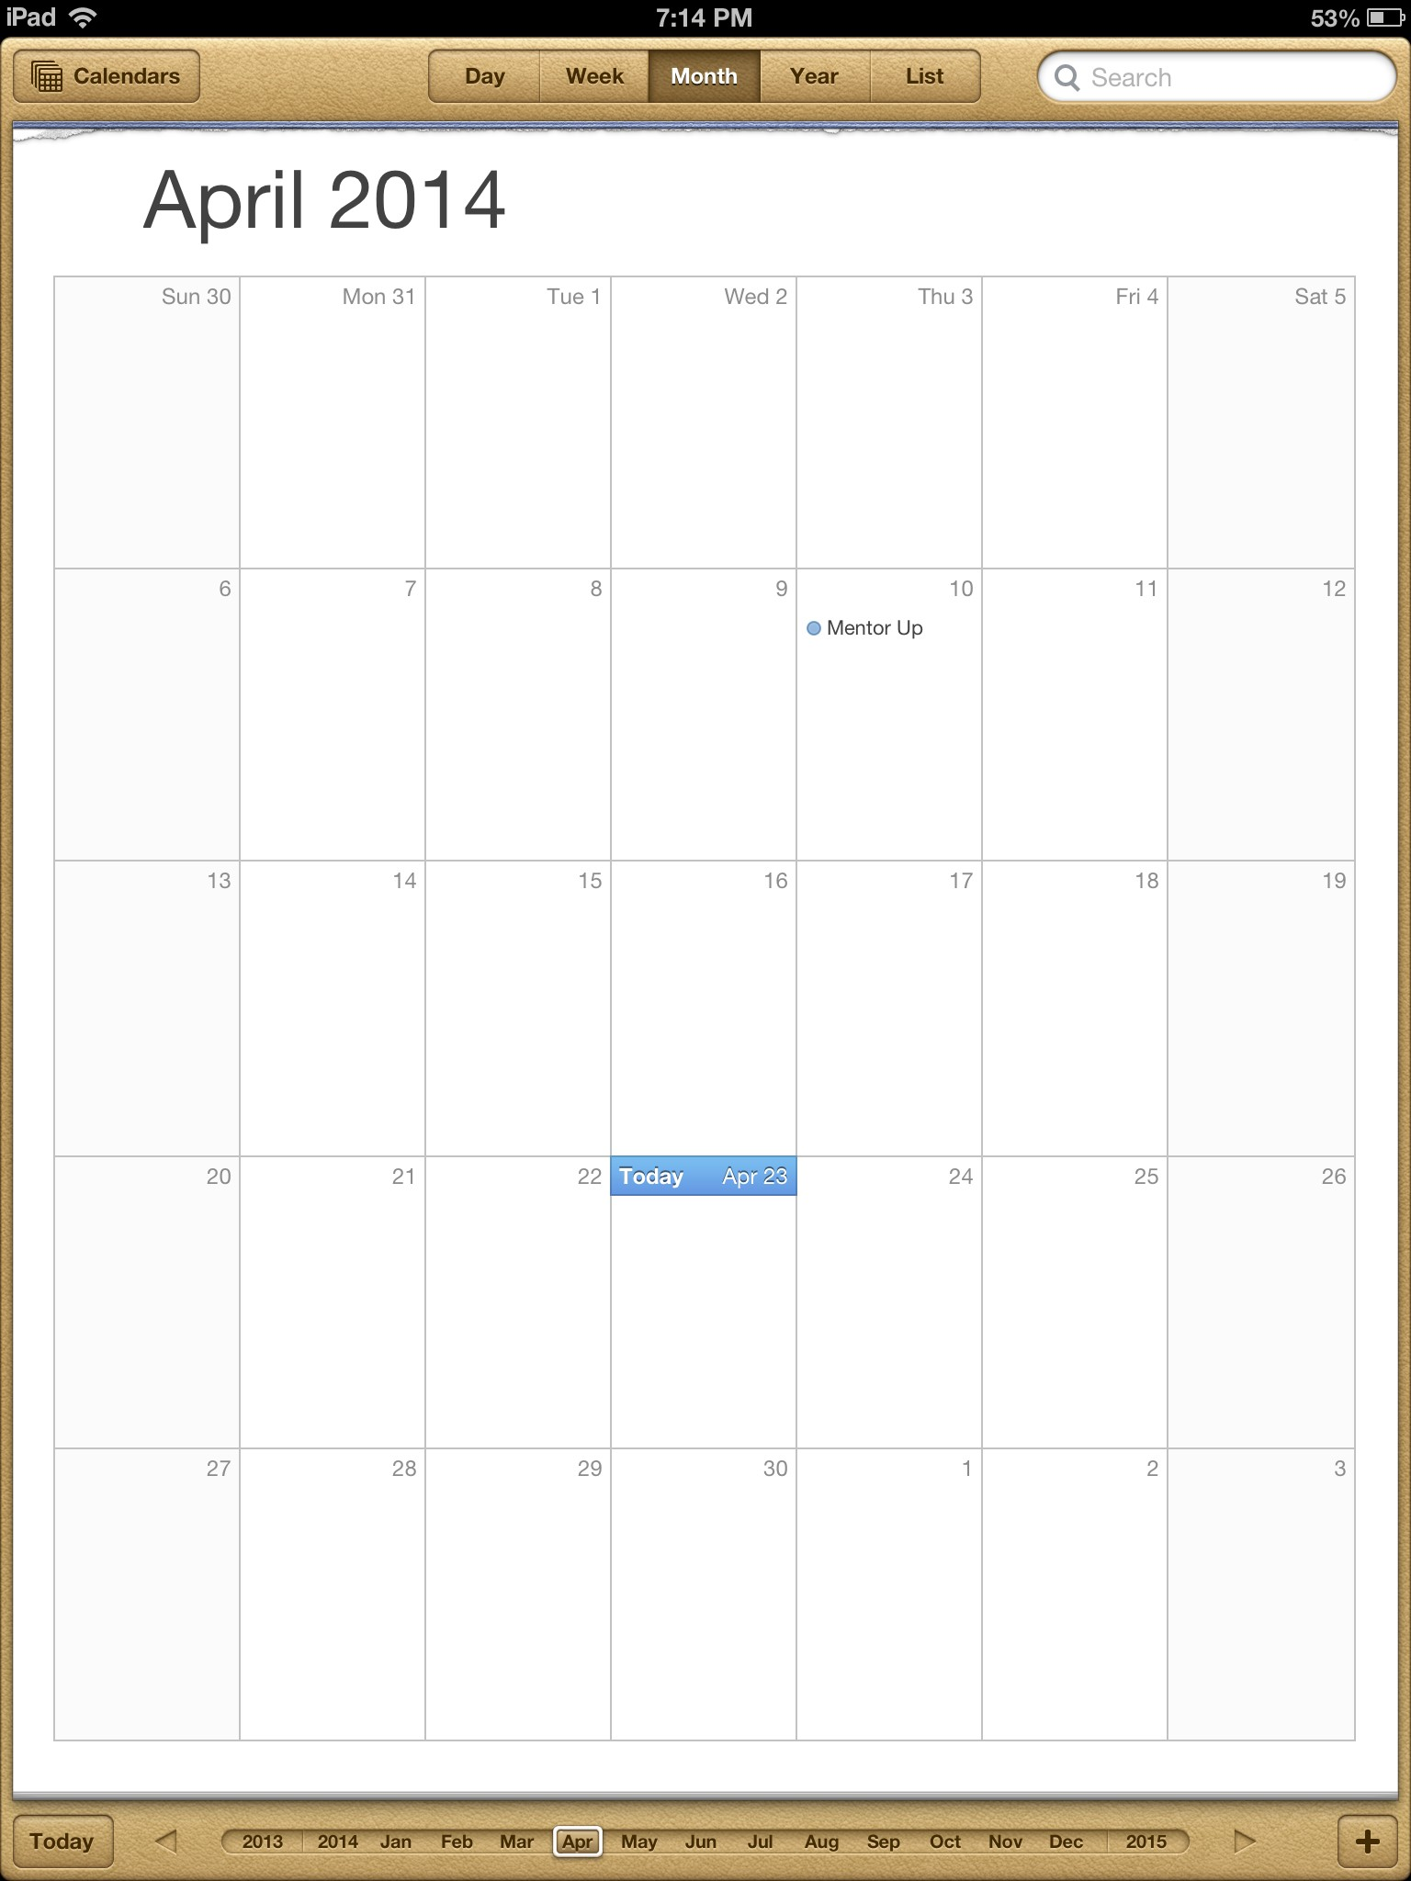
The ipad calendar
Your iPad has a calendar app that can help you keep track of birthdays, anniversaries, appointments, and meetings.
Adding events is simple.
You can even set reminders to alert you when the event is close.

Slide 15
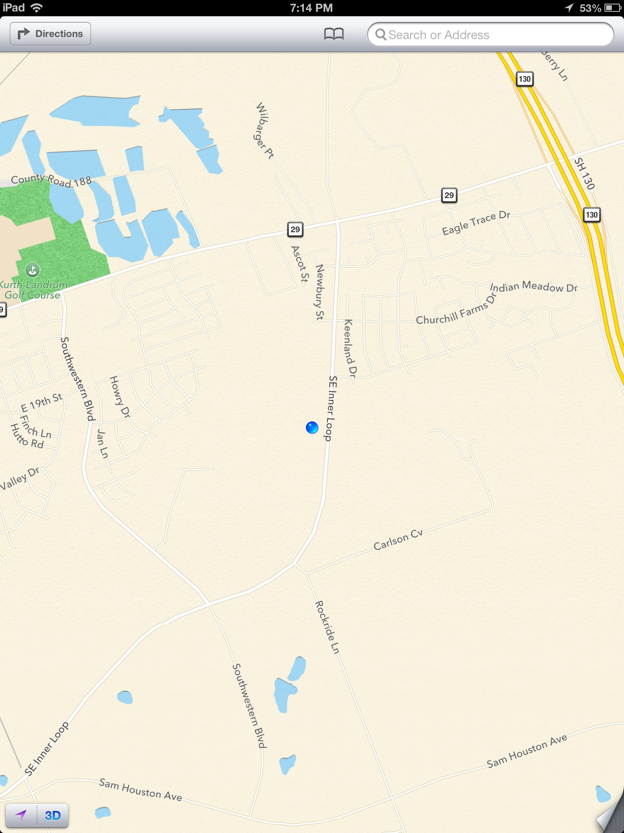
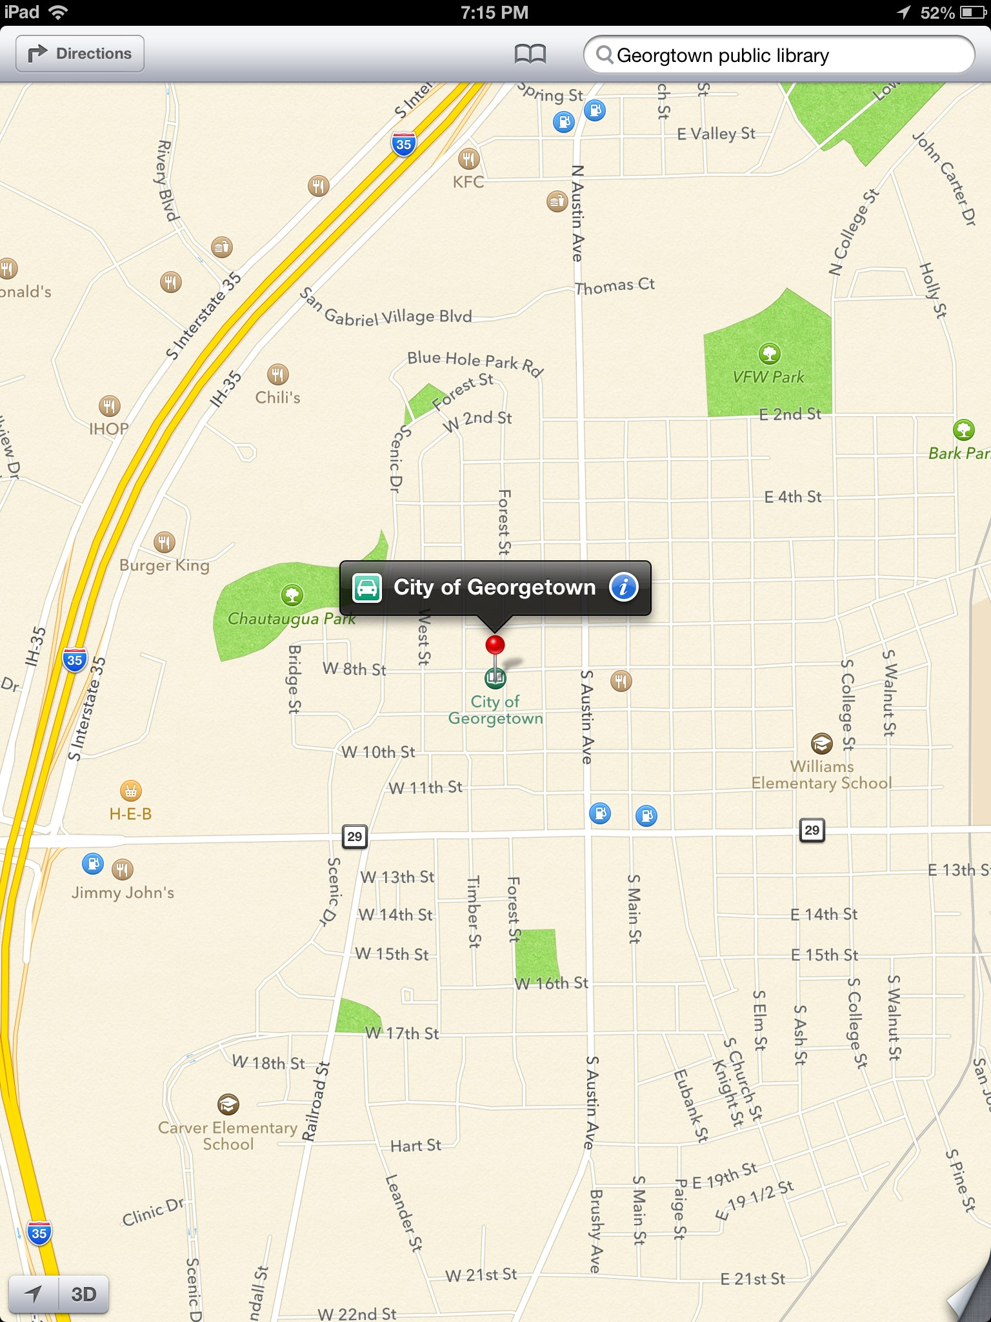
Lost?
Maps can help!
Notes:
The iPad maps help you locate where you are and where you would like to go.
When you open the Maps app, it will pull up a screen showing you where you are currently.
To search for a location, such as a Public Library, type your query in the search bar at the upper right hand corner of the screen.
The app when then locate your desired destination.

Slide 16
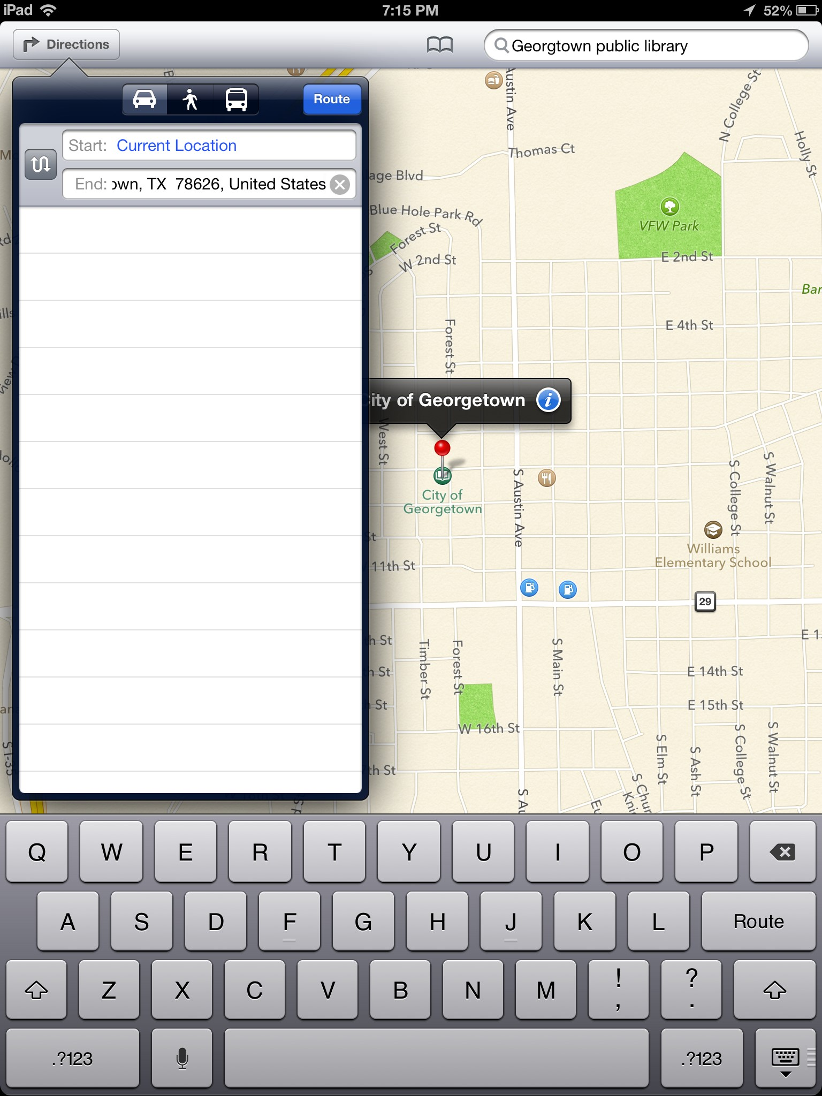
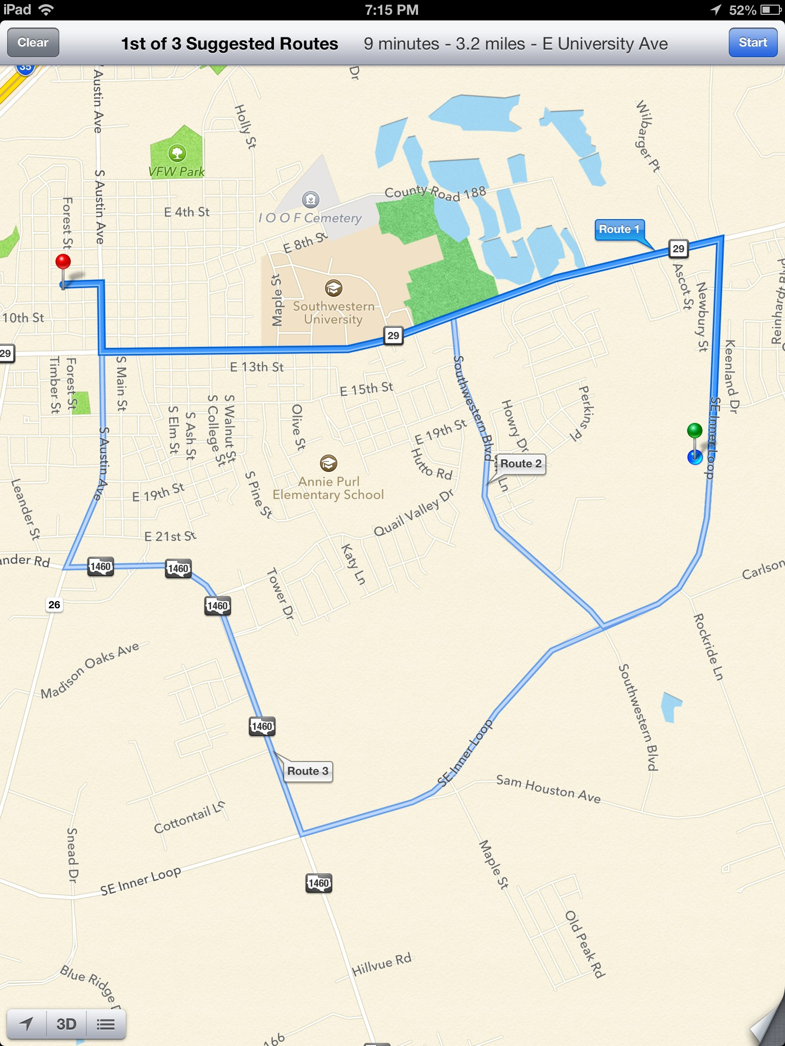
Get directions!
Notes:
To get directions to your destination, touch the small blue “i” icon on the right side of the location.
A box will pop up and ask if you want the route to your destination.
Click the blue “Route” box at the top right hand corner of the box to get started.
The app will then highlight several ways to get from point A to B in blue.
Tap the route you wish to take and press the blue “Start” button at the top right hand corner of the screen to begin receiving verbal directions to your destination.

Slide 17
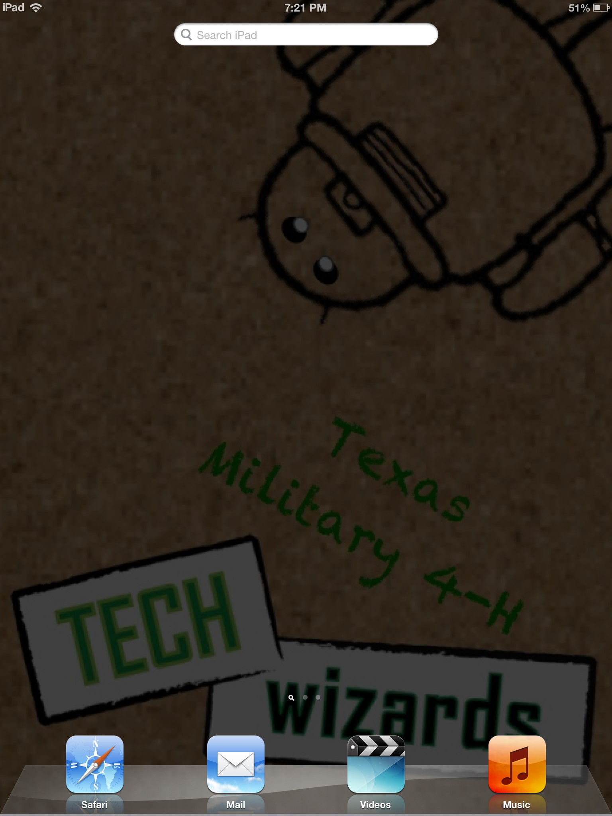
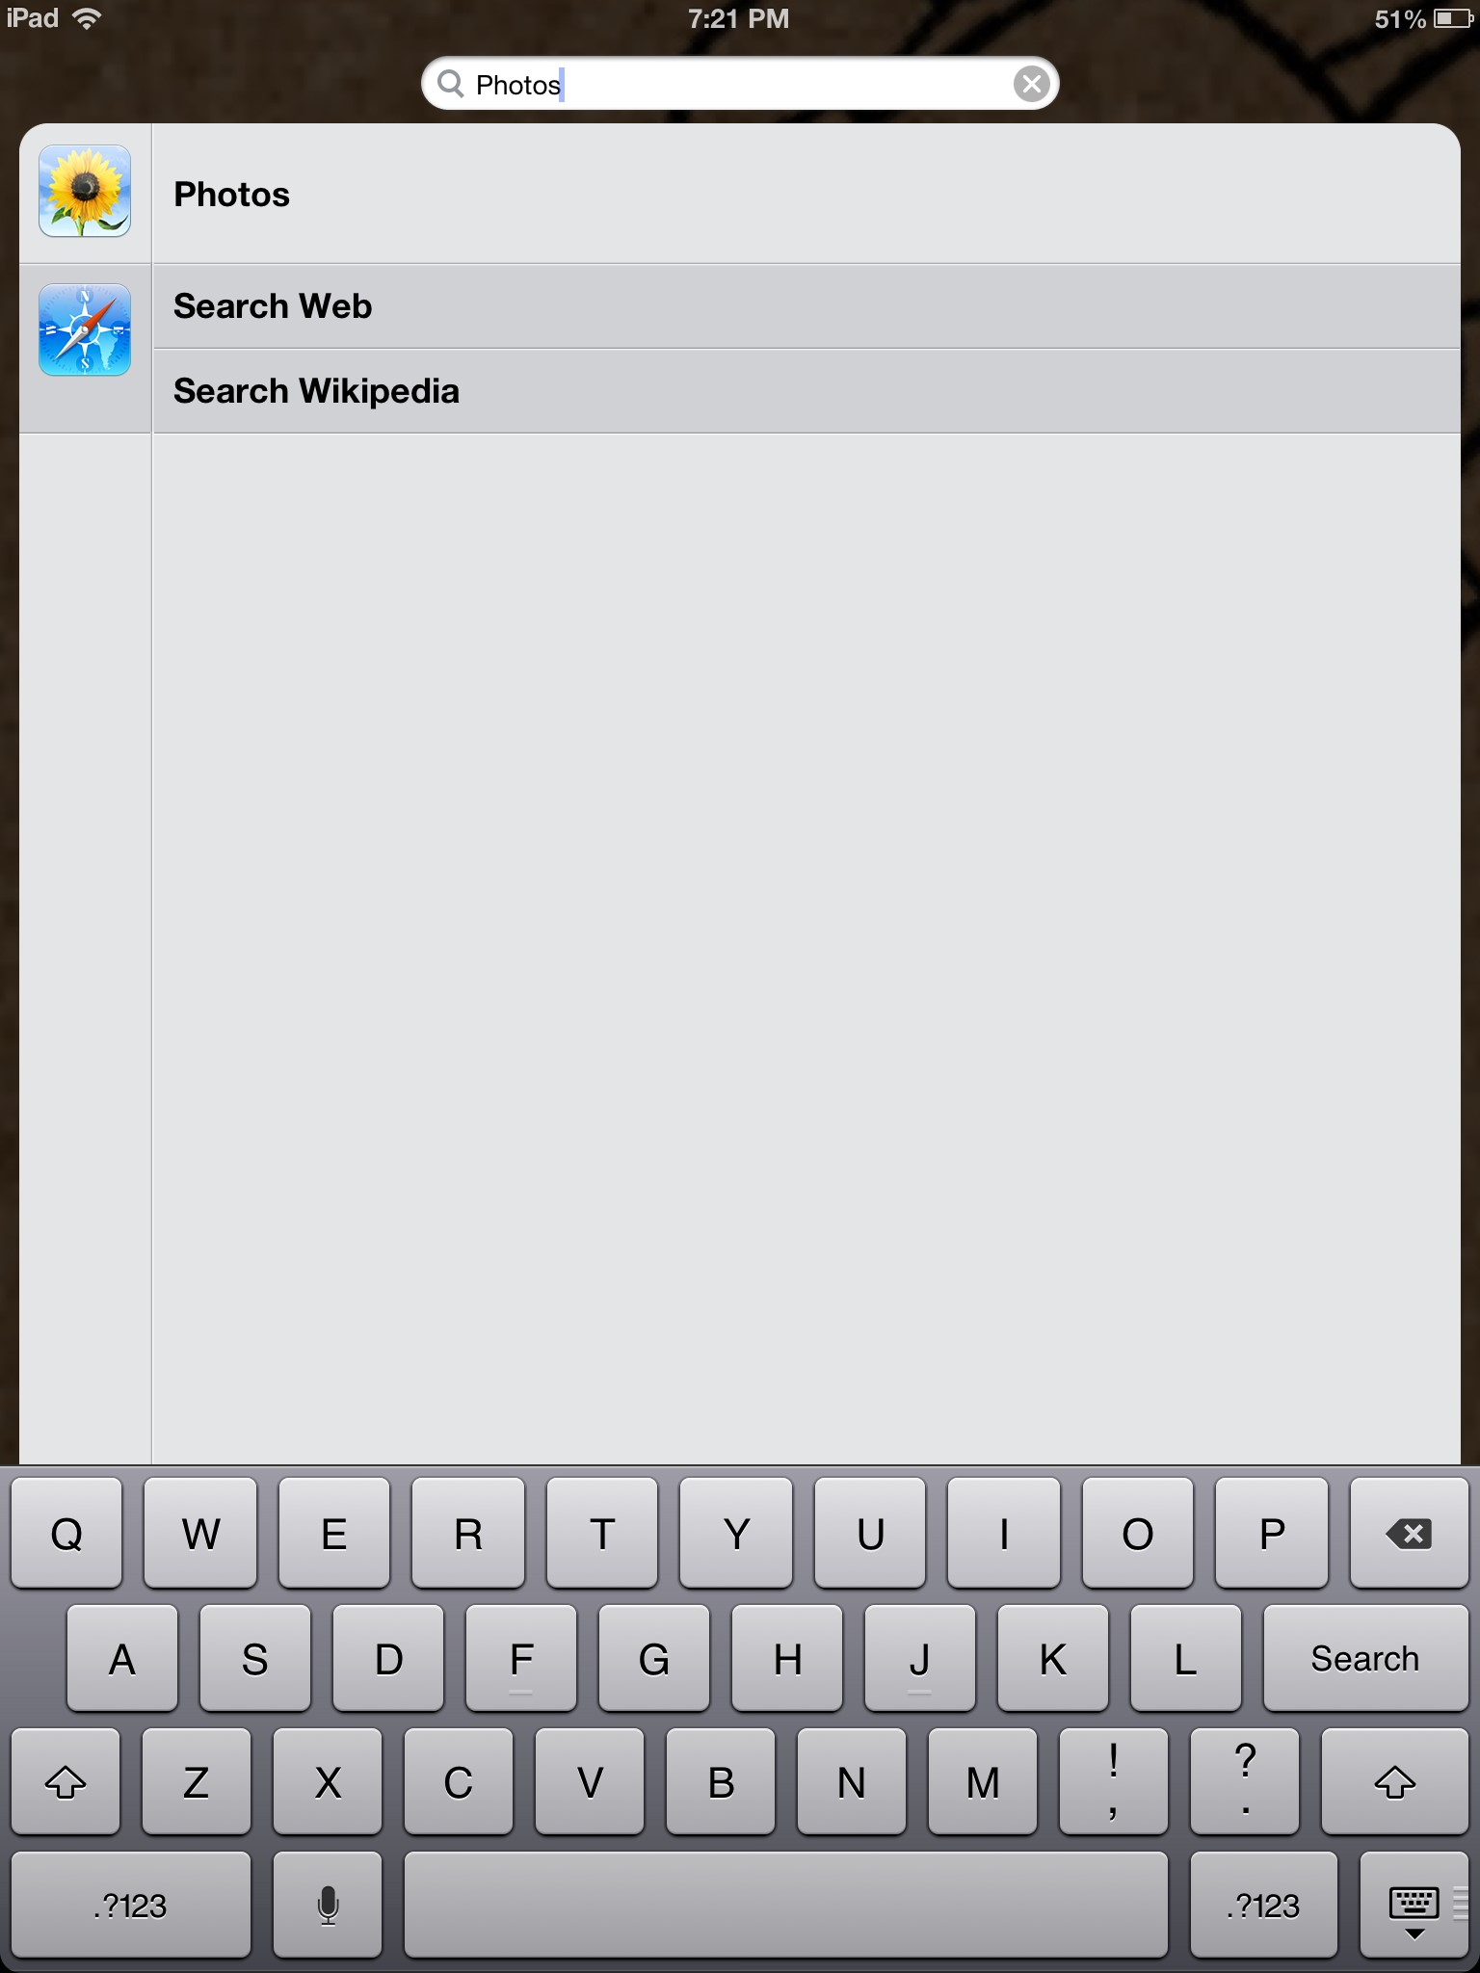
Ipad functions you need to know
2. Search!
If you cannot find an app or an icon on your iPad, there is a built in way to search for it!
Just swipe from left to right on your home screen!
1. Swipe!
3. Locate!
Notes:
Now that we have shown you several cool apps that come with your iPad, there are still a few basic functions that you need to know to help you make the most out of your device.

Slide 18
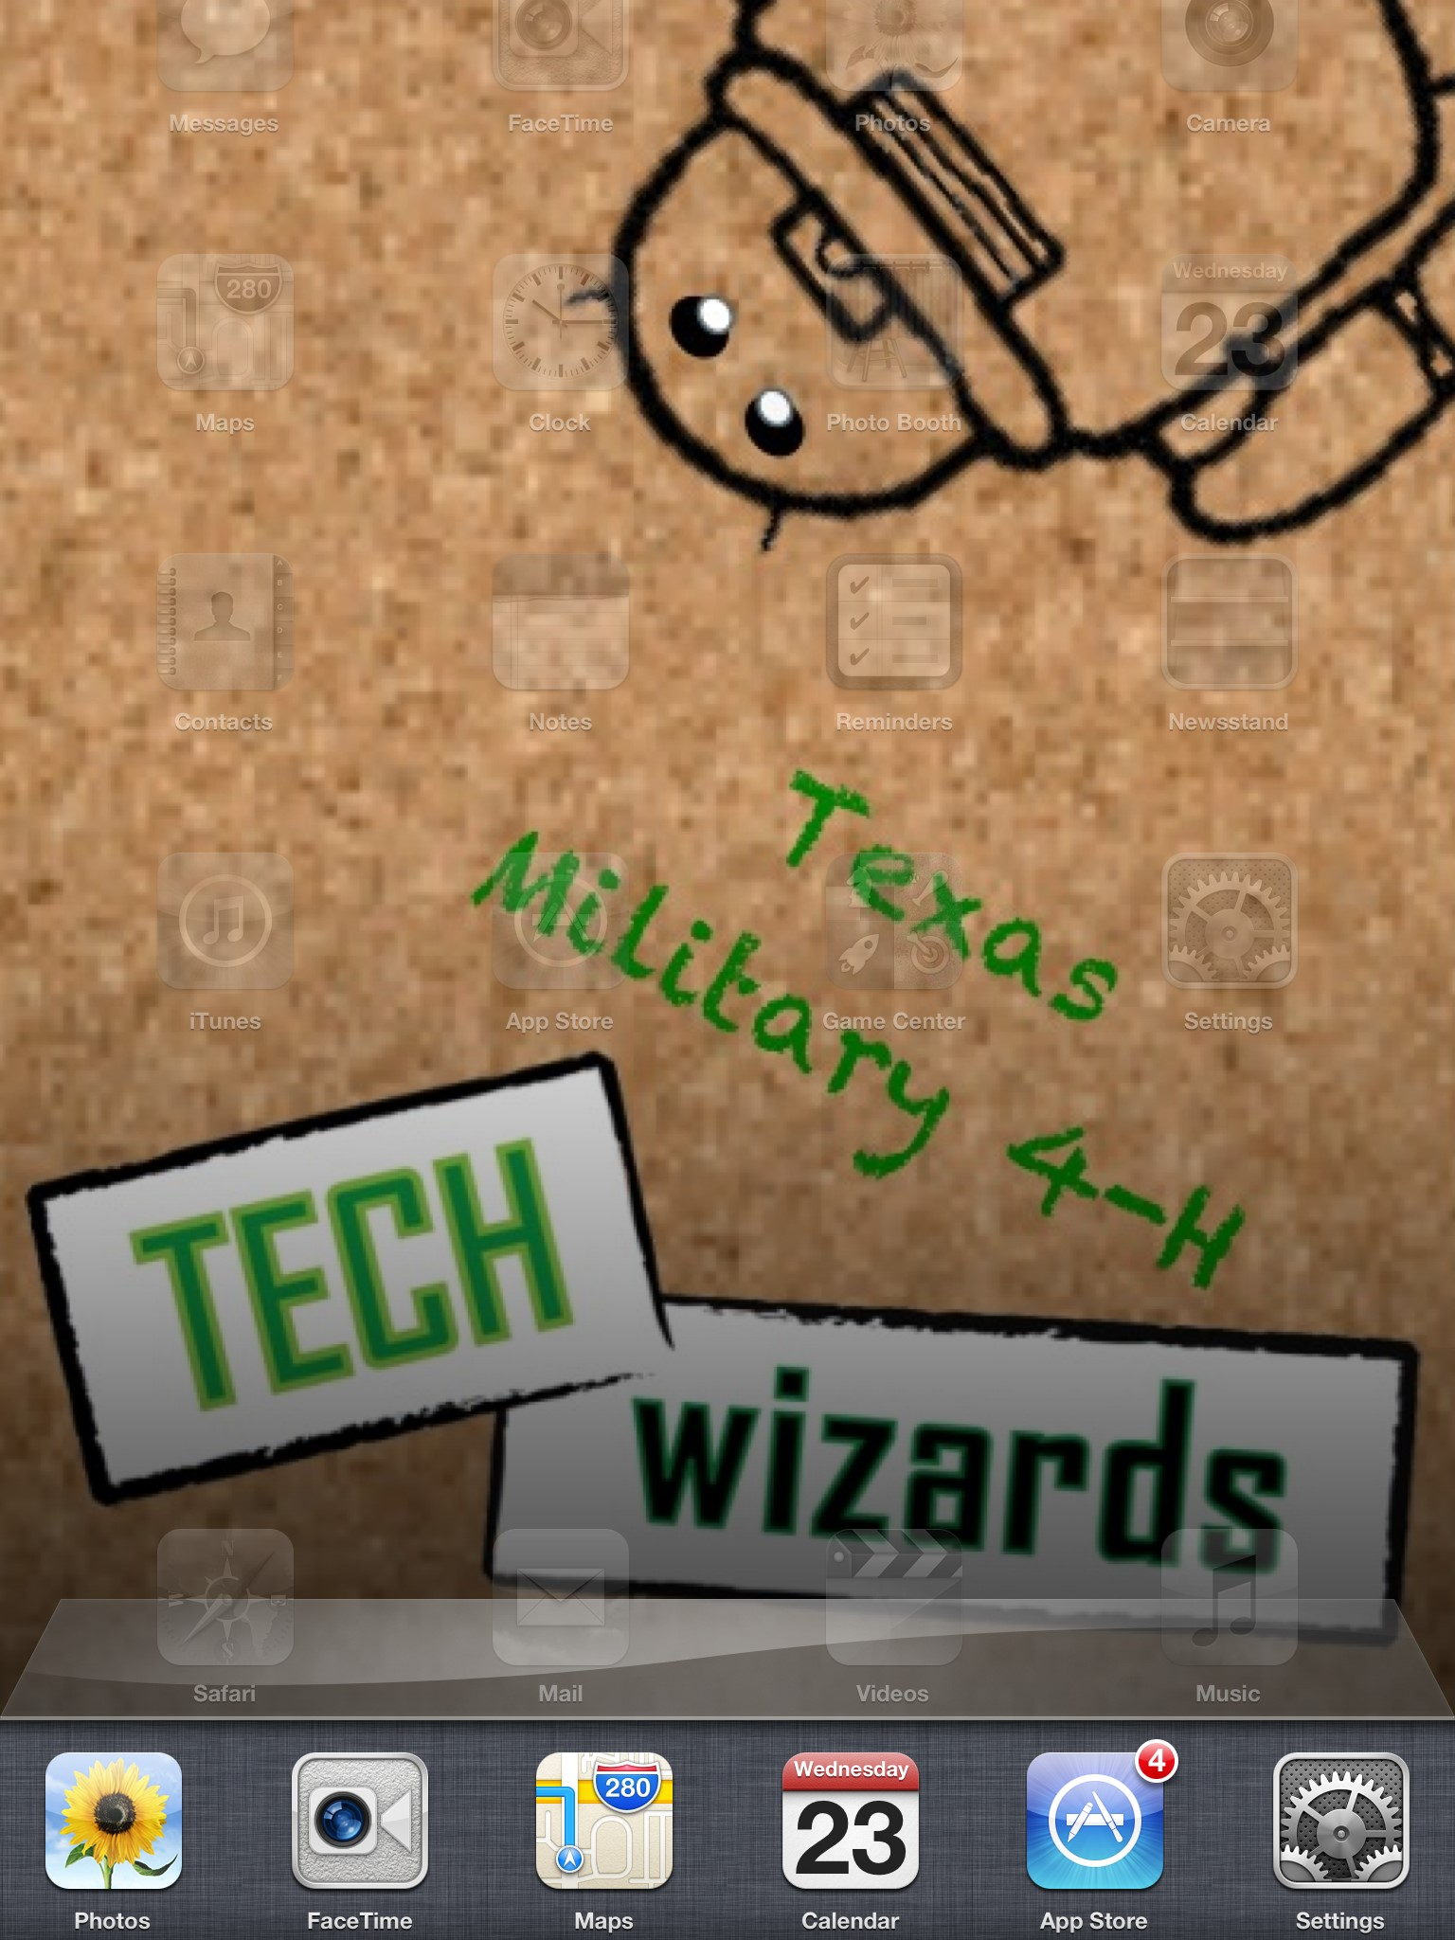
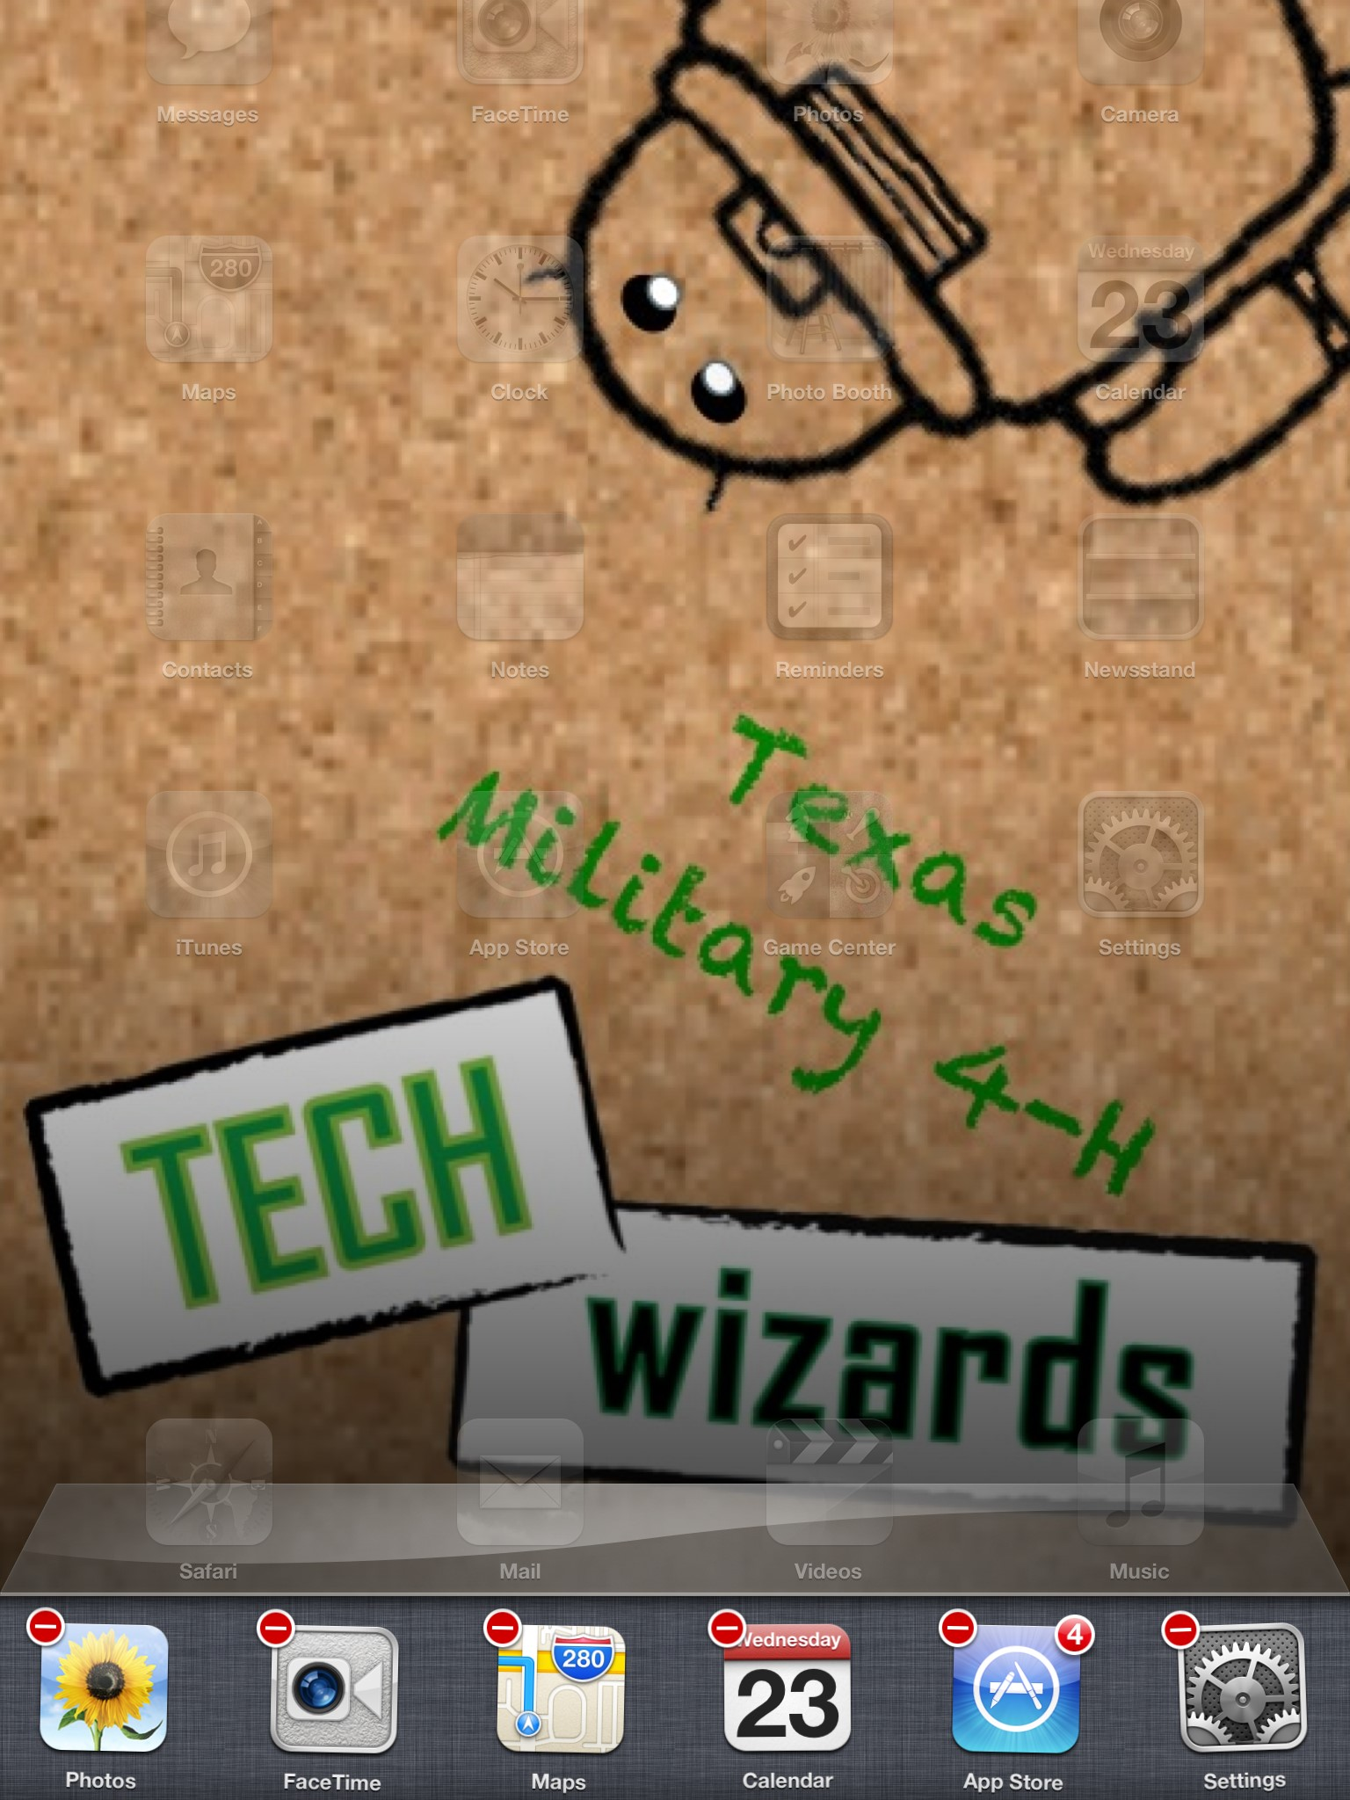
Ipad functions you need to know
Low batteries? Try closing your background apps to conserve battery power.
Double clicking your home button will pull up a bar containing all of your open apps that are running in the background.
Touch and hold one of the icons to make red circles appear on the left corner. Touch the red circles to close the apps until they are all gone!
Notes:
Something that might occur to you while using your iPad is, how do you close or shutdown an app after you have finished using it?
These apps still take battery power, even if you are not using it.

Slide 19
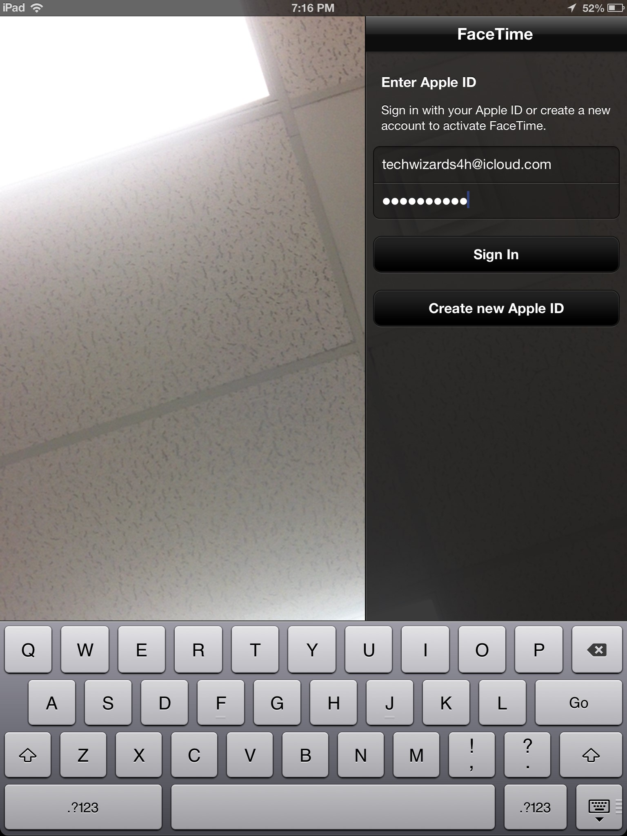
Bonus Activity: Facetime
A fun iPad feature to use is an app called FaceTime.
FaceTime allows you to make video calls via Wi-Fi to the people in your contacts list.
You will need to sign-in using your Apple ID and password on the right side of the screen first.
Notes:
After you have signed in, you simply search for a contact to call!
Your friends’ face will appear and you can see them while you talk to them!

Slide 20
Thank you!
Questions?
Educational programs of the Texas A&M AgriLife Extension Service are open to all people without regard to race, color, religion, sex, national origin, age, disability, genetic information or veteran status. The Texas A&M University System, U.S. Department of Agriculture, and the County Commissioners Courts of Texas Cooperating

