Slide 1
DIVERSITY: How does it make us see, hear, feel, think and act?
Lakshmi Mahadevan, Ph.D.
Assistant Professor/Extension Specialist – Special Populations
Texas A&M AgriLife Extension Service
Educational programs of the Texas A&M AgriLife Extension Service are open to all people without regard to race, color, sex, religion, national origin, age, disability, genetic information, or veteran status. The Texas A&M University System, U.S. Department of Agriculture, and the County Commissioners Courts of Texas Cooperating

Slide 2
Educational programs of the Texas A&M AgriLife Extension Service are open to all people without regard to race, color, sex, religion, national origin, age, disability, genetic information, or veteran status. The Texas A&M University System, U.S. Department of Agriculture, and the County Commissioners Courts of Texas Cooperating

Slide 3
“Yes, we are all different. Different customs, foods, mannerisms and languages, but not so different after all…if we will disagree without being disagreeable.” - J Martin Kohe

Slide 4
1. Define diversity 2. Introduce “Isms” 3. Stereotyping 4. About… 5. On the flip side… 6. Consciousness Checks 7. Rules of Thumb
Objectives

Slide 5
ACTIVITY – Living in a Diverse Environment
Pick a card any – any card
Don’t look at it
Hold it to your forehead
Now we will mingle and interact
The ACES are most popular and liked – you will be treated with lots of positivity and respect
The Sixes are averagely liked – you will be treated with muted respect and some amount of positivity
The Twos are the lowest on the totem pole – you will be ignored or treated with little to no regard
Can you guess which you were? An Ace, Two or a Six?
What did it feel like to be ignored/not so ignored/much loved?
Notes:
If audience is too large – divide them in to smaller groups so the activity has an impact. Use the provided template to make cards. Lotion can be used to stick paper to the forehead or for small groups laminate the cards – shuffle well before distributing.

Slide 6
Train-the-Trainer
For a 30 minute presentation –
Do the card exercise
Define diversity
Discuss ageism, ableism, racism, ethnicity and stereotyping
Teach the consciousness checks and rules of thumb
For a 1-hour presentation –
Do the card exercise
Define diversity
Discuss all “isms”
Teach the consciousness checks and rules of thumb
For a 15-minute lesson –
Do the card exercise
Define diversity
Discuss racism, ethnicity and stereotyping
Teach the consciousness checks and rules of thumb
Handouts – Complete ppt; survey

Slide 7
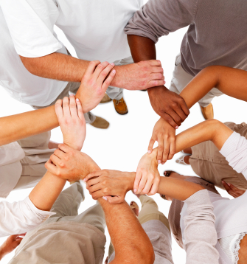
What is diversity?
Diversity is all the ways that we are different from each other age, race, sexual orientation, socio-economic status/class, religion, gender, physical and mental abilities, education, language, family and marital status.
Notes:
Ask audience to define diversity as well.

Slide 8
The “ISMS”

Slide 9
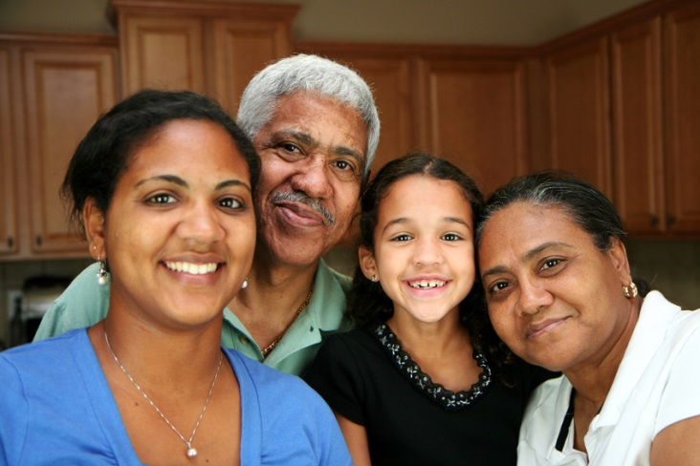
Ageism
Ageism is discrimination based on age. You are being insensitive when you think:
You are too young – what do you know?
Your generation will never get it!
Notes:
Ask audience to provide examples of any of the isms they may have experienced.

Slide 10
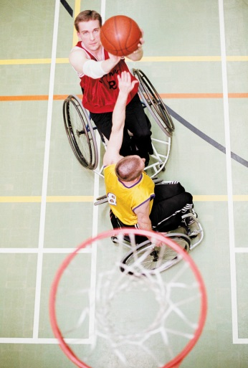
Ableism
Ableism is discrimination based on physical or mental disabilities. When you:
Feel uncomfortable with visible disabilities
Look at somebody in a wheelchair and automatically go to aid them. Just ask – can I help? And don’t be surprised (or hurt) if they say “no”.
Apologize to someone who has a visual impairment because you said, “You see…”, “Let me show you…”
Use words like “retard” or “handicapped” even in a humorous context

Slide 11
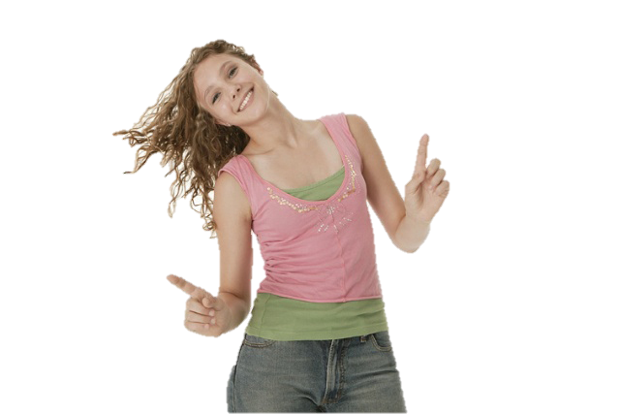
Sexism
Sexism are behaviors and beliefs that rank the sexes (the physical characteristics that define male and female) and genders (the cultural definitions of what is feminine and what is masculine), placing more value on one than another.

Slide 12
Female - ism
When you:
Say, (before the person is more comfortable with you) “Ooh I like your skirt/dress, where did you get it?”
Think, “I have a female boss – bet she’s “moody”!”
Gossip with a female colleague because that’s what women do.
Motherhood vs. Singlehood

Slide 13
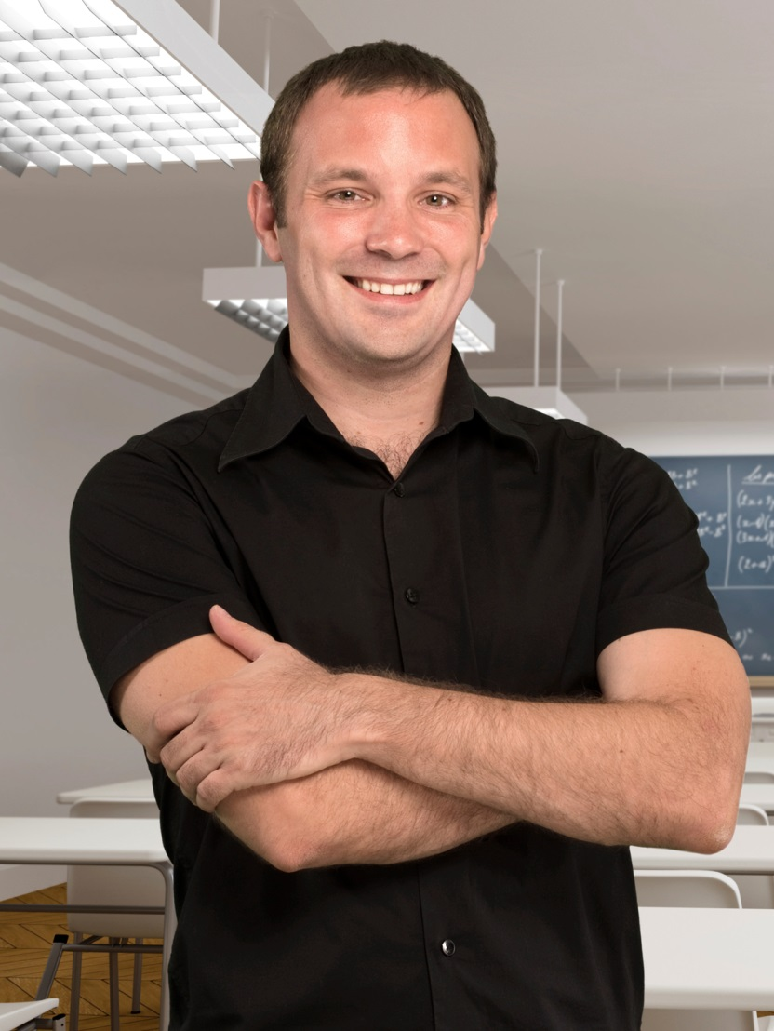
Male - ism
When you:
Think, “The boss is a male, how not surprising!”
Say, “The males get all the breaks”.
Are surprised that the males at work cook, are hospitable or perform “womenly” tasks

Slide 14
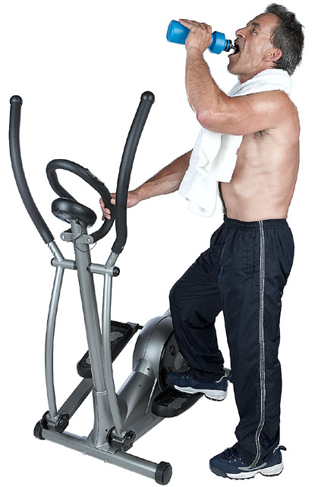
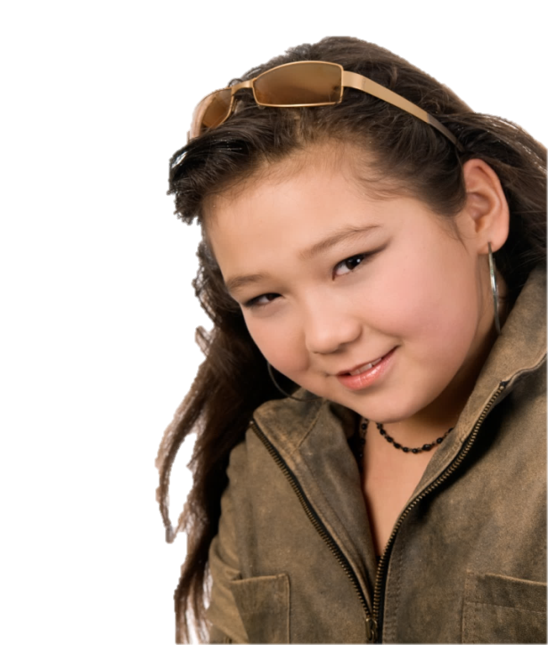
Weight-ism
Bias or discrimination against people who are over or under-weight.
Wow he is big!
She needs to eat a sandwich
At the gym you think “they don’t need to exercise”, or “it’s too late for them to be here”.

Slide 15
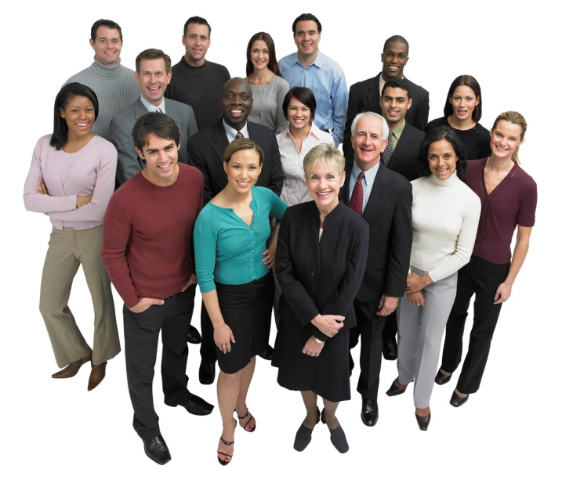
Racism
Racism is discrimination based on color and/or race and/or ethnicity. This includes discriminatory practices that protect or promote the power of the dominant group. Racism may also be the belief in the inherent superiority of one group over another.

Slide 16
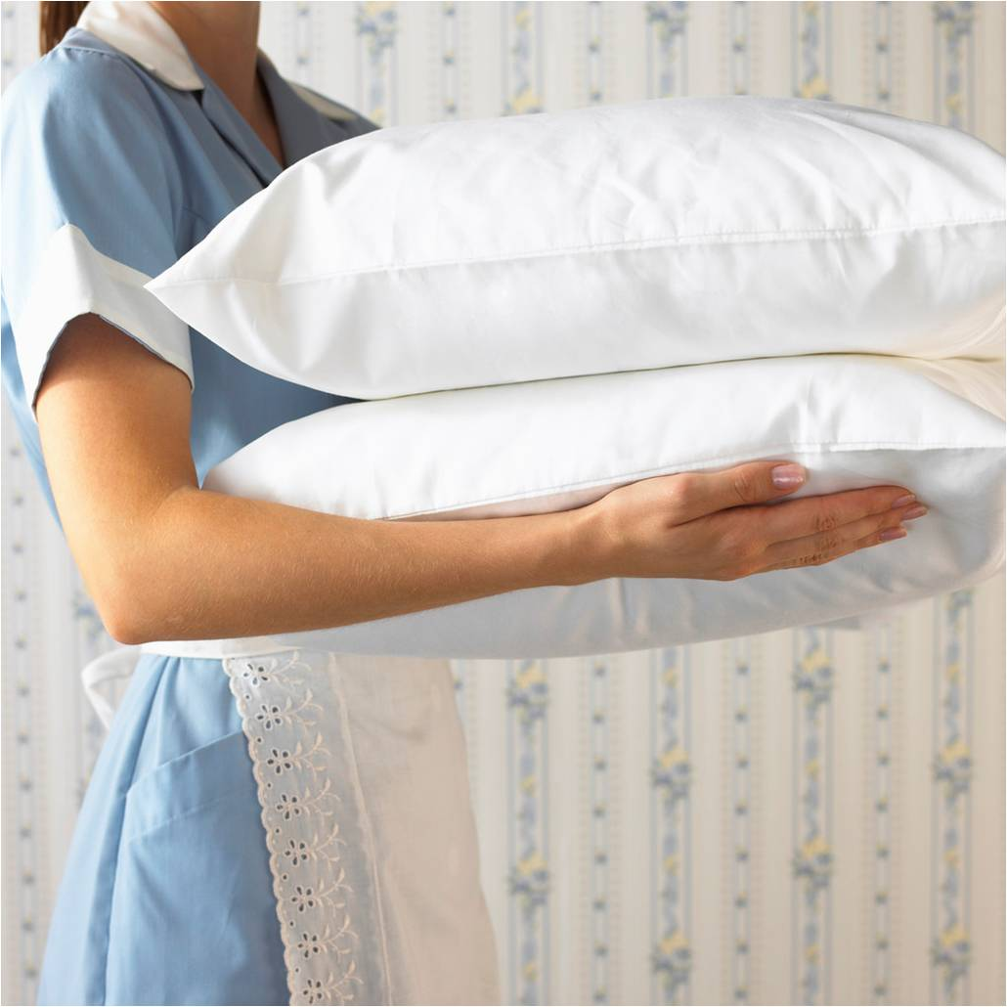
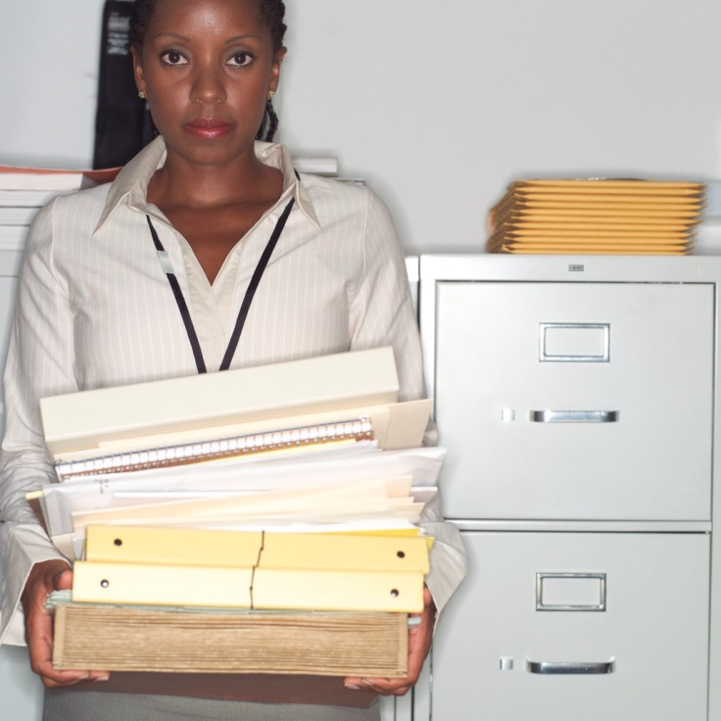
Ethnicity
When you:
Are surprised that the Latino/a/Hispanic person holds a high position
Assume that the African-American woman is a secretary
Are shocked that the custodial staff is Caucasian
Notes:
Discuss ramifications of changing minds when the evidence shows that most Latino/African Americans do not hold high positions.

Slide 17
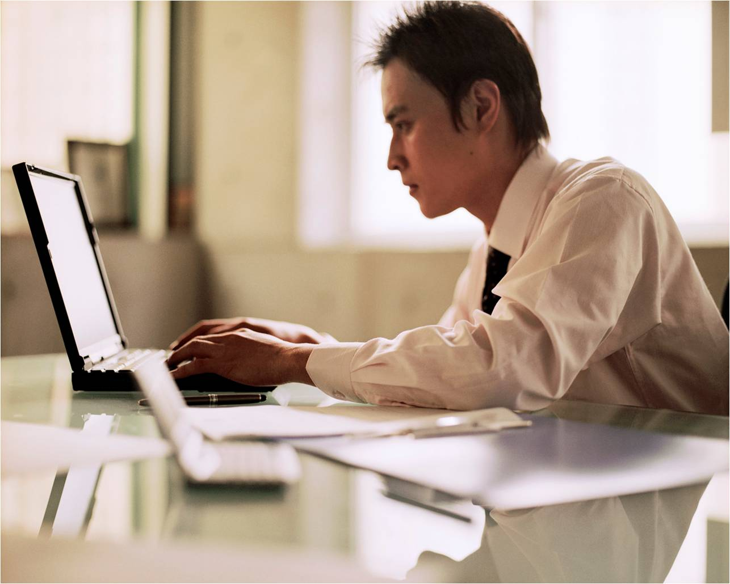
Stereotyping
Oh you must be good at Math, Engineering
Oh you probably don’t know what that means…
Oh you must be familiar with rap, hiphop etc.
I am sorry I can’t say your name
I have been to India, do you know…?
Bet you love dancing!
Do you play basketball?
Wow you have a Masters?
You speak great English!
I have a friend who is…
Notes:
Ask audience examples of stereotyping they may have expereinced.

Slide 18
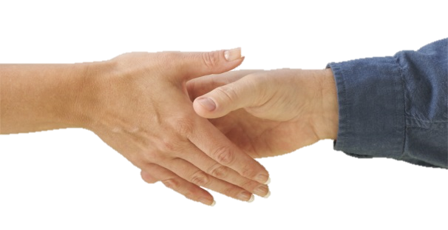
About…
Lack of eye contact – often a sign of respect; not inattentive/unmotivated/rude – give it time.
Physical contact– handshakes – wait till they extend their hand. Do not be too touchy-feely.
Saying no – you may not always receive a direct answer.

Slide 19
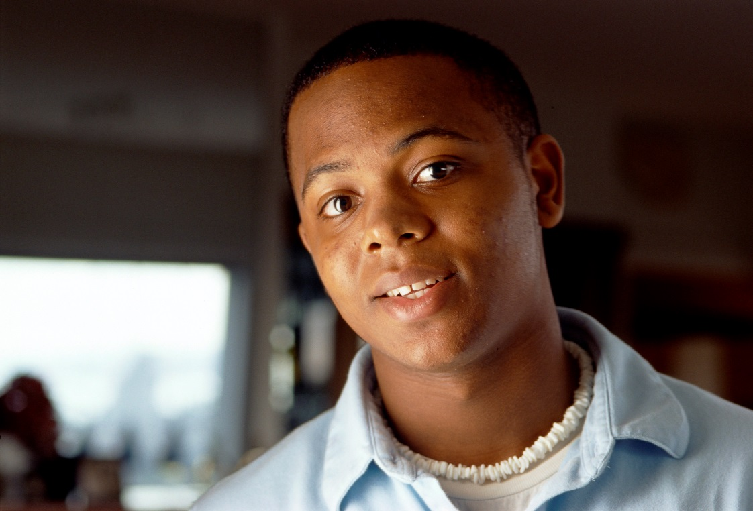
On the flip side:
I feel that:
People think I am privileged because I am one of the majority
Everything is easier for me
I should prove that I have earned my place
Notes:
This slide is what the majority feels. Ask audience if this is true and if not what would they define as the “flipside”.

Slide 20
Consciousness “Checks”
You need to explore your sub-conscious self if you answer yes to the following questions -
Are you assuming?
Is it easy for you to make racist jokes?
Are you over-explaining; over-justifying?
When your mind triggers a discriminatory thought are you starting the conversation by apologizing?
Are you trying to be too sensitive?
Take a Diversity Survey – are you really biased or do you simply put your foot in your mouth?
If you are biased accept it and be more mindful of how it manifests itself.
Know that nothing is really offensive unless you mean it to be.
Most people appreciate it when they see you are making an effort.
Notes:
Pause between each question so audience has time to consider.

Slide 21
Rules of Thumb
Listen patiently and let the person finish talking
Smile
Make small talk
Be positive
Be courteous and attentive
Don’t be self-conscious
Be observant of culture
Ask for help
Think before you speak
Don’t gossip
Clarify your doubts

Slide 22
Additional References
http://www.ncehs.com/strategy.htm
http://www.aacounty.org/Partnership/Resources/Cultural_Sensitivity.pdf
http://www.culturecoach.biz/culturalquicktip.html

Slide 23
Website and Contact Information
For more information please go to:
http://ctsp.tamu.edu
Mailing Address:
Texas A&M AgriLife Extension Service
Attn: Lakshmi Mahadevan
TAMU MS 2251
College Station, TX 77843-2251
Phone: 979-845-4374
Fax: 979-845-6496
Email: ctsp@tamu.edu

